Slide 1
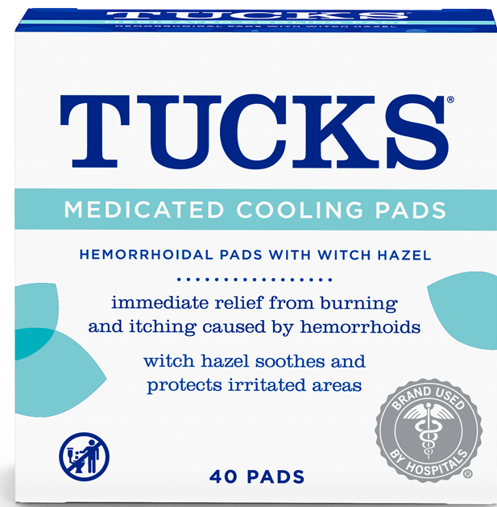
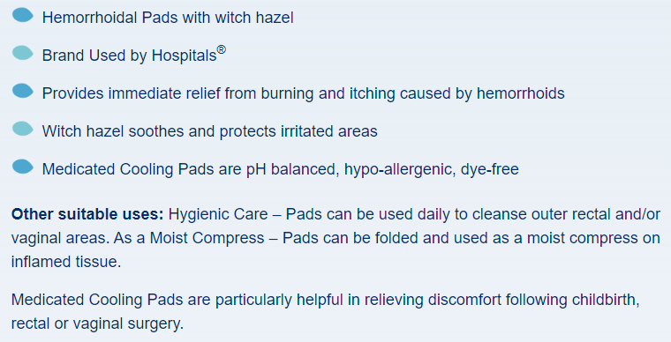

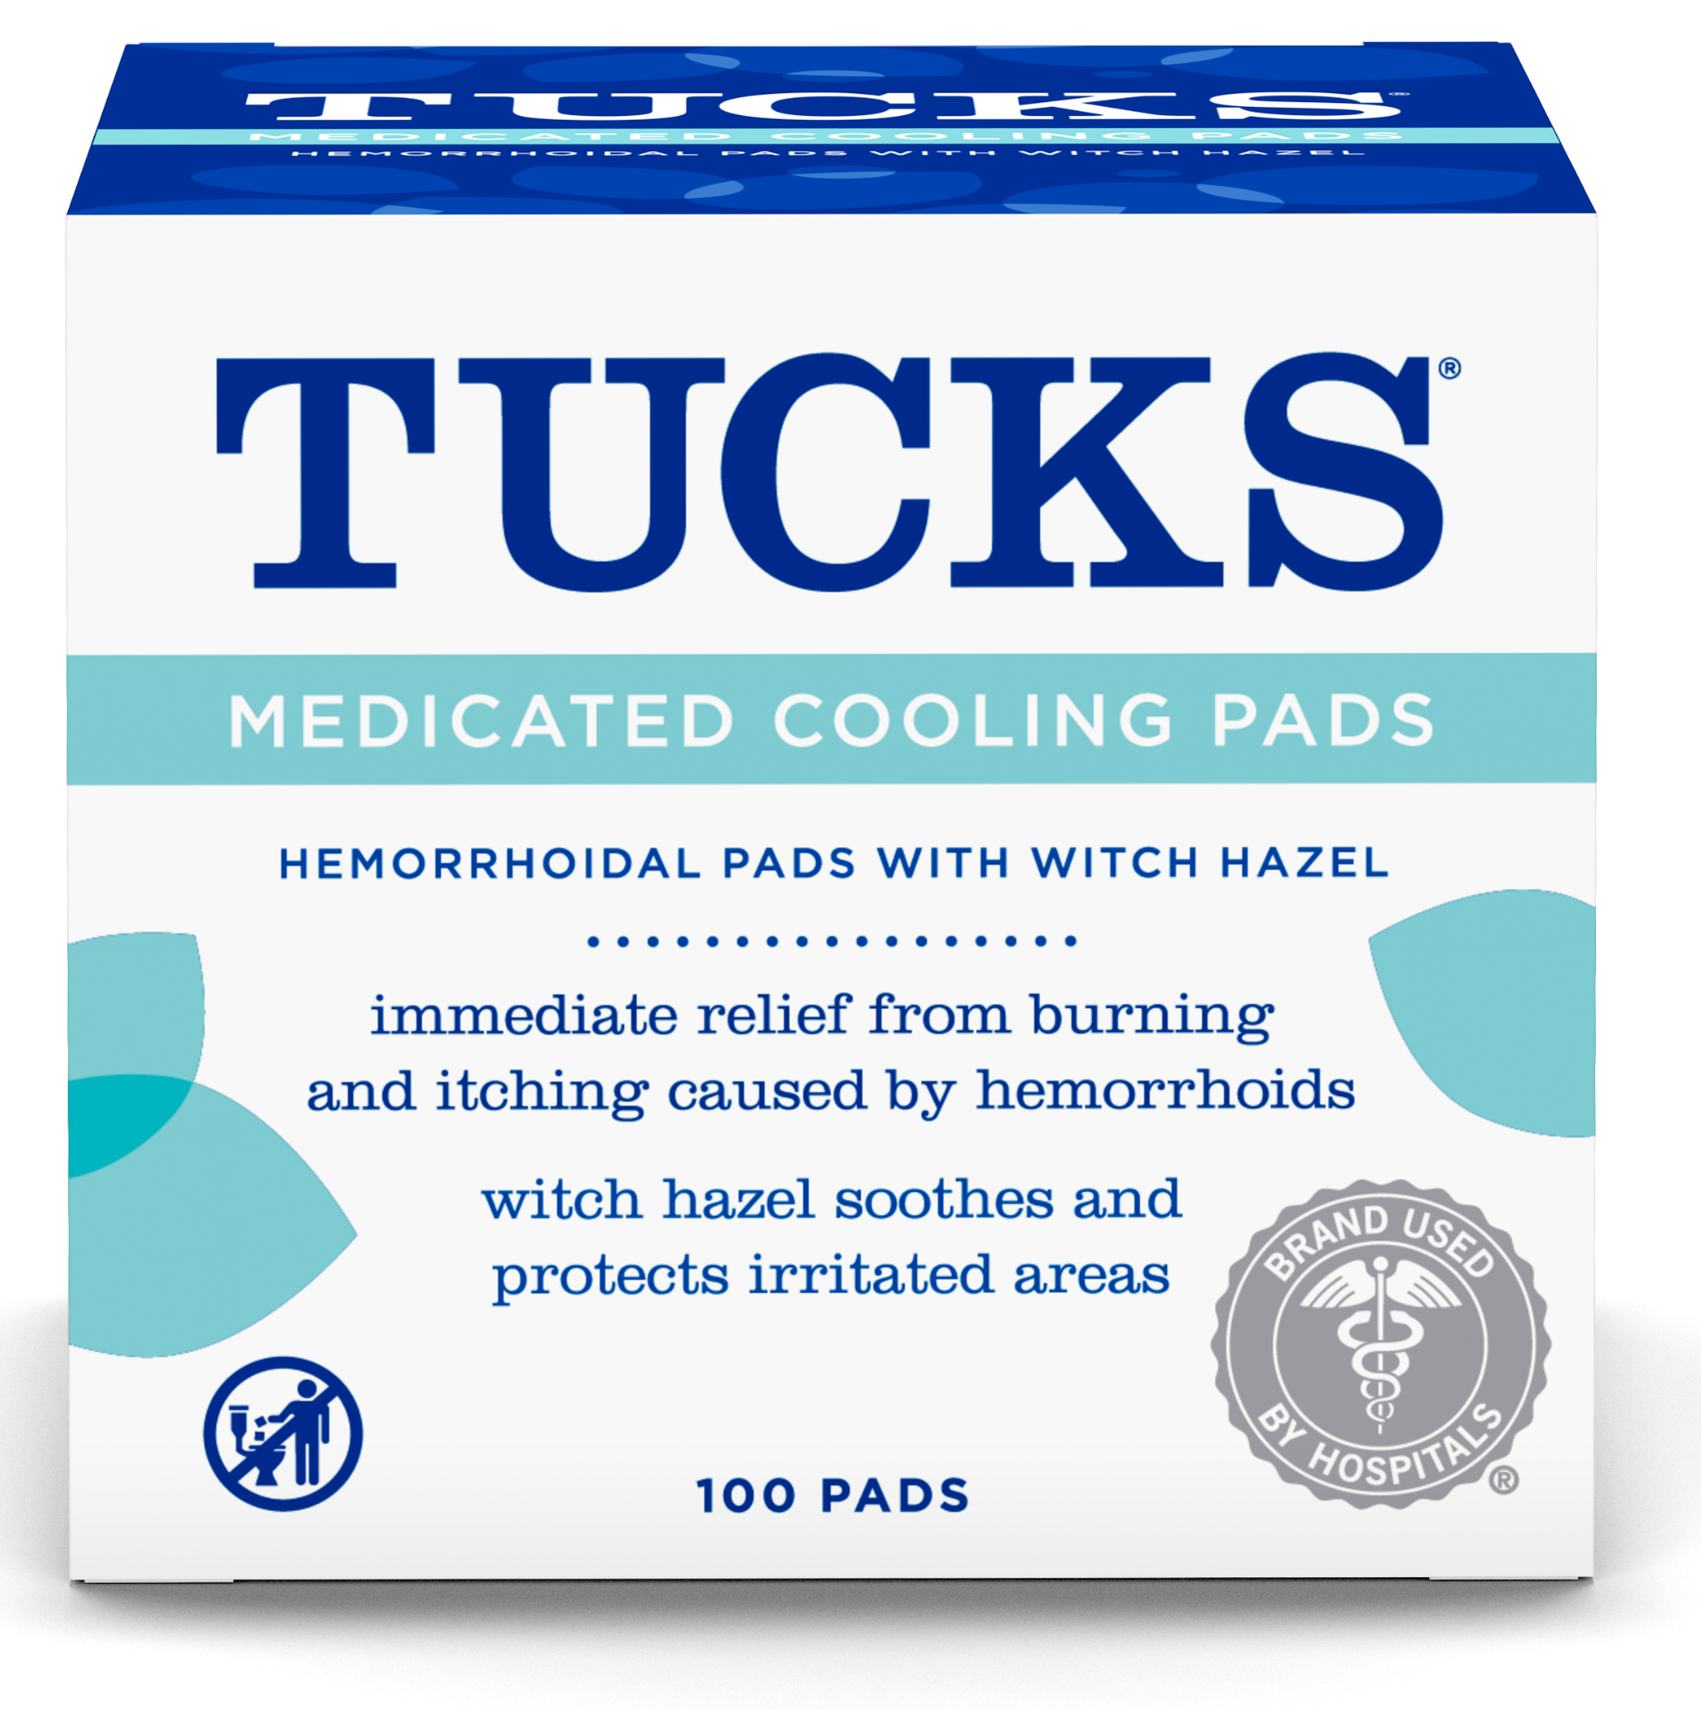
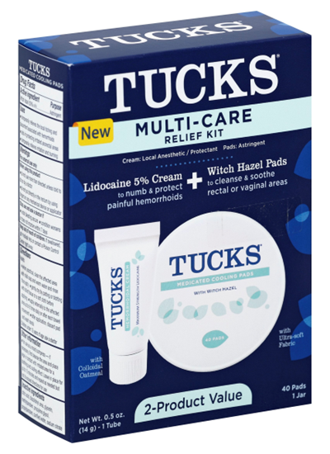
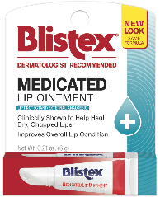
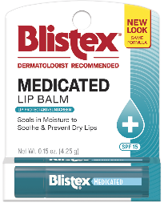

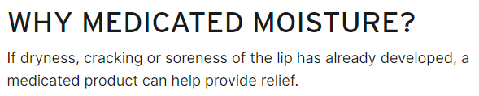
Tucks Medicated Cooling Hemorrhoidal Pads 40 ct.
(Retail Pack)
Case pack: 4x3 = 12 units
Unit UPC: 041388 00732 8
Case UPC: 041388 00767 0
Case Cost: $
Unit Cost: $
Tucks Medicated Cooling Hemorrhoidal Pads 40 ct.
(Hospital Pack)
Case pack: 1x72 = 72 units
Unit UPC: 041388 00734 2
Case UPC: 041388 52041 4
Case Cost: $
Unit Cost: $
CHS# 247631
CHS# 247632
New Case Pack starts shipping 6/3/24
Tucks Medicated Cooling Hemorrhoidal Pads 100 ct.
(Retail Pack)
Case pack: 4x3 = 12 units
Unit UPC: 041388 00730 4
Case UPC: 041388 52100 8
Case Cost: $
Unit Cost: $
Tucks Multi-Care Relief Kit
(Retail Pack)
Case pack: 4x3 = 12 units
Unit UPC: 041388 008776
Case UPC: 041388 008790
Case Cost: $
Unit Cost: $
CHS# xxxxxx
CHS# 247629
Blistex Medicated Ointment .21 oz
(Retail Pack)
Case pack: 12x12 = 144 units
Unit UPC: 041388 210216
Case UPC: 041388 228846
Case Cost: $
Unit Cost: $
Blistex Medicated Balm .15 oz.
(Retail Pack)
Case pack: 12x12 = 144 units
Unit UPC: 041388 220611
Case UPC: 041388 831244
Case Cost: $
Unit Cost: $
CHS# xxxxxx
CHS# xxxxxx
New Packaging starts shipping 7/15/24
New Packaging starts shipping 7/15/24

