Slide 1
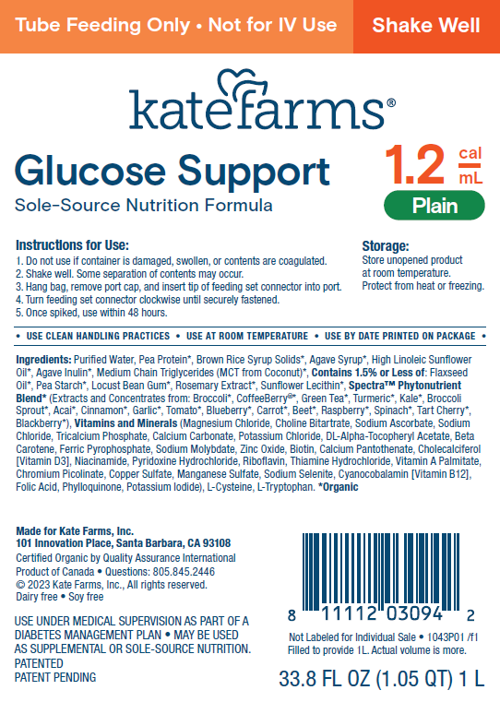
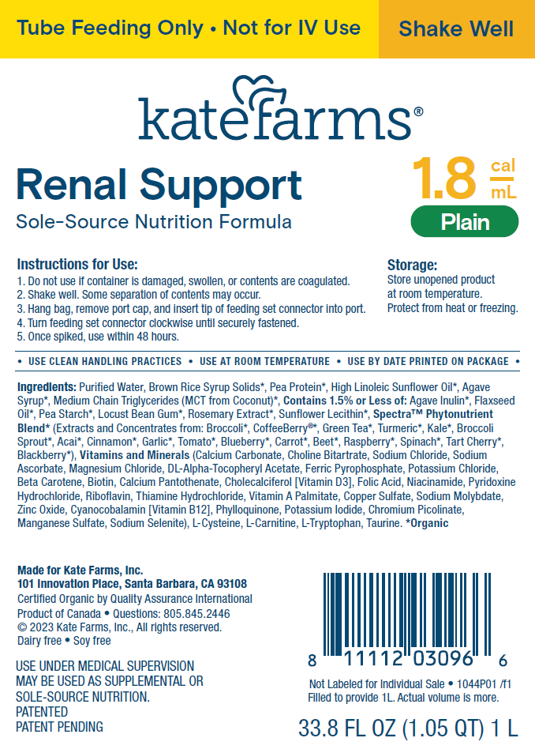
Kate Farms® is pleased to announce national availability of two Specialized Nutrition products
Kate Farms® Glucose Support 1.2 Closed System Kate Farms® Renal Support 1.8 Closed System
Available July 2024
Kate Farms is available through major distributors.

Slide 2
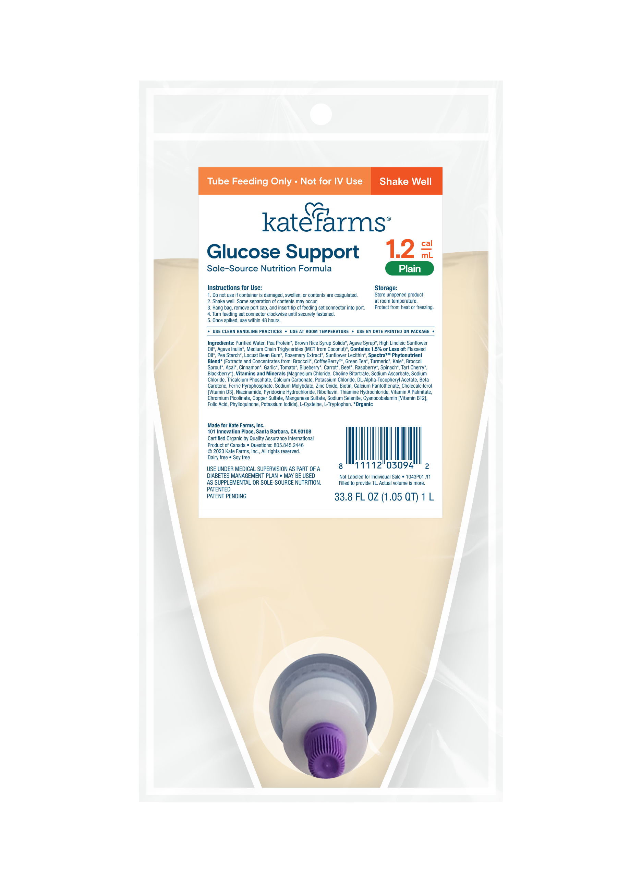



Designed to help support blood sugar management* and overall health
Contains a unique blend † designed to support blood sugar management as part of a balanced diet
64 g protein per L ‡
Unique fiber blend that supports tolerance, gut health, and the microbiome¹
Low glycemic index²
Made for tolerance
Low osmolality that may support GI tolerance
Organic MCT oil for easy fat absorption
No artificial sweeteners and no sugar alcohols
UPC case: 811112030959
NDC: 11112-0030-94
Highest quality certifications
*As part of a balanced diet.
†A blend of plant-based protein, soluble and insoluble fiber, and carbohydrates.
‡See nutrition information for fat and saturated fat content.
Reference: 1. Cara KC, Beauchesne AR, et al. JPEN J Parenter Enteral Nutr. 2021;45(5):882–906. 2. Inquis Clinical Research, Toronto.
© 2024 Kate Farms, Inc. All Rights Reserved.
2
Notes:
Pea

Slide 3
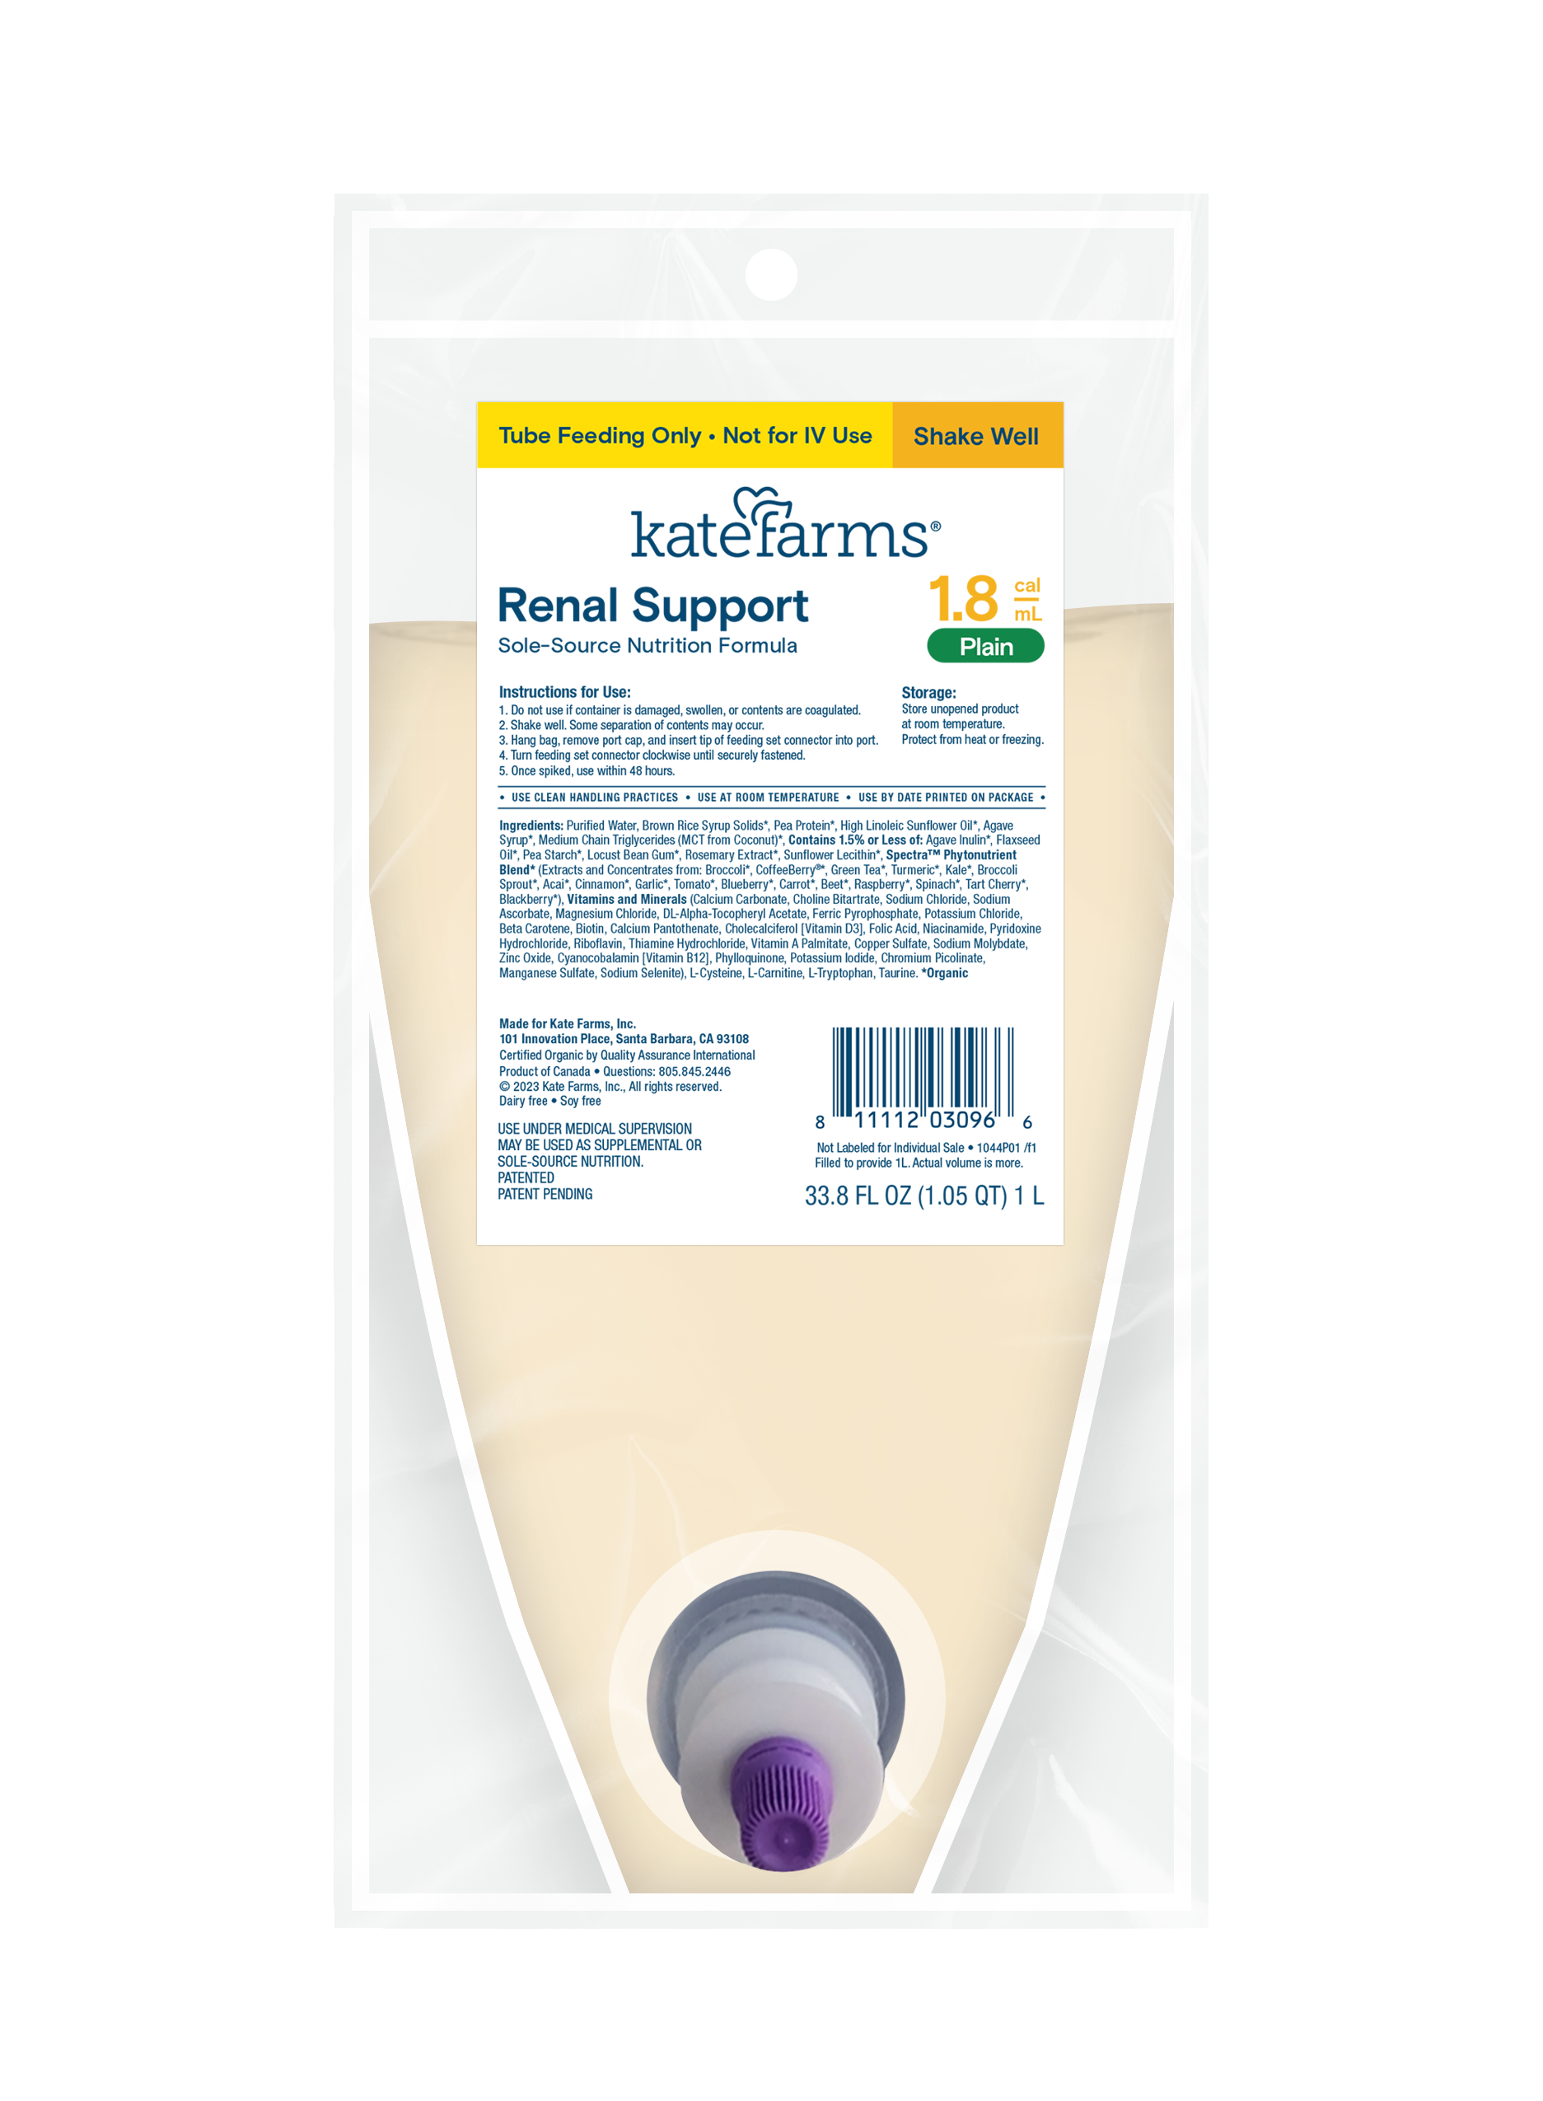

Designed to help meet the nutrition needs of people on dialysis¹
Formulated to meet expert recommendations*²
Calorically dense
80 g protein per L†
Sodium, potassium, and phosphorus optimized to help manage imbalances
Made for tolerance
50% lower osmolality to support GI tolerance‡
Organic MCT oil for easy fat absorption
No artificial sweeteners and no sugar alcohols
Unique fiber blend that supports tolerance, gut health, and the microbiome²
UPC case: 811112030973
NDC: 11112-0030-96
Highest quality certifications
*For the nutritional needs of people on dialysis.
†See nutrition information for fat and saturated fat content.
‡Compared to Nepro® and Novasource® Renal.
References: 1. Ikizler TA, Burrowes JD, et al. Am J Kidney Dis. 2020;76(3):S1-S107. 2. Cara KC, Beauchesne AR, et al. JPEN J Parenter Enteral Nutr. 2021;45(5):882–906.
© 2024 Kate Farms, Inc. All Rights Reserved.
3
Notes:
Pea

Slide 4
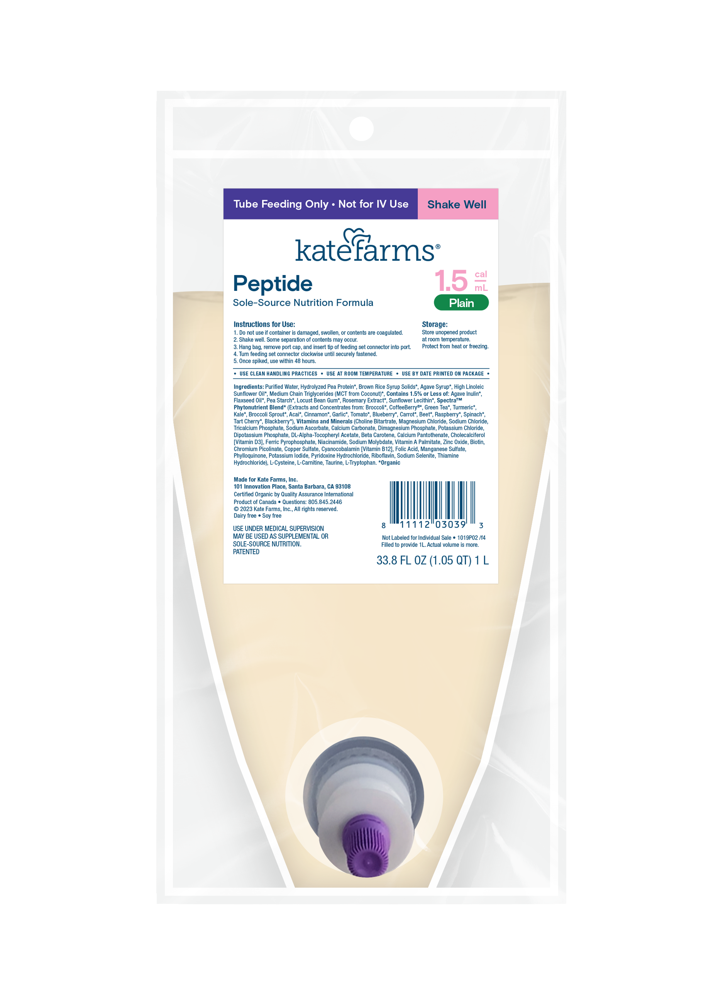
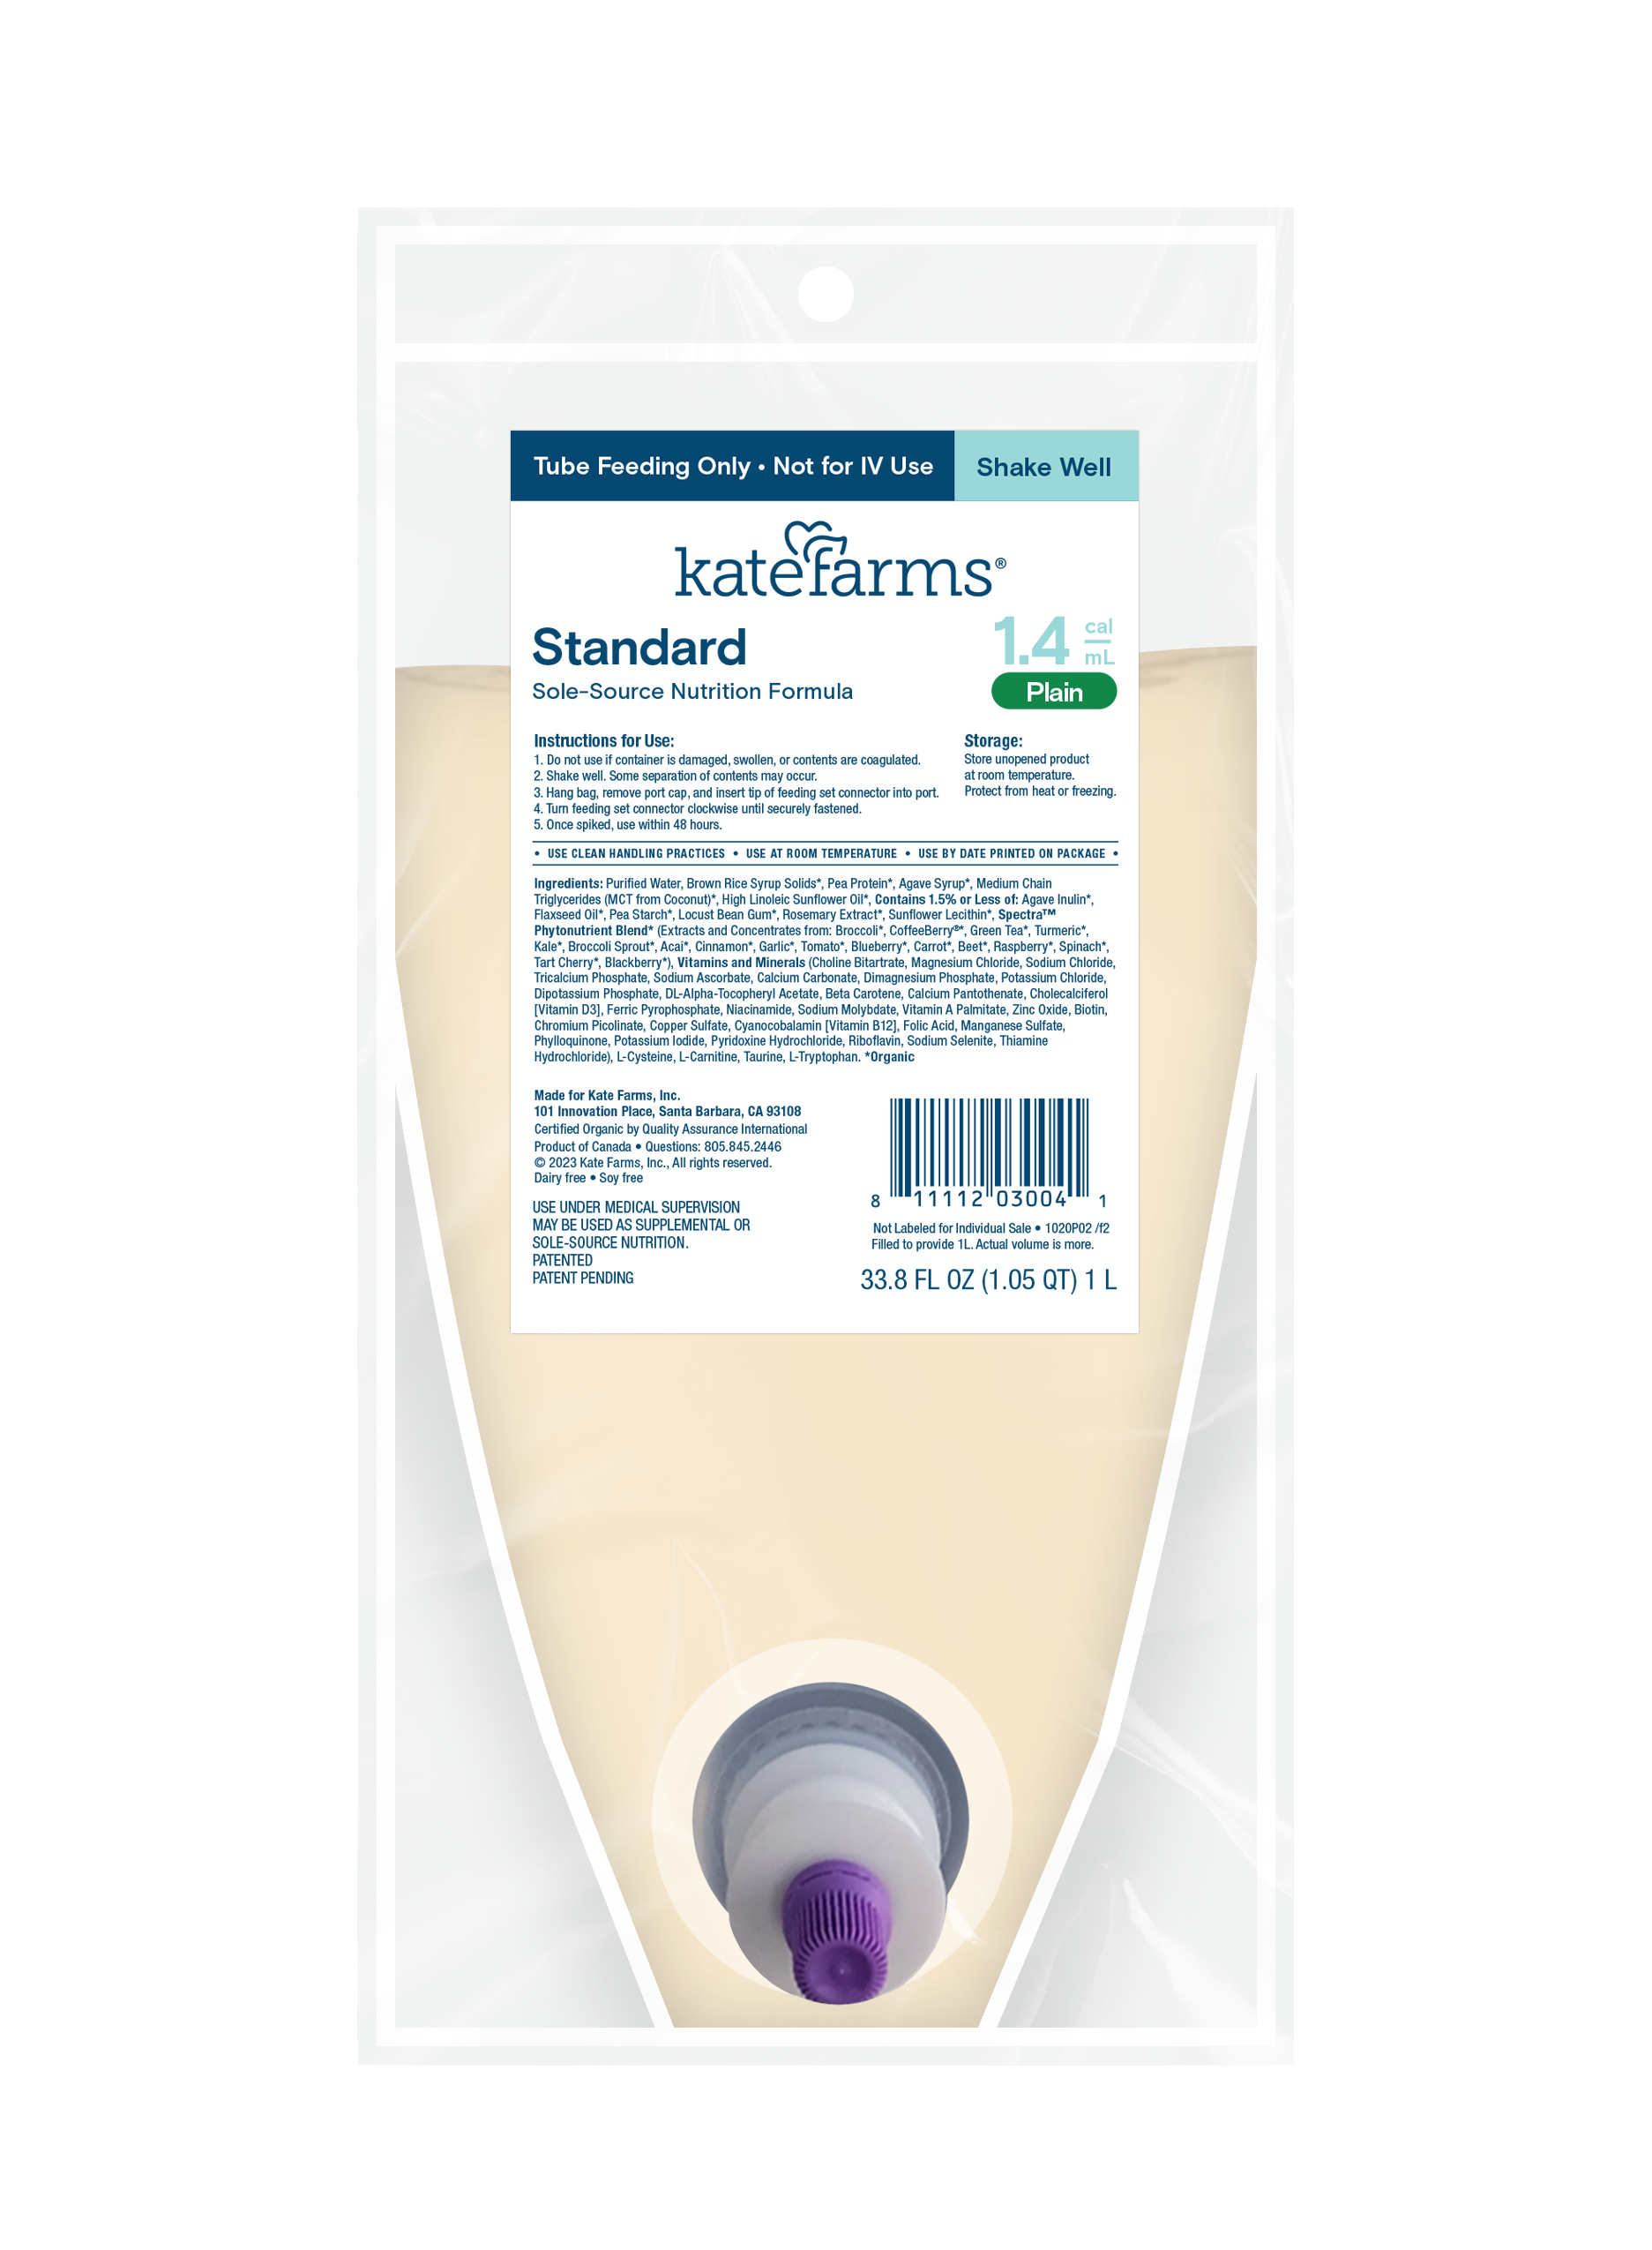
Kate Farms closed feeding systems
Quality nutrition designed for safety and convenience
Convenient, sterile, ready-to-hang 1L bag
Easy access front-of-bag port and instructions
Universal connector fit
Aerodynamic design and overfill to ensure full delivery of formula
© 2024 Kate Farms, Inc. All Rights Reserved.
4

