Slide 1
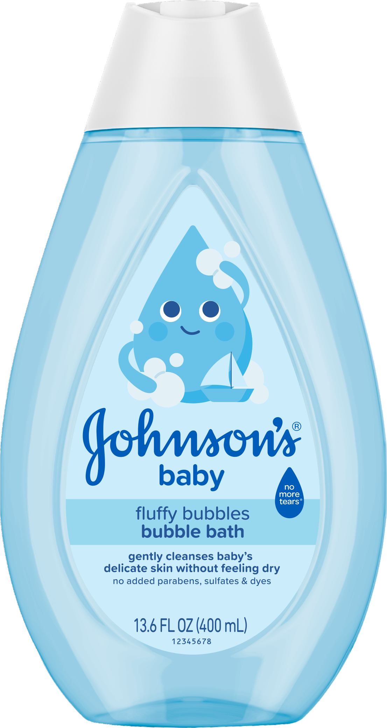
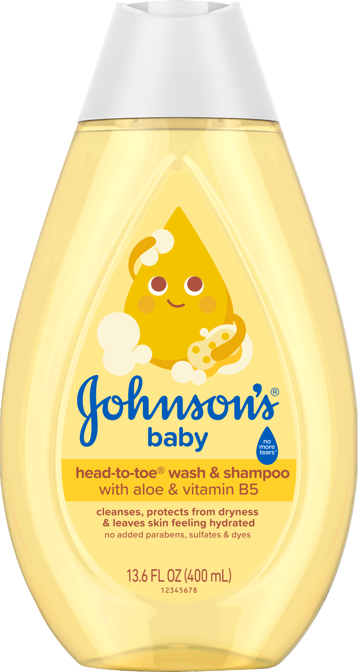
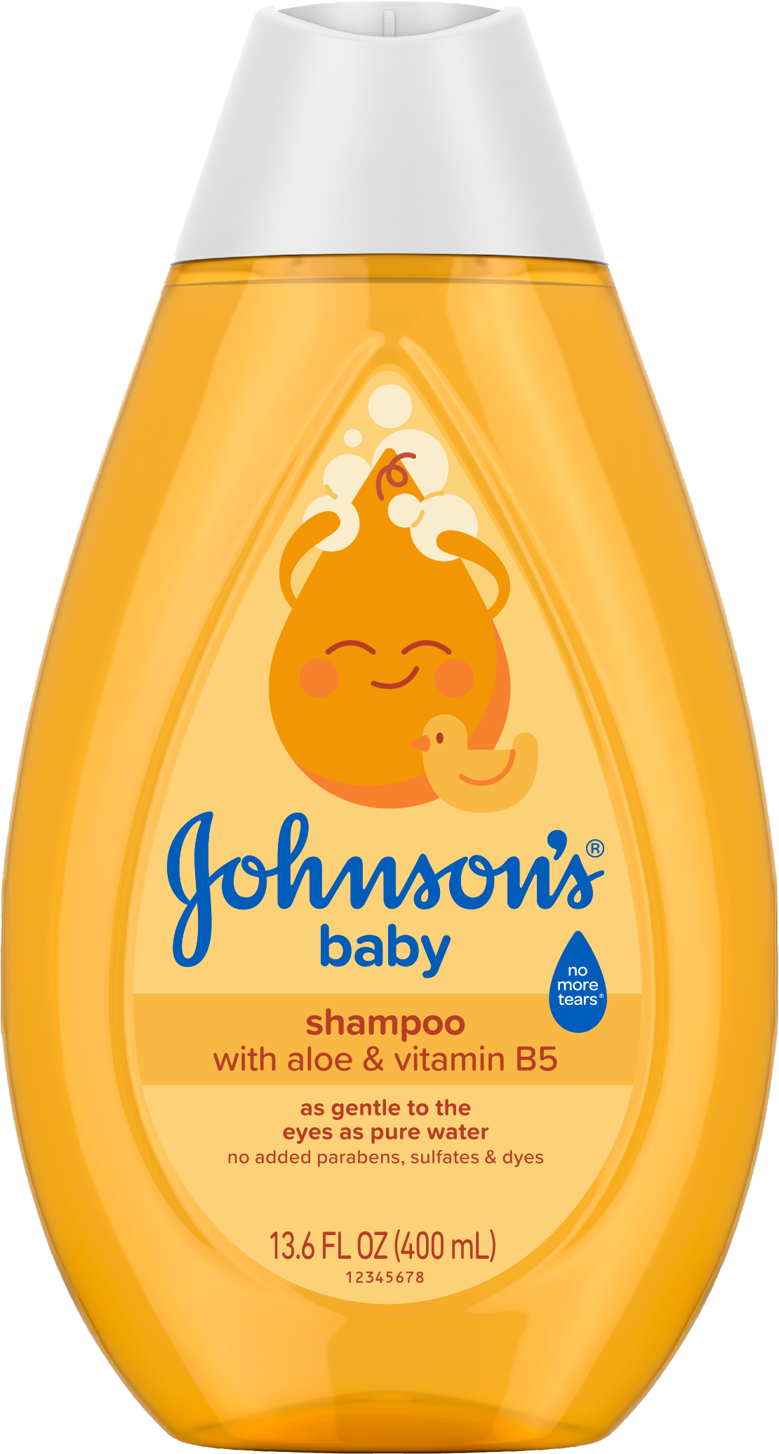
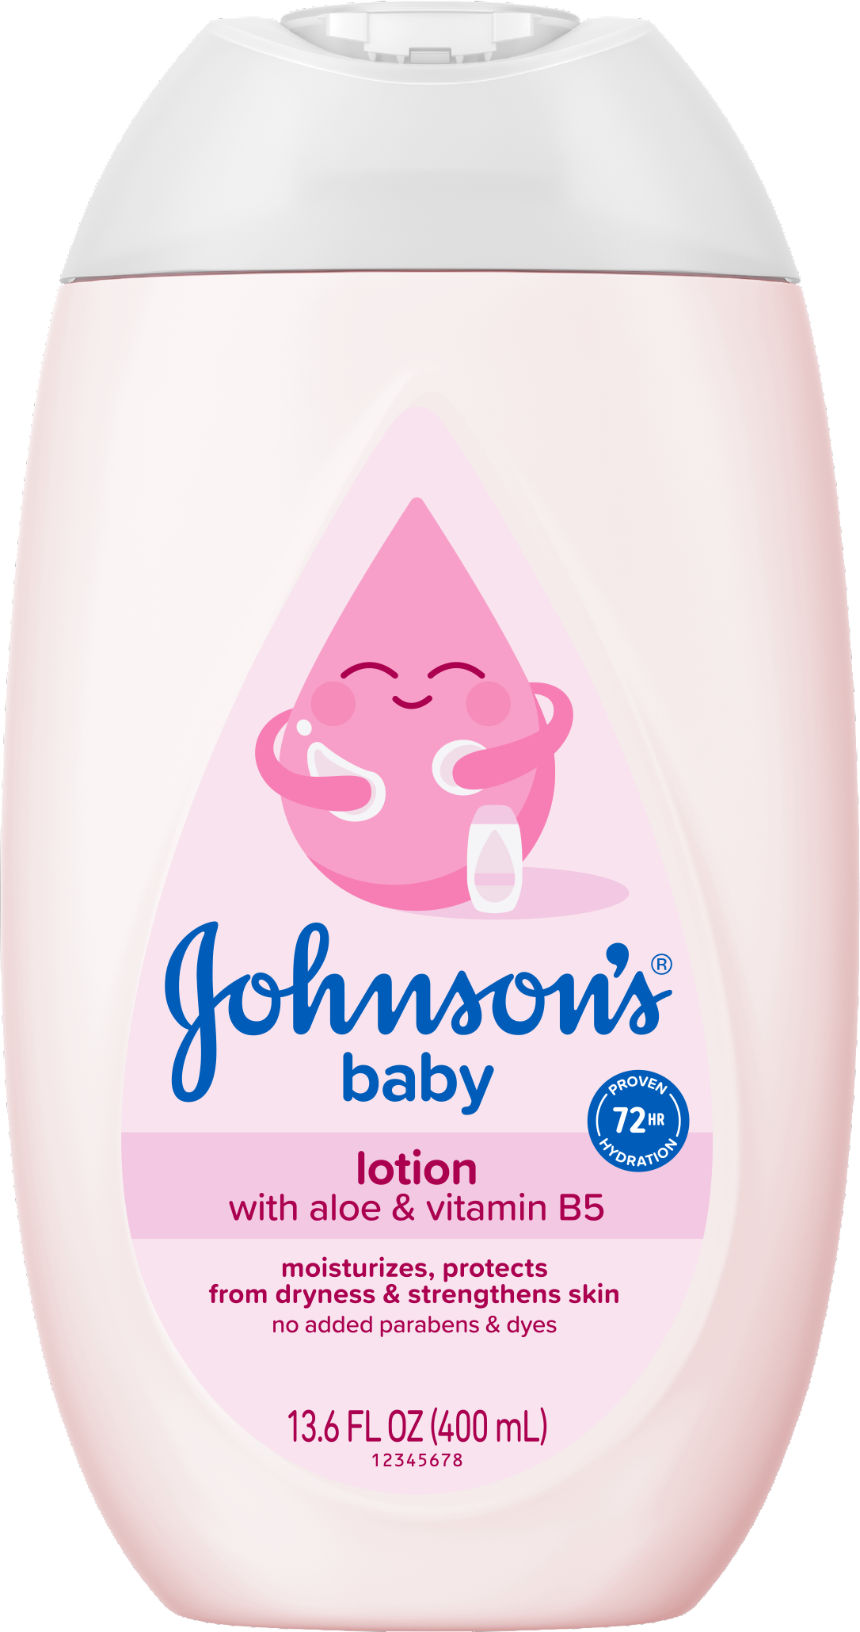
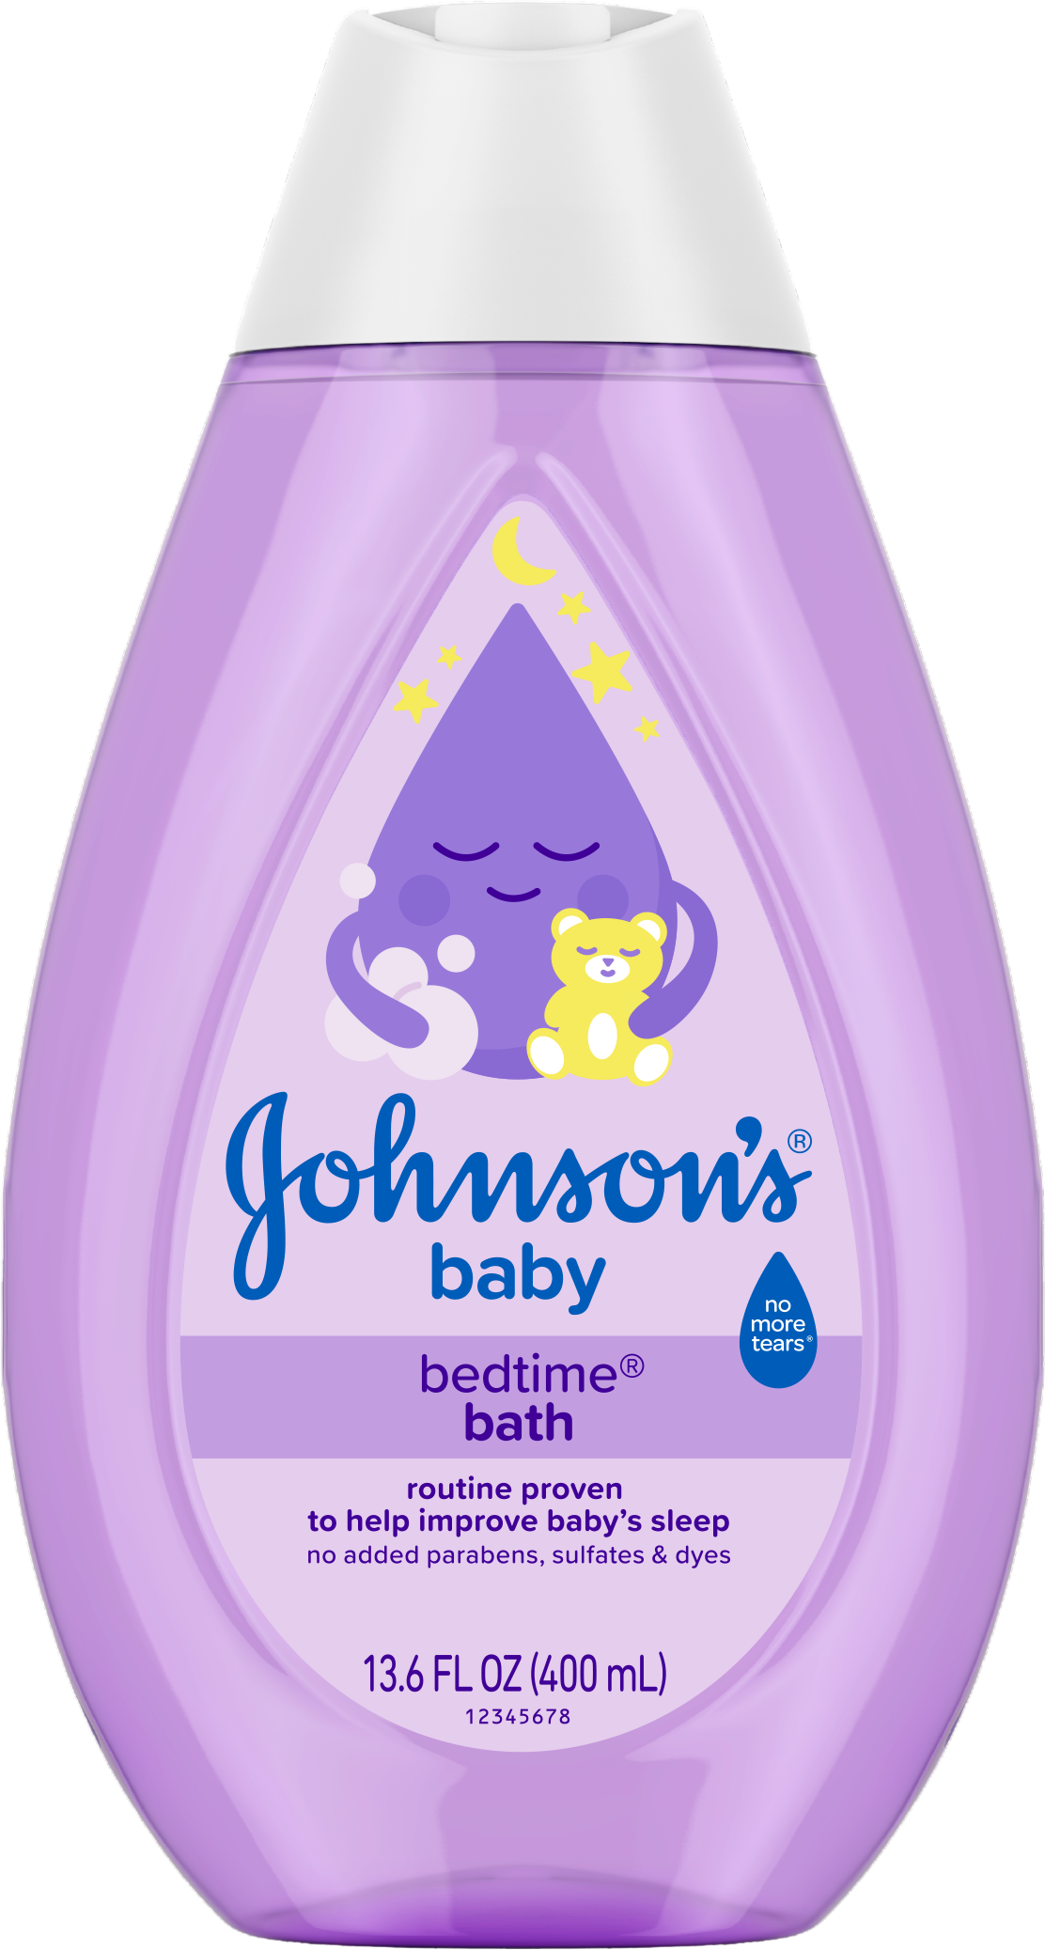

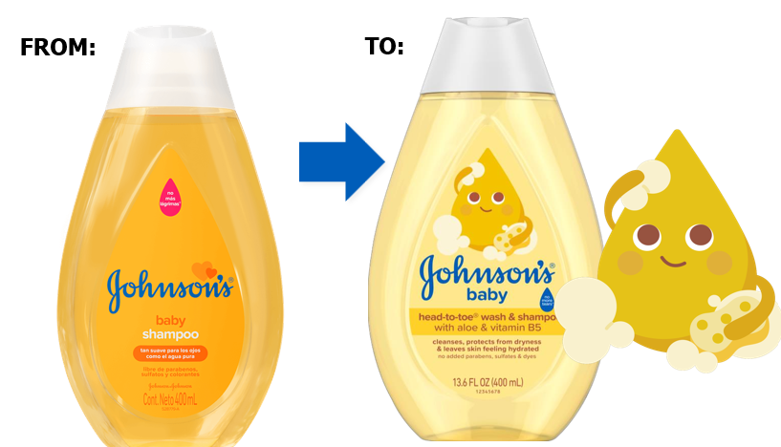
Strengthens the skin barrier after 1st use
Our packaging will be re-born
More sustainable +50% recycled plastic
Begins August 2025
No Item Code Changes
Johnson's Classics now with Aloe & Vitamin B5

Slide 2



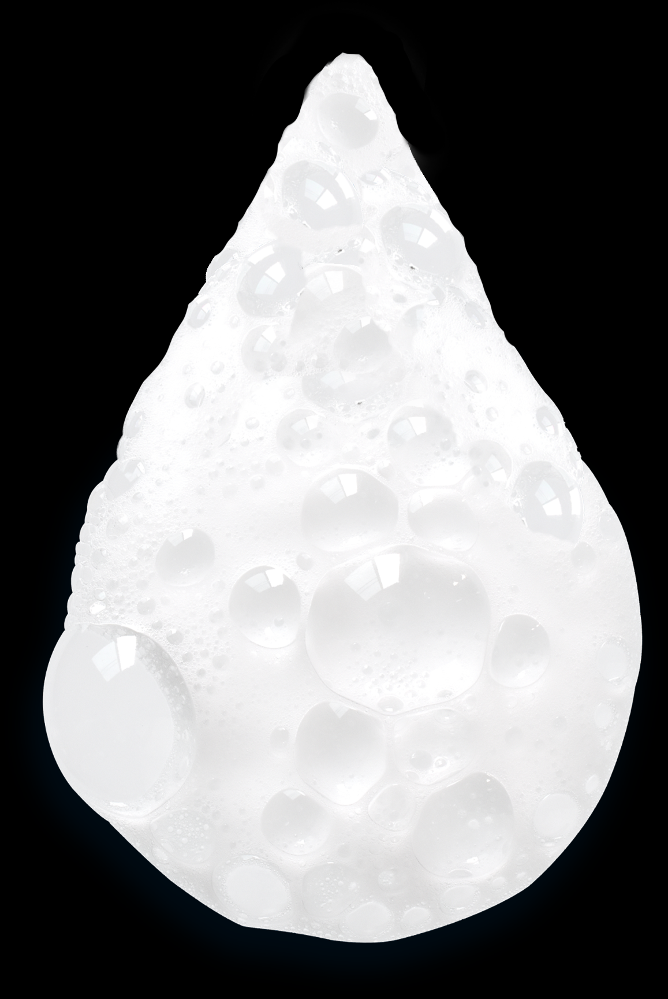
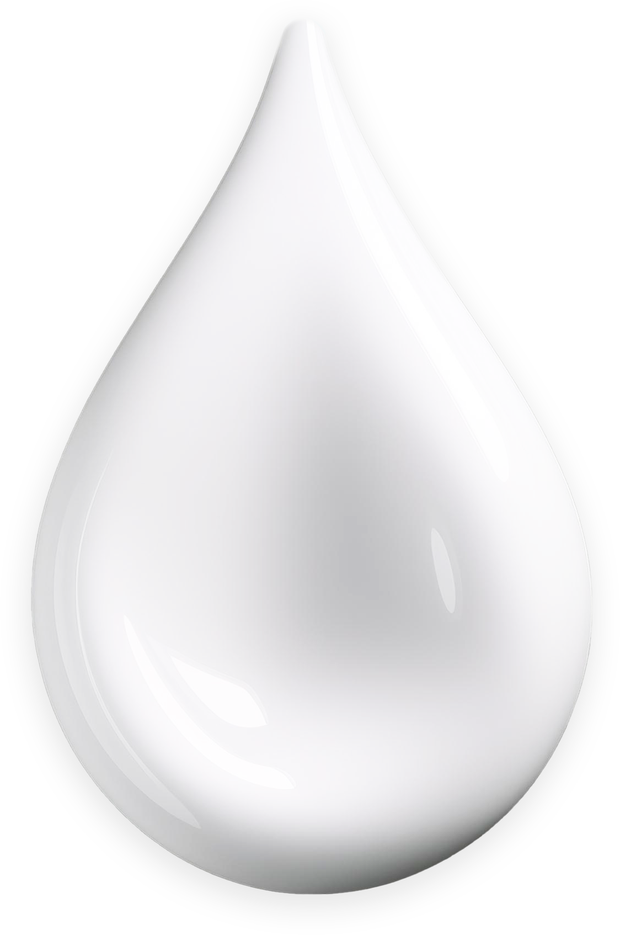
Our top selling formulations
will be re-born
to strengthen & protect the baby skin
Wraps your baby in
2x more moisture
Leaves hair & skin
feeling hydrated
Strengthens their skin barrier & Protects from dryness
Gently cleanses
& Protects from dryness
Clinically proven
72h hydration
Now with
Aloe & Vit B5
Improved formulation
Improved formulation
Now with
Aloe & Vit B5
(Pink Lotion only)
NEW FORMULAS: Pink Lotion, Bedtime Lotion, Bedtime Cream,
Skin Nourish Vanilla & Oats Lotion, Skin Nourish Shea & Cocoa Butter Lotion
NEW FORMULAS:
Gold Shampoo & HTT

