Slide 1

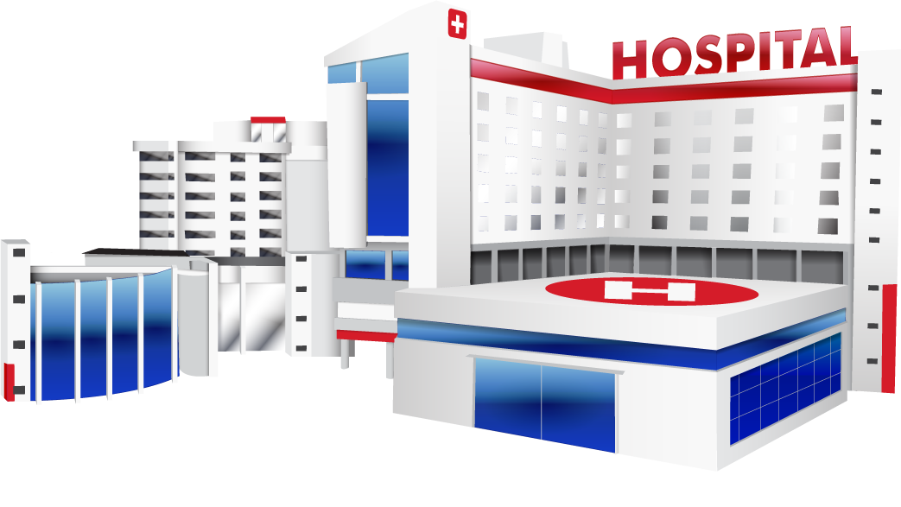

Slide 2
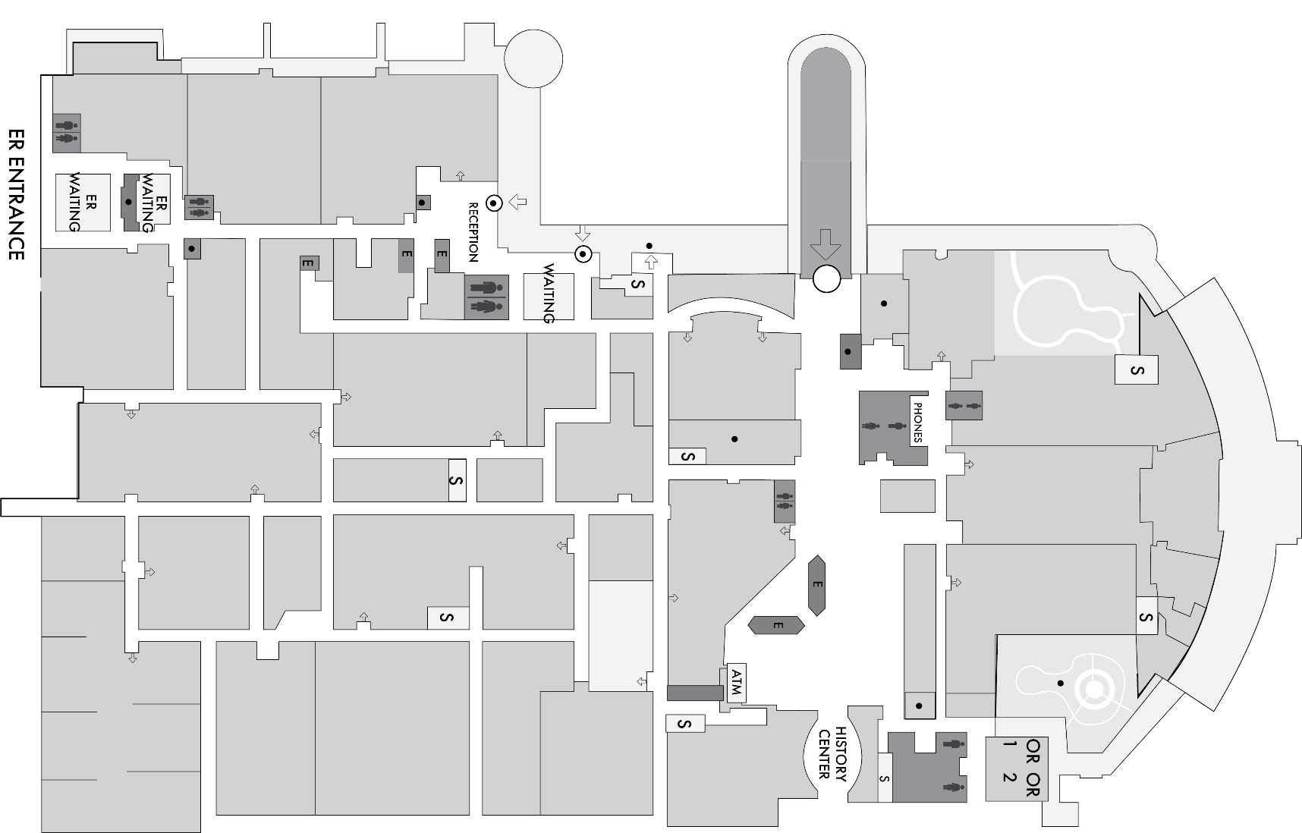

MAP
OUTPATIENT
MORGUE
BURN UNIT
ER
PHARMACY/
PHLEBOTOMY
LAUNDRY
ICU
CRITICAL CARE
OR
LONG TERM CARE
FOOD SERVICE
CAFETERIA
NEONATAL
SURGICAL
MATERNITY
NUTRITION/
ENDOCRINOLOGY
BARIATRIC
DIALYSIS
PEDIATRICS

Slide 3

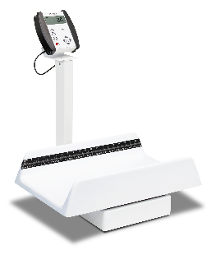
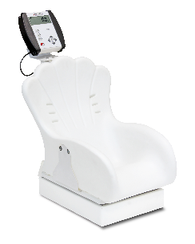
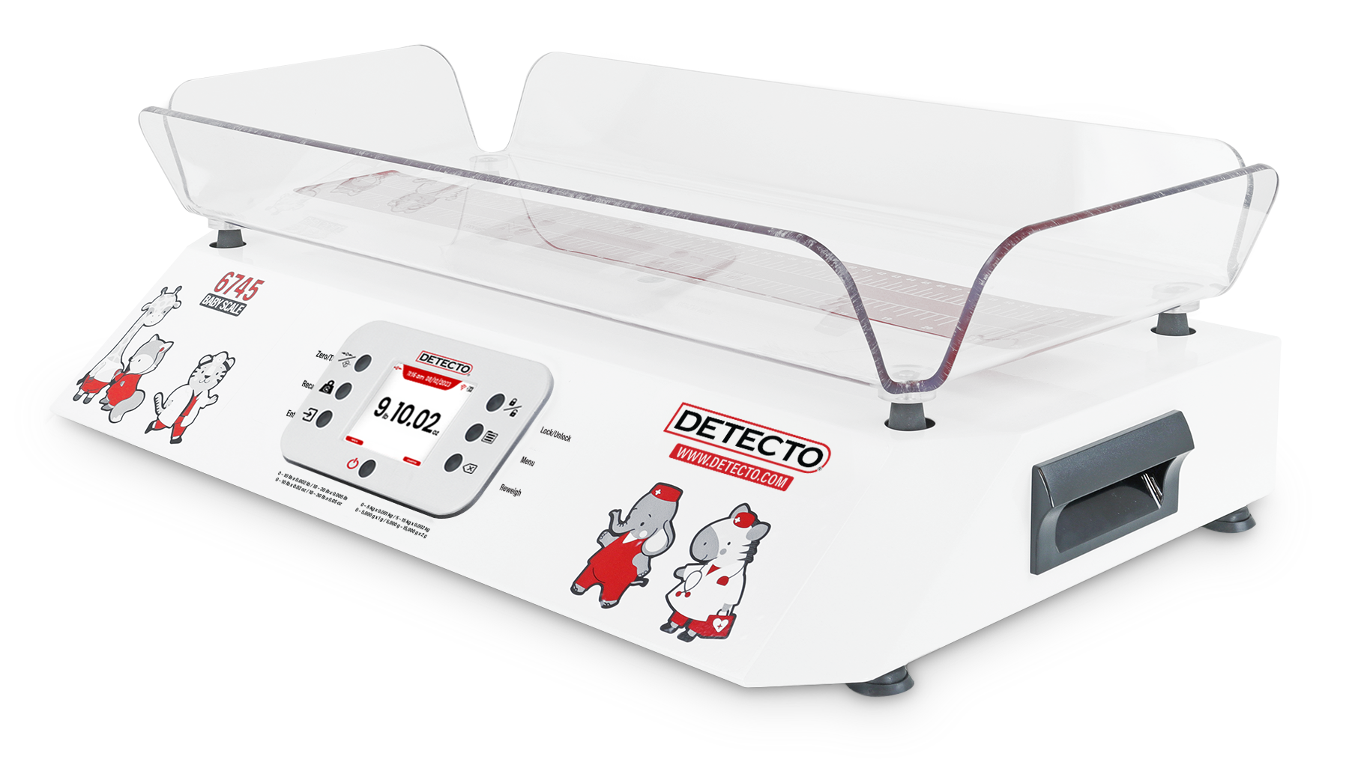
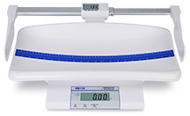
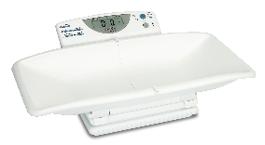
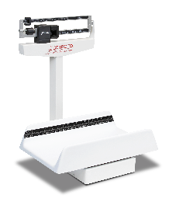
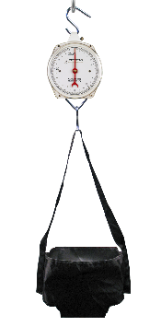
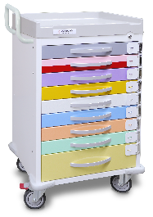
PEDIATRIC SCALES
PEDIATRICS
LAUDRY
MAP
6745
MB130
PEDIATRIC SCALES
8440
8435
8432-CH
30 lb/15kg Capacity
AC Power Cord Included
Integral Measuring Tape
Roomy Weighing Tray
Serial Output for Printers
44 lb /20 kg Capacity and 0.01 lb /5 g Divisions
Portable and Lightweight for Mobile Medical Use
Easy to Operate with Large Readouts
Integral Analog Measuring Tape
Optional Digital Length Measuring Available
Collapsible Tray for Storage/Transport
Standing Toddler or Baby Weighing
1-in-high LCD
Storage or Previous Weight
MEDICAL CARTS
Digital Speed and Accuracy
130 lb x 0.1 lb / 59 kg x 0.05 kg Capacity
Durable, Long-Lasting Steel Construction
44 lb / 20 kg Capacity
Simple-to-Use Weight Indicator
EMR/EHR Serial Connectivity
450
HS25KGP
RESCUE
Time-tested, Reliable Weighbeam Accuracy
Durable Construction / Clinical Quality
Roomy Weighing Tray
Weighbeam is Readable from Both Sides
25 kg Capacity
No Power Required
Waterproof Vinyl Weighing Trousers
360-Degree Rotation for Tight Corners
Push Handle with User-Friendly Design
9 Multi-colored Drawers using Broselow Color coding

Slide 4

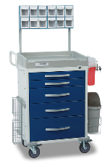
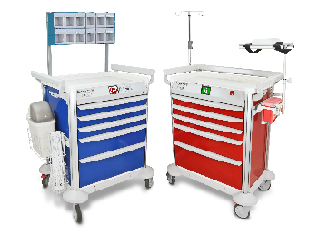

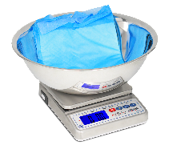
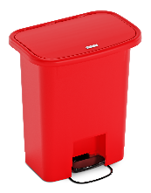
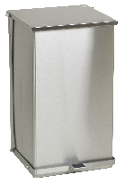
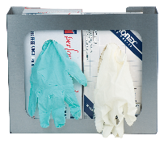
MEDICAL CARTS
ICU/CRITICAL CARE
PHYSICIAN SCALES
WET DIAPER SCALES
MAP
WASTE RECEPTACLE
WPS12UT
RESCUE
MOBILECARE
SOLO
GLOVE BOX HOLDERS
Measure Fluids or Blood Loss During Clinical Procedures
Weigh Chux Pad / Wet Diapers / Lap Sponges / Organs
Six Different Capacities, Including 192 oz x 0.05 oz
and 5,500 g x 1 g
Deep Bowl Aids Sample Retention and Allows Easy Clean-up
360-Degree Rotation for Tight Corners
ABS Countertop Surface
Available in 5- or 6-Drawer Models
Push Handle with User-Friendly Design
Quality Steel Cart Body Construction
3 Lock Types Available: Electronic (RFID and Touchscreen Pincode), Quick Release, and Keyed
Innovative Quick Release Unlocking Saves Valuable Seconds When a Patient Codes
Proprietary Onboard and PC Software Developed by DETECTO
550 lb x 0.2 lb/250 kg x 0.1 kg Capacity
Weight, Height, and Body Mass Index
14 in W x 15 in D x 2.5 in H/
36 cm W x 38 cm D x 6 cm H Platform Size
Inline Mechanical Height Rod
GH2SS
WASTE MATE
STEP ON CAN
Commercial-grade trash cans
High-grade plastic resists rust, scratches, and denting
4 sizes and 2 standard colors
FM approval for safety
Baked Epoxy or Stainless Steel
Durable-Grade Construction
Free Biohazard and Infectious Waste Labels
Heavy-Duty Foot Pedal and Linkage
Self-Closing Lid
Accommodates Most Latex Glove Boxes
Detecto Lifetime Guarantee
Installs in Seconds
Stainless Steel
Open Face Design

Slide 5


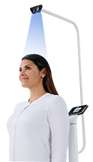
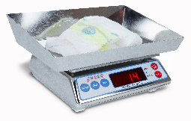
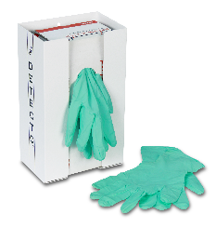
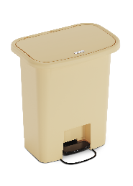
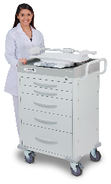
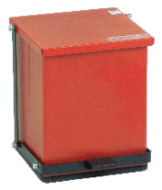
PEDIATRIC SCALES
PHYSICIAN SCALES
MATERNITY
WET DIAPER SCALES
MAP
6745
MB130
APEX
ICON
AP-4KD
WASTE RECEPTACLES
MEDICAL CARTS
30 lb/15kg Capacity
AC Power Cord Included
Integral Measuring Tape
Roomy Weighing Tray
Serial Output for Printers
44 lb /20 kg Capacity and 0.01 lb /5 g Divisions
Portable and Lightweight for Mobile Medical Use
Easy to Operate with Large Readouts
Integral Analog Measuring Tape
Optional Digital Length Measuring Available
600 lb x 0.2 lb/300 kg x 0.1 kg Capacity
Weight, Height, and Body Mass Index
17 in W x 17 in D x 2.75 in/ 43.2 cm W x
43.2 cm D x 7 cm H Platform Size
Inline Mechanical Height Rod
Extra-high 1,000-lb/500 kg Capacity
Ultra-thin Platform Only
1.5 in/3.8 cm High
Displays Weight, Height, and BMI Onscreen Simultaneously
.5-in-high LCD Display
AC Adapter Included
Pushbutton Tare
Stainless Steel Enclosure
Compact Size
GLOVE BOX HOLDERS
GLOVE BOX HOLDERS
MODEL 6745
GH1
RESCUE
WASTE MATE
STEP ON CAN
Commercial-grade trash cans
High-grade plastic resists rust, scratches, and denting
4 sizes and 2 standard colors
FM approval for safety
Baked Epoxy or Stainless Steel
Durable-Grade Construction
Free Biohazard and Infectious Waste Labels
Heavy-Duty Foot Pedal and Linkage
Self-Closing Lid
360-Degree Rotation for Tight Corners
ABS Countertop Surface
Available in 5- or 6-Drawer Models
Push Handle with User-Friendly Design
Quality Steel Cart Body Construction
Accommodates Most Latex Glove Boxes
Detecto Lifetime Guarantee
Installs in Seconds
Open Face Design

Slide 6

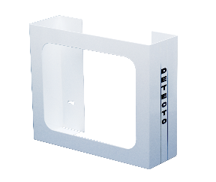
WET DIAPER SCALES
MEDICAL CARTS
PEDIATRIC SCALES
NEONATAL
MAP
6745
WASTE RECEPTACLES
RESCUE
AP-4KD
WPS12UT
GLOVE BOX HOLDERS
30 lb/15kg Capacity
AC Power Cord Included
Integral Measuring Tape
Roomy Weighing Tray
Serial Output for Printers
.5-in-high LCD Display
AC Adapter Included
Pushbutton Tare
Stainless Steel Enclosure
Compact Size
Measure Fluids or Blood Loss During Clinical Procedures
Weigh Chux Pad / Wet Diapers / Lap Sponges / Organs
Six Different Capacities,
360-Degree Rotation for Tight Corners
ABS Countertop Surface
Available in 5- or 6-Drawer Models
Push Handle with User-Friendly Design
Quality Steel Cart Body Construction
GH2
WASTE MATE
STEP ON CAN
Commercial-grade trash cans
High-grade plastic resists rust, scratches, and denting
4 sizes and 2 standard colors
FM approval for safety
Baked Epoxy or Stainless Steel
Durable-Grade Construction
Free Biohazard and Infectious Waste Labels
Heavy-Duty Foot Pedal and Linkage
Self-Closing Lid
Accommodates Most Latex Glove Boxes
Detecto Lifetime Guarantee
Installs in Seconds
Open Face Design

Slide 7

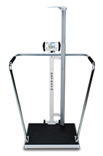
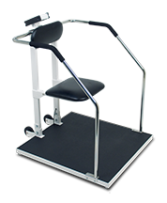

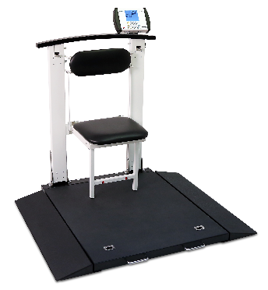
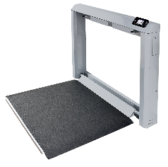
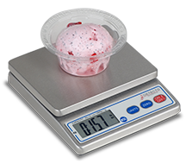
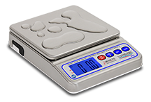
BARIATRIC SCALES
PHYSICIAN SCALES
NUTRITION/ENDOCRINOLOGY
MAP
6857DHR
6800
ICON
6868
PORTIONING SCALES
SOLO
WHEELCHAIR SCALES
550 lb x 0.2 lb/250 kg x 0.1 kg Capacity
Weight, Height, and Body Mass Index
14 in W x 15 in D x 2.5 in H/
36 cm W x 38 cm D x 6 cm H Platform Size
Inline Mechanical Height Rod
Extra-High 1,000-lb/ 500kg Capacity
Sonar Touchless Height Rod
Ultra-Thin Platform Only 1.5 in/3.8 cm High
Multi-Color Touchscreen LCD Display
Displays Weight, Height, And BMI
1000 lb/450 kg Capacity
BMI Calculation
Digital Height Rod
EMR/EHR Ready
Spacious Platform
1000 lb/450 kg Capacity
BMI Calculation
EMR/EHR Ready
Extra-Large 32 In X 34 In/81.3 cm W x 85.7 cm D x 6.0 cm H Platform
1000 lb/450 kg Capacity
BMI Calculation
EMR/EHR Ready
Integral Carrying Handle
Low Profile Design
6570
7550
WPS12
PS4
1000 lb/450 kg Capacity
Single-Pass Weighing with Keypad and Pushbutton Tare
Vertical Mode for Transport and Storage
3-in-1 Standing Seated Wheelchair Scale
1,000 lb/300 kg Capacity
Wi-Fi for EMR/EHR
Sturdy Steel Construction
Compact Storage
Slim 6.6-inch/17-cm Compact Profile
Large 1in/25 mm High Digits
NSF Approved
Submersible IP67 Rating
Washdown for Sanitary Environments
1 Gram Divisions
Compact Size
NSF Approved
Stainless Steel Enclosure

Slide 8
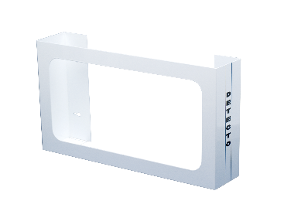
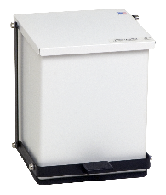
WASTE RECEPTACLES
GLOVE BOX HOLDERS
NUTRITION/ENDOCRINOLOGY
MAP
GH3
WASTE MATE
STEP ON CAN
Commercial-grade trash cans
High-grade plastic resists rust, scratches, and denting
4 sizes and 2 standard colors
FM approval for safety
Baked Epoxy or Stainless Steel
Durable-Grade Construction
Free Biohazard and Infectious Waste Labels
Heavy-Duty Foot Pedal and Linkage
Self-Closing Lid
Accommodates Most Latex Glove Boxes
Detecto Lifetime Guarantee
Installs in Seconds
Open Face Design

Slide 9
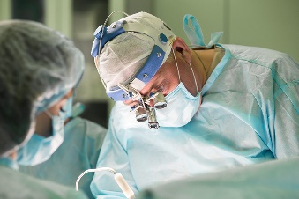
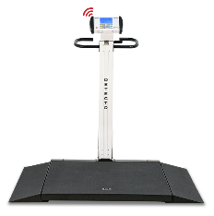
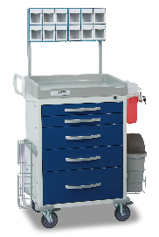
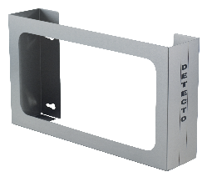
PHYSICIAN SCALES
WHEELCHAIR SCALES
SURGICAL
WET DIAPER SCALES
MAP
6550
7550
WPS12UT
APEX
ICON
WASTE RECEPTACLES
Measure Fluids or Blood Loss
During Clinical Procedures
Weigh Chux Pad / Wet Diapers /
Lap Sponges / Organs
Six Different Capacities, Including
192 oz x 0.05 oz and 5,500 g x 1 g
600 lb x 0.2 lb/300 kg x 0.1 kg Capacity
Weight, Height, and Body Mass Index
17 in W x 17 in D x 2.75 in/ 43.2 cm W x
43.2 cm D x 7 cm H Platform Size
Inline Mechanical Height Rod
MEDICAL CARTS
1,000 lb/300 kg Capacity
Wi-fi for EMR/EHR
Sturdy Steel Construction
Compact Storage
Slim 6.6-inch/17-cm Compact Profile
GLOVE BOX HOLDERS
WHEELCHAIR SCALES
Extra-High 1,000-lb/ 500kg Capacity
Sonar Touchless Height Rod
Ultra-Thin Platform Only 1.5 in/3.8 cm High
Multi-Color Touchscreen LCD Display
Displays Weight, Height, and BMI
1,000 lb/450 kg Capacity
Portable Scale with Vertical
Fold-Up Storage
2-way Low-Profile Platform for Easy
Patient Access
RESCUE
GH3SS
WASTE MATE
STEP ON CAN
Commercial-grade trash cans
High-grade plastic resists rust, scratches, and denting
4 sizes and 2 standard colors
FM approval for safety
Baked Epoxy or Stainless Steel
Durable-Grade Construction
Free Biohazard and Infectious Waste Labels
Heavy-Duty Foot Pedal and Linkage
Self-Closing Lid
Accommodates Most Latex Glove Boxes
Detecto Lifetime Guarantee
Installs in Seconds
Stainless Steel
Open Face Design
360-Degree Rotation for Tight Corners
Available in 5- or 6-Drawer Models
Push Handle with User-Friendly Design
Quality Steel Cart Body Construction

Slide 10
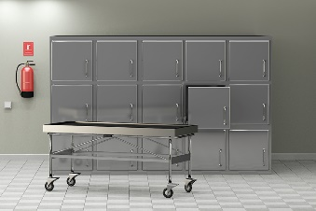
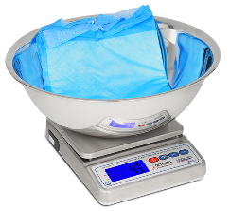
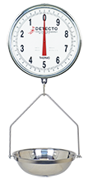
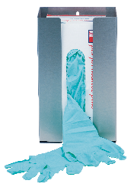
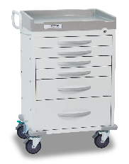
SUBMERSIBLE SCALES
HANGING DIAL SCALES
MEDICAL CARTS
MORGUE
MORTURARY
GLOVE BOX HOLDERS
MAP
WPS12UT
T3530
GH1SS
RESCUE
WASTE RECEPTACLES
Measure Fluids or Blood Loss During Clinical Procedures
Weigh Chux Pad / Wet Diapers / Lap Sponges / Organs
Six Different Capacities, Including 192 oz x 0.05 oz and 5,500 g x 1 g
Deep Bowl Aids Sample Retention and Allows Easy Clean-Up
360-Degree Rotation for Tight Corners
Available in 5- or 6-Drawer Models
Push Handle with User-Friendly Design
Quality Steel Cart Body Construction
15 in/37 cm-Diameter Double Dial
Avoirdupois and Metric Models
Includes Aluminum Commodity Pan
Protective Glass Plate Over Dial Face
Accommodates Most Latex Glove Boxes
Detecto Lifetime Guarantee
Installs in Seconds
Open Face Design
WASTE MATE
Commercial-grade trash cans
High-grade plastic resists rust, scratches, and denting
4 sizes and 2 standard colors
FM approval for safety

Slide 11

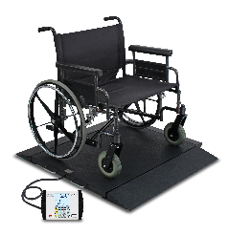
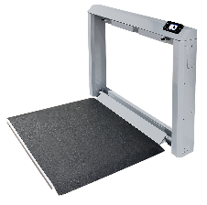
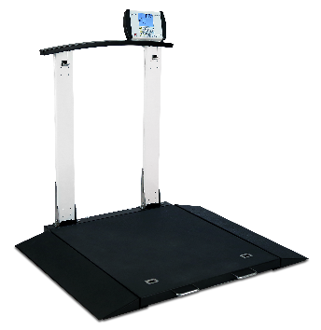
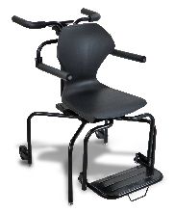
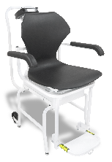
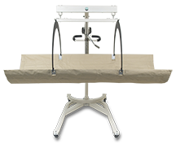
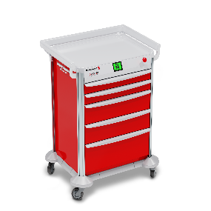
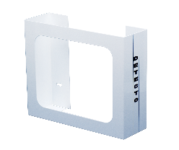
WHEELCHAIR SCALES
CHAIR SCALES
LONG TERM CARE
IN-BED SCALES
MAP
BRW1000
7550
6560
6880
6475
IBFL500
MEDICAL CARTS
Robust 1,000 lb/450 kg Capacity
40-inch Extra-wide, Portable Platform
Two-Way, Easy-Access,
Integral Ramps
1,000 lb/300 kg Capacity
Wi-Fi for EMR/EHR
Sturdy Steel Construction
Slim 6.6-inch/17-cm Compact Profile
1000 lb/450 kg Capacity
Curved Handrail for Patient Stability
Two-Way, Easy-access,
Integral Ramps
OIML EC Class III Model Available
EMR/EHR Ready
Integral Full Revolution
Swiveling Wheels
Lift-Away Arms and Footrest
Plastic-Molded Seat
.75-in/19 mm-high LCD With BMI
EMR/EHR Ready
Integral Wheels Ease Transport
Hydraulic Lift Mechanism Eases Lifting
EMR/EHR Ready
Stretcher Carrying Strap and
“Easy Stow” Hoops
IBFL500 – 500 lb/225 kg Capacity
WET DIAPER SCALES
GLOVE BOX HOLDERS
WASTE RECEPTACLES
AP-4KD
GH2
RESCUE
MOBILECARE
WASTE MATE
.5-in-high LCD Display
AC Adapter Included
Pushbutton Tare
Stainless Steel Enclosure
Compact Size
Commercial-grade trash cans
High-grade plastic resists rust, scratches, and denting
4 sizes and 2 standard colors
FM approval for safety
Accommodates Most Latex Glove Boxes
Detecto Lifetime Guarantee
Installs in Seconds
Open Face Design
360-Degree Rotation for Tight Corners
Available in 5- or 6-Drawer Models
Push Handle with User-Friendly Design
Quality Steel Cart Body Construction
3 Lock Types Available: Electronic, Quick Release, and Keyed
Innovative Quick Release Unlocking Saves Valuable Seconds When a Patient Codes

Slide 12
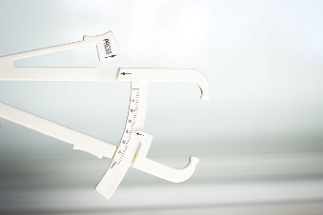
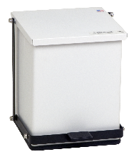



BARIATRIC SCALES
WASTE RECEPTACLES
BARIATRIC
MAP
WHEELCHAIR SCALES
6857DHR
6800
6856
6868
WASTE MATE
STEP ON CAN
Commercial-grade trash cans
High-grade plastic resists rust, scratches, and denting
4 sizes and 2 standard colors
FM approval for safety
1000 lb/450 kg Capacity
BMI Calculation
Digital Height Rod
EMR/EHR Ready
Spacious Platform
1000 lb/450 kg Capacity
BMI Calculation
EMR/EHR Ready
Extra-large 32 In X 34 In/81.3 cm W x 85.7 cm D x 6.0 cm H Platform
1000 lb/450 kg Capacity
BMI Calculation
EMR/EHR Ready
Integral Carrying Handle
Low Profile Design
MEDICAL CARTS
GLOVE BOX HOLDERS
Baked Epoxy or Stainless Steel
Durable-Grade Construction
Heavy-Duty Foot Pedal and Linkage
Self-Closing Lid
1000 lb/450 kg Capacity
BMI Calculation
EMR/EHR Ready
Spacious Platform
6550
7550
BRW1000
RESCUE
GH1
1,000 lb/300 kg Capacity
Wi-Fi For EMR/EHR
Sturdy Steel Construction
Mounts Securely to a Wall for
Compact Storage
Robust 1,000 lb/450 kg Capacity
40-inch Extra-wide, Portable Platform
Two-Way, Easy-Access,
Integral Ramps
360-Degree Rotation for Tight Corners
Available in 5- or 6-Drawer Models
Push Handle with User-Friendly Design
Quality Steel Cart Body Construction
1,000 lb/450 kg Capacity With Optional Wi-Fi
2-way Low-profile Platform for Easy Patient Access
Accommodates Most Latex Glove Boxes
Detecto Lifetime Guarantee
Installs in Seconds
Open Face Design

Slide 13


WASTE RECEPTACLES
GLOVE BOX HOLDERS
CHUX SCALE
OPERATING ROOM
MAP
GH3SS
WPS12UT
MEDICAL CARTS
WASTE MATE
STEP ON CAN
Measure Fluids or Blood Loss During Clinical Procedures
Weigh Chux Pad / Wet Diapers / Lap Sponges / Organs
Six Different Capacities, Including 192 oz x 0.05 oz and 5,500 g x 1 g
Accommodates Most Latex Glove Boxes
Detecto Lifetime Guarantee
Installs in Seconds
Stainless Steel
Open Face Design
Commercial-grade trash cans
High-grade plastic resists rust, scratches, and denting
4 sizes and 2 standard colors
FM approval for safety
Baked Epoxy or Stainless Steel
Durable-Grade Construction
Free Biohazard and Infectious Waste Labels
Heavy-Duty Foot Pedal and Linkage
Self-Closing Lid
RESCUE
MOBILECARE
360-Degree Rotation for Tight Corners
Available in 5- or 6-Drawer Models
Push Handle with User-Friendly Design
Quality Steel Cart Body Construction
3 Lock Types Available: Electronic, Quick Release, and Keyed
Innovative Quick Release Unlocking Saves Valuable Seconds When a Patient Codes

Slide 14



IN-BED SCALES
GLOVE BOX HOLDERS
BURN UNIT
MEDICAL CARTS
MAP
IBFL500
WASTE RECEPTACLES
RESCUE
GH2SS
Hydraulic Lift Mechanism Eases Lifting
RS232 Serial Connectivity: EMR/EHR Ready
Stretcher Carrying Strap and
“Easy Stow” Hoops
500lb/225 kg Capacity
Accommodates Most Latex Glove Boxes
Detecto Lifetime Guarantee
Installs in Seconds
Stainless Steel
Open Face Design
360-Degree Rotation for Tight Corners
Available in 5- or 6-Drawer Models
Push Handle with User-Friendly Design
Quality Steel Cart Body Construction
WASTE MATE
STEP ON CAN
Commercial-grade trash cans
High-grade plastic resists rust, scratches, and denting
4 sizes and 2 standard colors
FM approval for safety
Baked Epoxy or Stainless Steel
Durable-Grade Construction
Free Biohazard and Infectious Waste Labels
Heavy-Duty Foot Pedal and Linkage
Self-Closing Lid

Slide 15



PHYSICIAN SCALES
MEDICAL CARTS
STRETCHER SCALES
EMERGENCY
UVC DISINFECTION
MAP
8550
APEX
WASTE RECEPTACLES
RESCUE
MOBILECARE
ICON
High-Capacity Digital Scale for Stretchers and Wheelchairs
1,000 lb x 0.2 lb / 450 kg x 0.1 kg Capacity
Two Integrated Ramps Included for Easy Access
Mobile for Use in Multiple Clinical Departments
GLOVE BOX HOLDERS
600 lb x 0.2 lb/300 kg x 0.1 kg Capacity
Weight, Height, and Body Mass Index
17 in W x 17 in D x 2.75 in/ 43.2 cm W
x 43.2 cm D x 7 cm H Platform Size
Inline Mechanical Height Rod
Extra-high 1,000-lb/500 kg Capacity
Ultra-thin Platform Only
1.5 in/3.8 cm High
Displays Weight, Height, and BMI Onscreen Simultaneously
360-Degree Rotation for Tight Corners
Available in 5- or 6-Drawer Models
Push Handle with User-Friendly Design
Quality Steel Cart Body Construction
3 Lock Types Available: Electronic, Quick Release, and Keyed
Innovative Quick Release Unlocking Saves Valuable Seconds When a Patient Codes
GH2
WASTE MATE
STEP ON CAN
Commercial-grade trash cans
High-grade plastic resists rust, scratches, and denting
4 sizes and 2 standard colors
FM approval for safety
Baked Epoxy or Stainless Steel
Durable-Grade Construction
Free Biohazard and Infectious Waste Labels
Heavy-Duty Foot Pedal and Linkage
Self-Closing Lid
Accommodates Most Latex Glove Boxes
Detecto Lifetime Guarantee
Installs in Seconds
Open Face Design

Slide 16




IN-FLOOR DIALYSIS SCALES
PHYSICIAN SCALES
PRECISION BALANCES
DIALYSIS
MAP
SOLACE
APEX
420
WASTE RECEPTACLES
MEDICAL CARTS
GLOVE BOX HOLDERS
600 lb x 0.2 lb/300 kg x 0.1 kg Capacity
Weight, Height, and Body Mass Index
17 in W x 17 in D x 2.75 in/ 43.2 cm W x
43.2 cm D x 7 cm H Platform Size
Inline Mechanical Height Rod
Intuitive and easy to use
Air shield included for precise measurement
Counting mode
Class II legal for trade
1,000 lb / 450 kg Capacity with Optional Wi-Fi
Portable Scale With Vertical Fold-Up Storage
2-Way Low-Profile Platform for Easy Patient Access
RESCUE
GH1SS
WASTE MATE
STEP ON CAN
Commercial-grade trash cans
High-grade plastic resists rust, scratches, and denting
4 sizes and 2 standard colors
FM approval for safety
Baked Epoxy or Stainless Steel
Durable-Grade Construction
Free Biohazard and Infectious Waste Labels
Heavy-Duty Foot Pedal and Linkage
Self-Closing Lid
360-Degree Rotation for Tight Corners
Available in 5- or 6-Drawer Models
Push Handle with User-Friendly Design
Quality Steel Cart Body Construction
Accommodates Most Latex Glove Boxes
Detecto Lifetime Guarantee
Installs in Seconds
Open Face Design

Slide 17




PHYSICIAN SCALES
WHEELCHAIR SCALES
GLOVE BOX HOLDERS
OUTPATIENT
MEDICAL CARTS
MAP
STADIOMETERS
6550
RESCUE
GH3
SOLO
APEX
WASTE RECEPTACLES
550 lb x 0.2 lb/250 kg x 0.1 kg Capacity
Weight, Height, and Body Mass Index
14 in W x 15 in D x 2.5 in H/36 cm W
x 38 cm D x 6 cm H Platform Size
Inline Mechanical Height Rod
600 lb x 0.2 lb/300 kg x 0.1 kg Capacity
Weight, Height, and Body Mass Index
17 in W x 17 in D x 2.75 in/ 43.2 cm W x
43.2 cm D x 7 cm H Platform Size
Inline Mechanical Height Rod
1,000 lb/450 kg Capacity with Optional Wi-Fi
2-way Low-profile Platform for Easy Patient Access
360-Degree Rotation for Tight Corners
Available in 5- or 6-Drawer Models
Push Handle with User-Friendly Design
Quality Steel Cart Body Construction
Accommodates Most Latex Glove Boxes
Detecto Lifetime Guarantee
Installs in Seconds
Open Face Design
PHR
DHRWM
SONARIS
WASTE MATE
STEP ON CAN
Commercial-grade trash cans
High-grade plastic resists rust, scratches, and denting
4 sizes and 2 standard colors
FM approval for safety
Baked Epoxy or Stainless Steel
Durable-Grade Construction
Free Biohazard and Infectious
Waste Labels
Self-Closing Lid
Portable, Reliable Height
Measurement Accuracy
4.5 in – 81 in / 11.5 cm – 205 cm Height Range
From Pediatric to Adult Measurement
Fast, Accurate Digital Height LCD Readouts
Display Can Be Mounted on Wall or Desk
View Height in Inches or Centimeters
Measures Up To 6'7" /200 Cm
Touchless Sonar Height Measurements
Measures Small Children to Tall Adults
Portable or Permanent Set-Up
Instant Digital Height Readouts

Slide 18




PRECISION BALANCES
MEDICAL CARTS
PHARMACY/PHLEBOTOMY
MAP
420
DP-15000
RESCUE
MOBILECARE
WASTE RECEPTACLES
GLOVE BOX HOLDERS
Intuitive and easy to use
Air shield included for precise measurement
Counting mode
Class II legal for trade
Accuracy to 50 milligrams
Counting mode
17 different units of measure
Built-in rechargeable battery included
360-Degree Rotation for Tight Corners
Available in 5- or 6-Drawer Models
Push Handle with User-Friendly Design
Quality Steel Cart Body Construction
3 Lock Types Available: Electronic, Quick Release, and Keyed
Innovative Quick Release Unlocking Saves Valuable Seconds When a Patient Codes
GH3
WASTE MATE
STEP ON CAN
Commercial-grade trash cans
High-grade plastic resists rust, scratches, and denting
4 sizes and 2 standard colors
FM approval for safety
Baked Epoxy or Stainless Steel
Durable-Grade Construction
Free Biohazard and Infectious Waste Labels
Heavy-Duty Foot Pedal and Linkage
Self-Closing Lid
Accommodates Most Latex Glove Boxes
Detecto Lifetime Guarantee
Installs in Seconds
Open Face Design

Slide 19





PORTIONING SCALES
PRICE COMPUTING SCALE
FOOD SERVICE/CAFETERIA
MAP
WPS12
PS4
PZ SERIES
DL1030P
APS20
Large 1-in/25-mm High Digits
NSF Approved
Submersible IP67 Rating
Washdown for Sanitary Environments
1 Gram Divisions
Compact Size
NSF Approved
Stainless Steel Enclosure
Large 0.8 In/20 Mm High LCD Display
GLOVE BOX HOLDERS
WASTE RECEPTACLES
BENCH SCALES
NSF Approved
Wall-mounting Bracket for Indicator
Wave-a-Weigh Hands-Free Tare
Wireless Connection Between Scale Base and Indicator
5990 PLUs
Available With or without Tower Pole Display
Integral Label Printer
30 lb or 60 lb Capacity
Adjustable Digital Filtering
NTEP Legal for Trade
Tower Display and Remote Display Mounting Options
GH3
EB-60-185B
STEP ON CAN
Baked Epoxy or Stainless Steel
Durable-Grade Construction
Free Biohazard and Infectious Waste Labels
Heavy-Duty Foot Pedal and Linkage
Self-Closing Lid
Rechargeable Battery Power
Column-Mounted 185B Rival Weight Indicator
NTEP, Measurement Canada, and
OIML Approved
Accommodates Most Latex Glove Boxes
Detecto Lifetime Guarantee
Installs in Seconds
Open Face Design

Slide 20





FLOOR SCALES
LAUNDRY
COUNTING SCALES
LAUDRY
MAP
EH-544-185
8852F-185B
RW-1000
C-100
GLOVE BOX HOLDERS
5000 lb x 1 lb Capacity
NTEP Legal for Trade
Rubber Load Cell Footings
4 x 4 ft Checkered Steel Deck Platform
RS232 Serial Port
19 X 28-in/ 48 x 71 cm Platform
5-in/12 cm-Diameter Wheels
NTEP Legal for Trade
Economically Priced – High Value
Checkered Deck for Rugged Traction
Robotically-Welded for Accuracy
1,000 lb x 0.5 lb Capacity
Piece Counts with Known and Unknown Weight Samples
Preset Weight and Quantity Limits with Alerts
Second Scale Input Port (remote scale only)
Weight Accumulator Mode
GH3
Accommodates Most Latex Glove Boxes
Detecto Lifetime Guarantee
Installs in Seconds
Open Face Design

