Slide 1

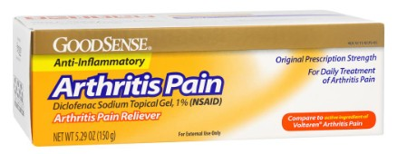
SAVE 25% Now through 5/1/2026
GoodSense® Arthritis Pain Relieving Diclofenac Topical Gel 5.29 oz
Item#: LP18903
Diclofenac Pain-Relieving Topical Gel
SRP $18.99
UNIT UPC: 301131189030
NDC: 0113-1189-03
Case Count: 6/24
Cases per Pallet: 50
Product dating: 04/30/27
Use Promo Code: DICLO25
Minimum Order: 2+ Cases
CLICK HERE FOR DIRECT LINK TO PRODUCT DETAILS

