Slide 1

Reli® PRO Suture
Suture Savvy
2026
Christopher Walker
Chief Commercial Officer
cwalker@mycomedical.com
Karen Decker
Channel Marketing Manager
kdecker@mycomedical.com

Slide 2
Main Objectives
Wound Healing Overview
What is a Suture & General Terminology
Suture Kingdom
Needles
MYCO Overview & Resources

Slide 3
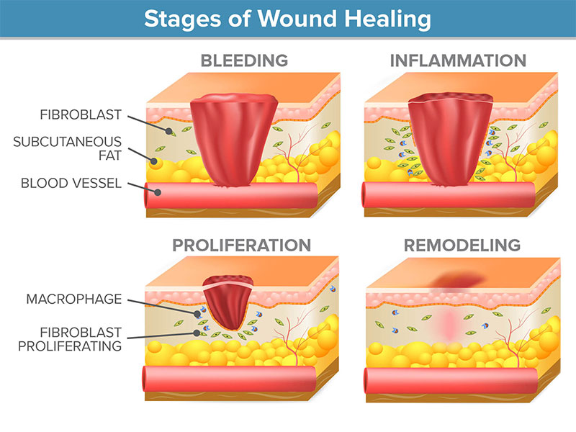
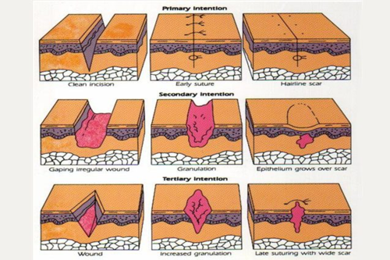
Wound Healing Overview

Slide 4
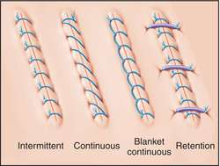
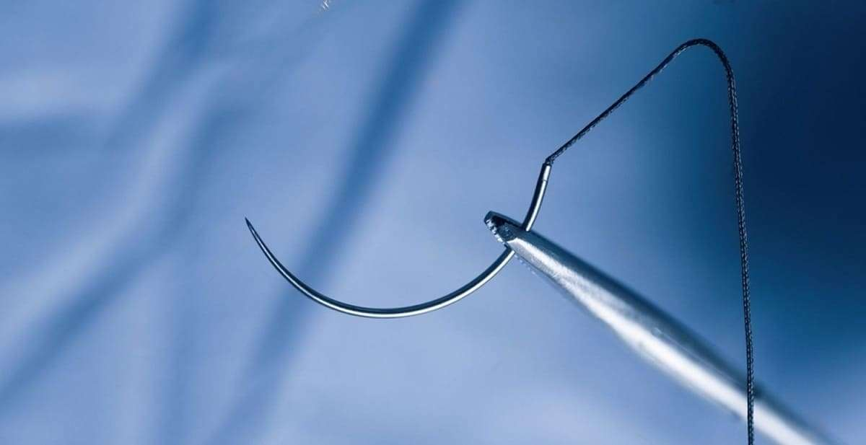
What is a suture (Ligature)? Why are they used?
Running vs. Interrupted
Approximate
Anastomosis
Absorbable vs. Non-Absorbable
Braid vs. Monofilament

Slide 5
Suture Kingdom . . . What should I use?
Suture
Non-Absorbable
Absorbable
Synthetic
Natural
Synthetic
Natural
Braid
Silk (Braid)
Steel
Gut (Twist)
Braid
Mono
Mono
Need Permanent Strength
Abs Too Short
Fast Removal
Wound Support (Tensile Strength)
Absorption

Slide 6
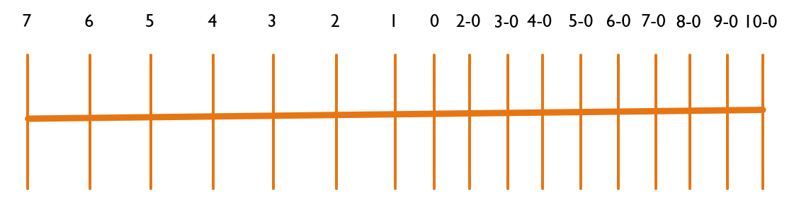
Suture Sizing – USP
Sternum Closure
Fascial Closure
Vascular
ACL – Achilles
Cannulization
Dermal Closure

Slide 7
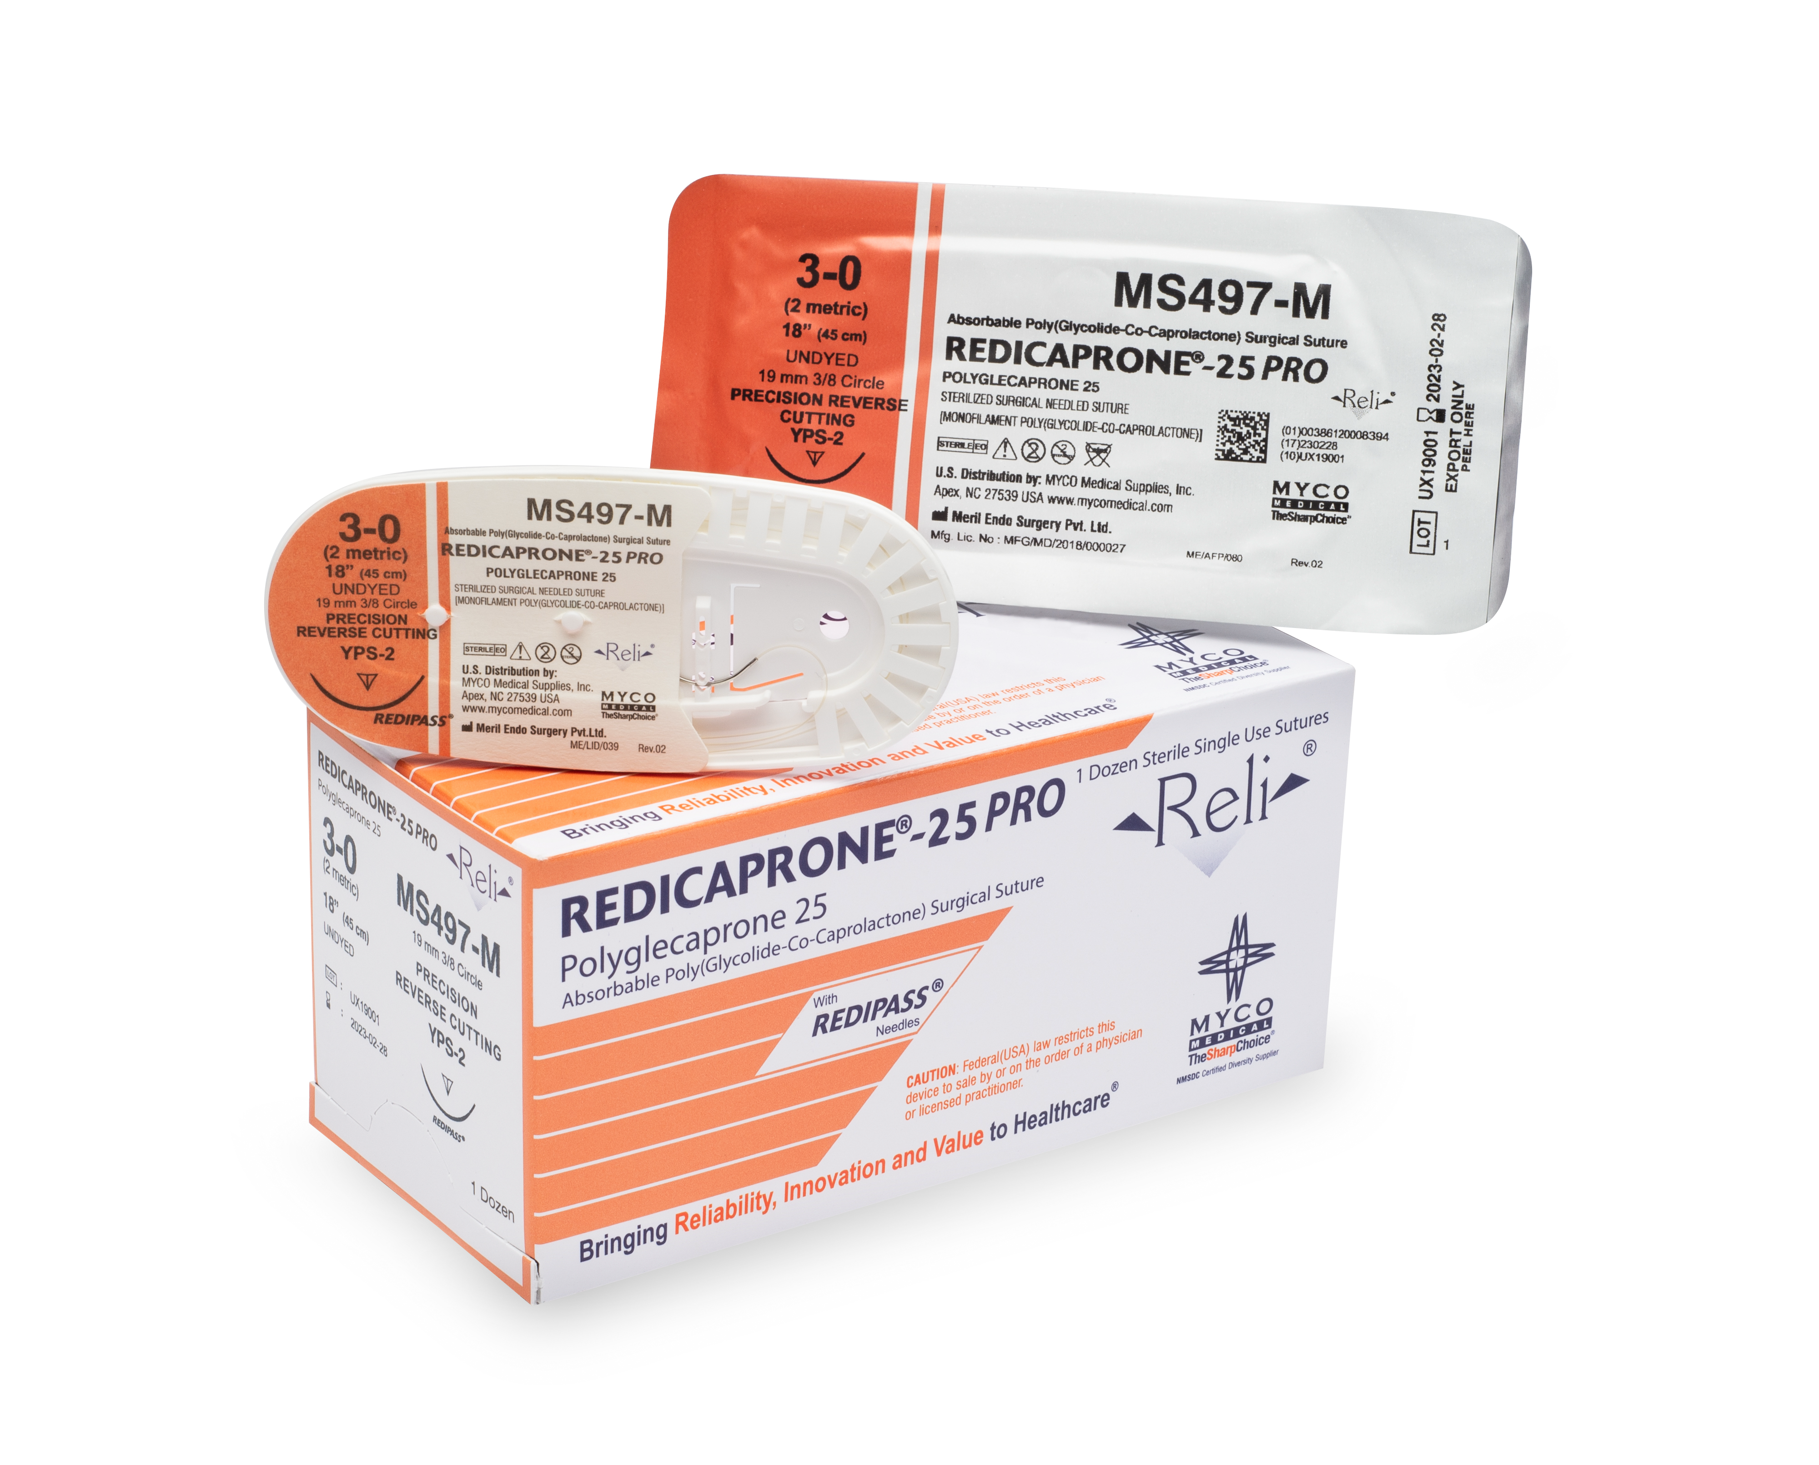
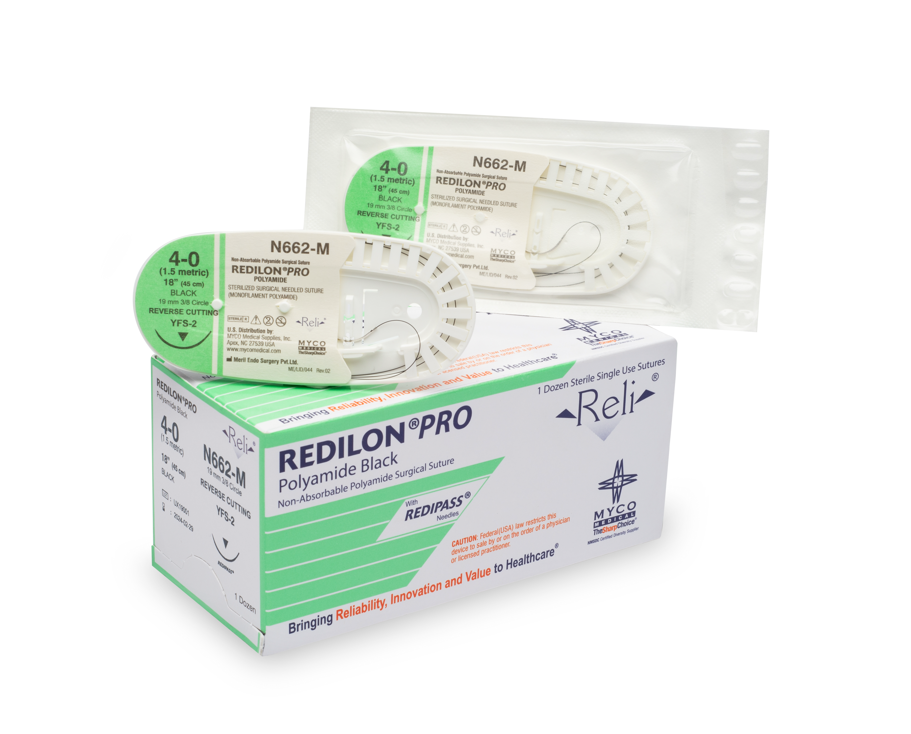
Suture Packaging

Slide 8



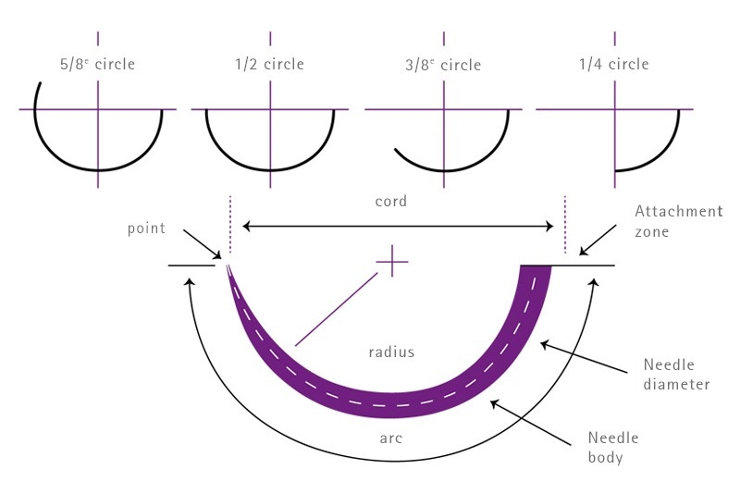
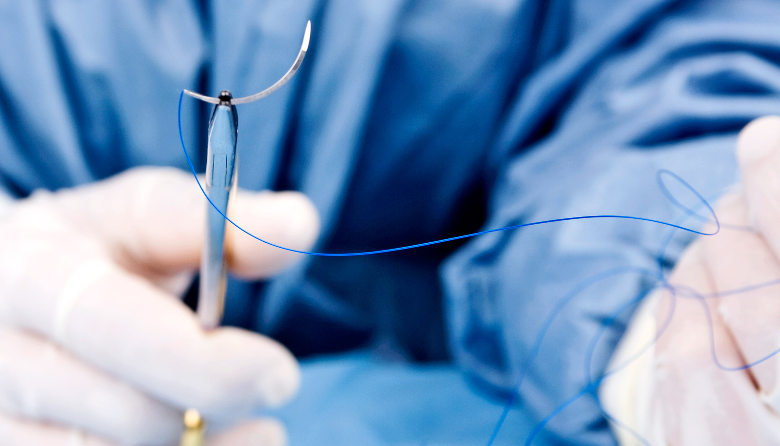
Needles
Needle Length
Needle Geometry
Needle Curvature

Slide 9
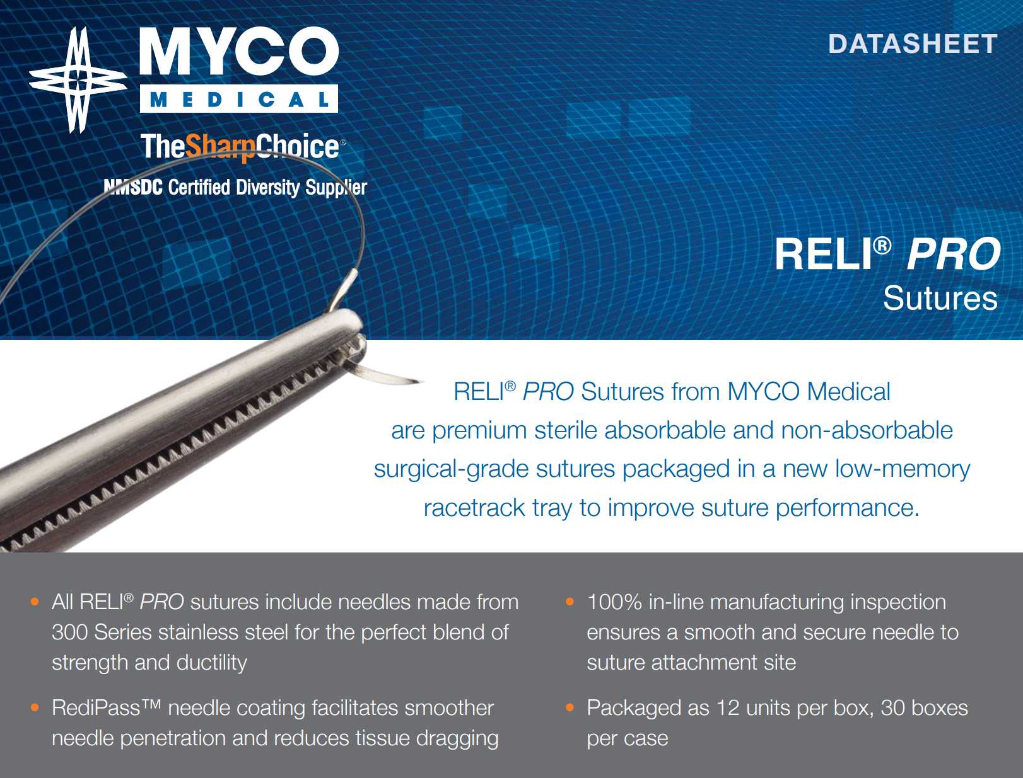
Notes:
-M , previous Reli are –SI and –BRC
Great success
300 series stainless
Quality product

Slide 10
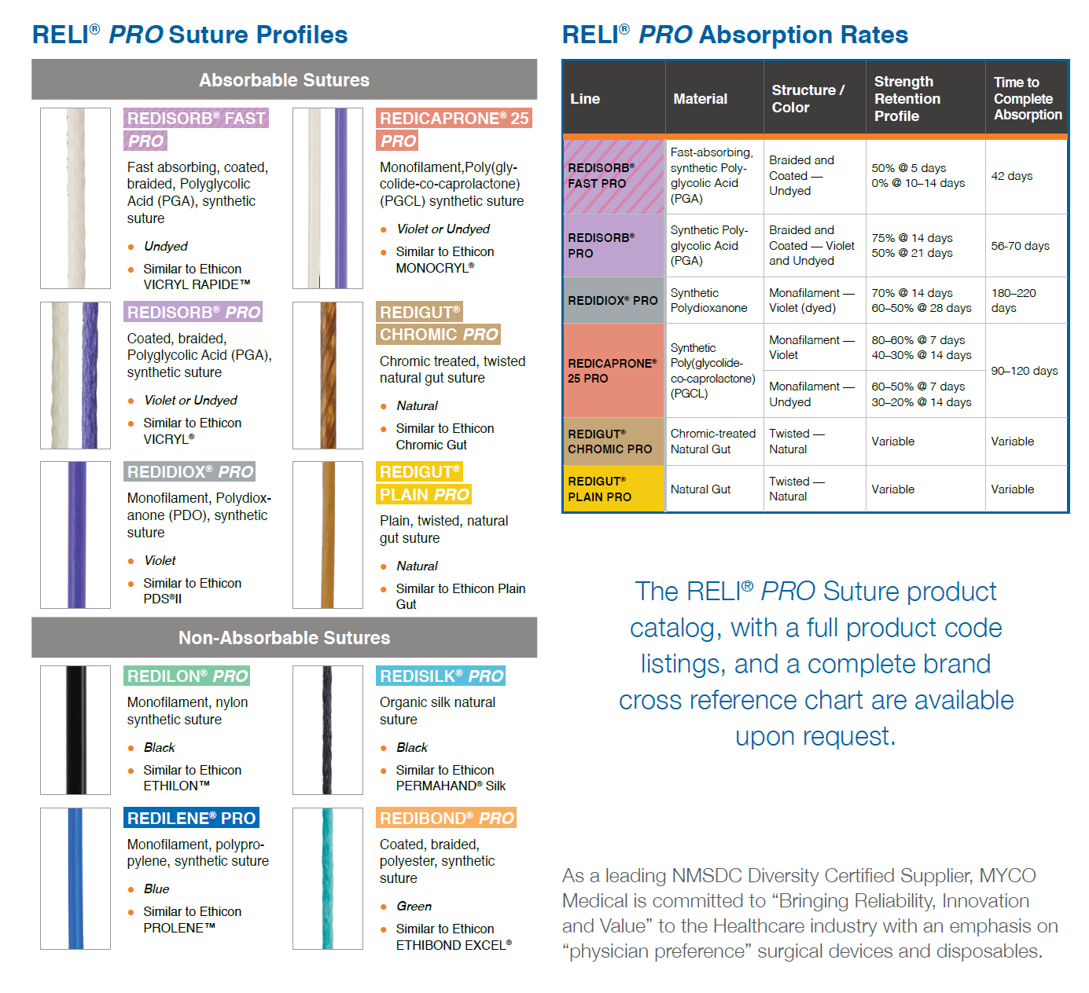
Color Coding
Suture Profiles
Absorption Rates

Slide 11
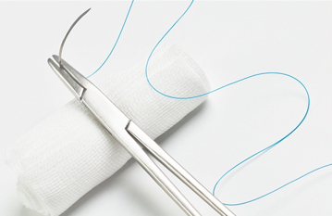
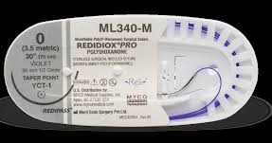
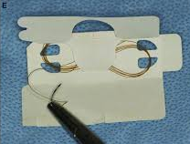
Packaging & Why it Matters!
Memory – the shape of the suture strand once removed from
packaging for use
Racetrack – plastic wheel dispenser tray. Sometimes referred to as a less memory tray or low memory tray (LMT)
Figure 8 –paper packaging with suture wound in a figure 8 pattern which causes more memory & ”notches” in suture

Slide 12
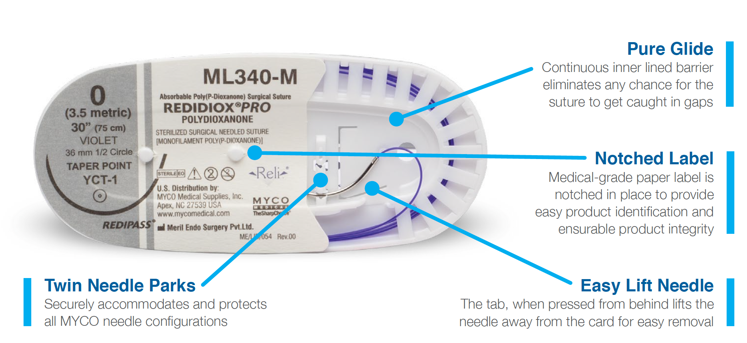
Just like industry leader . . . 85%
Color codification
Racetrack design
Labeling

Slide 13
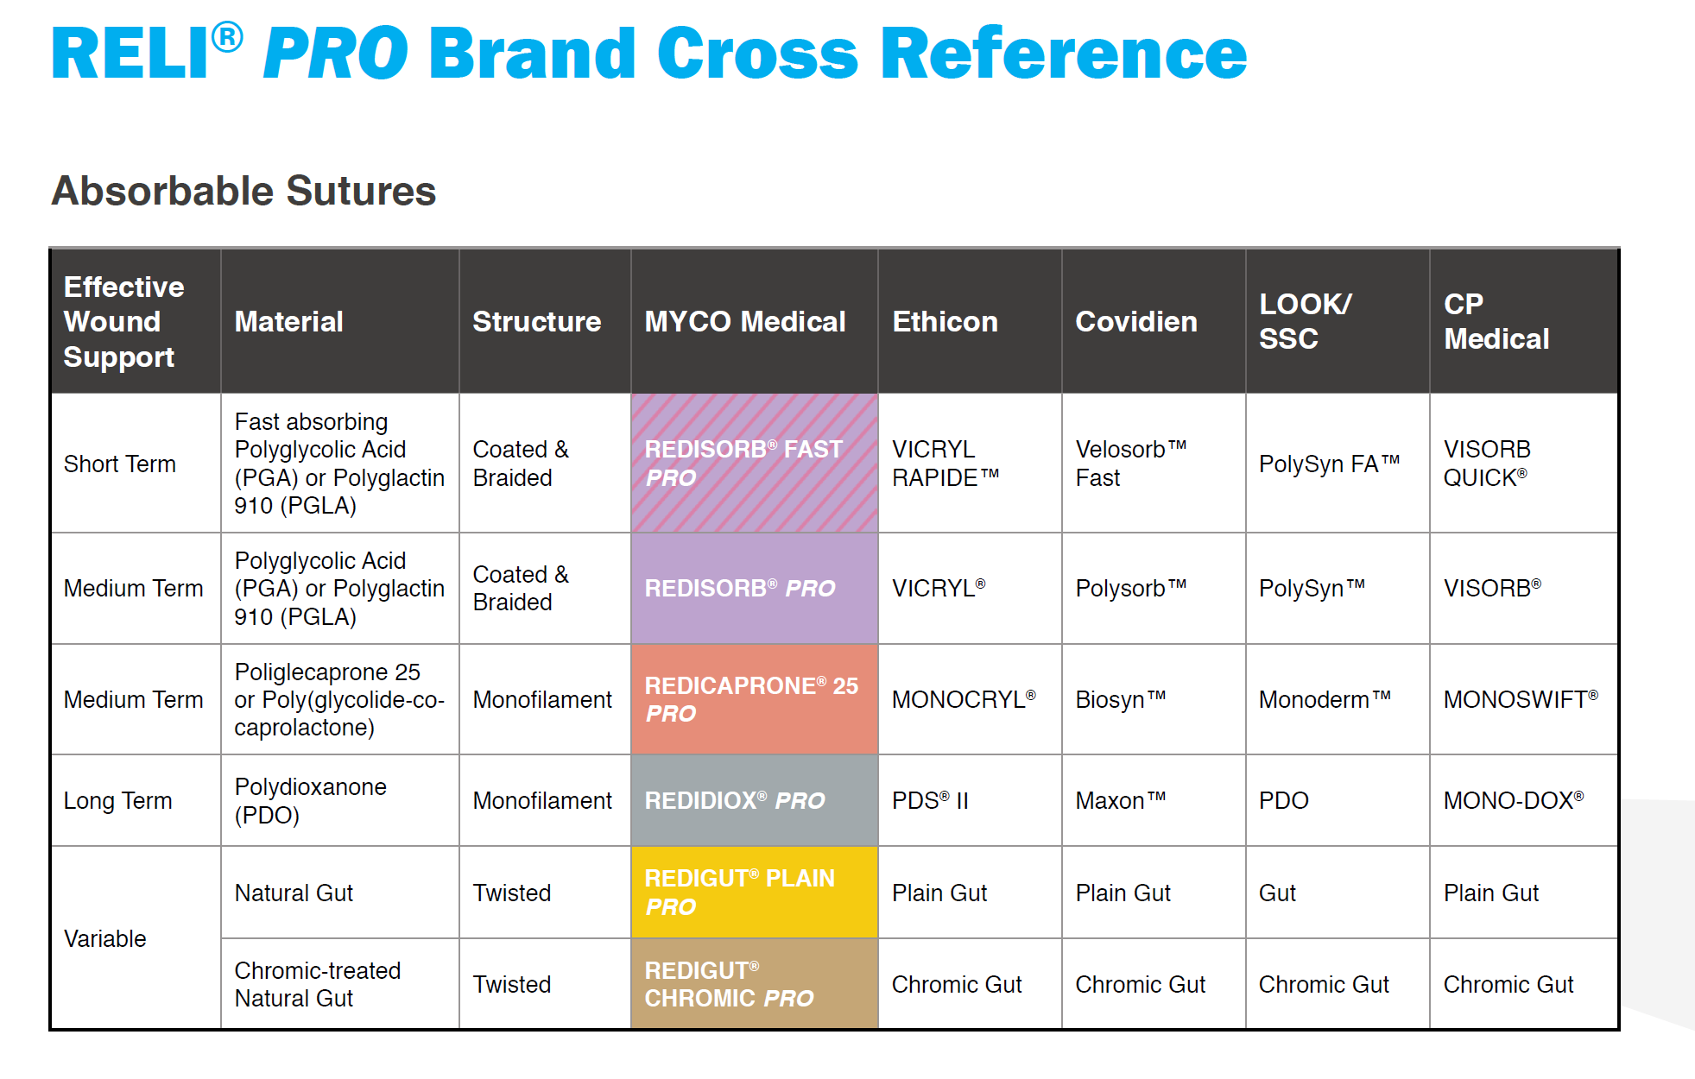

Slide 14
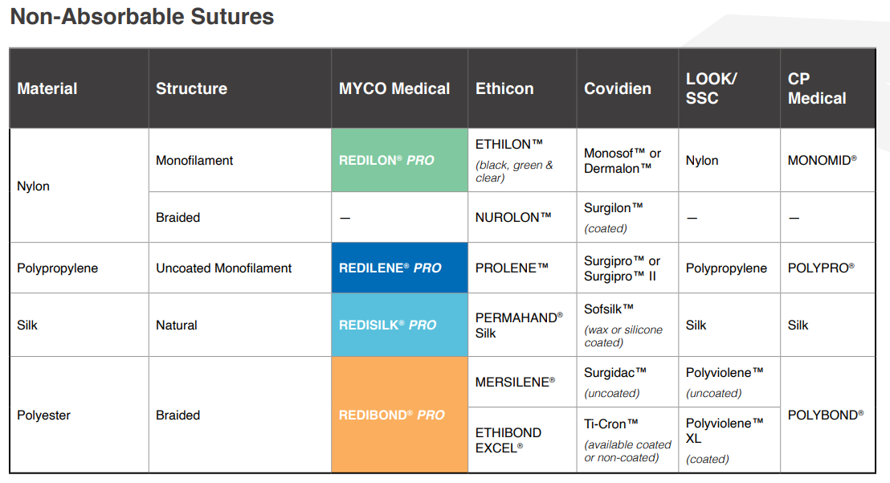

Slide 15
For assistance or samples:
Crosses@mycomedical.com
Samplerequests@mycomedical.com
Kdecker@mycomedical.com

Slide 16
Questions?

Slide 17


