Slide 1
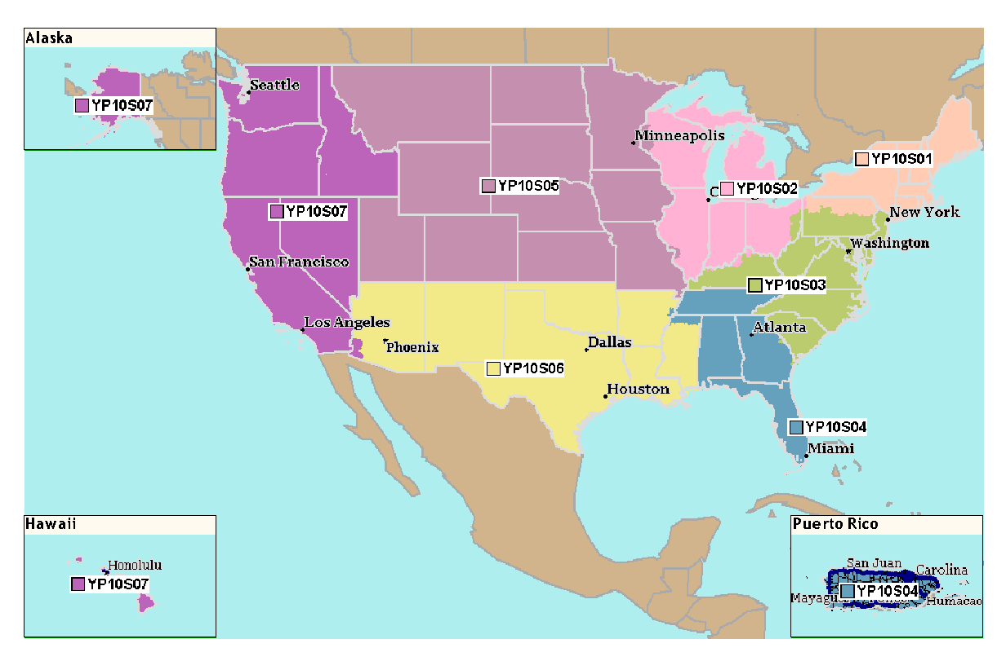
2025 Roche Diagnostics Near Patient Care Inside Sales Territory Map
S01 - Kyle Workman kyle.workman@roche.com
317-625-0295
S02 - OPEN
*Reach out to Victoria Stout (contact info below) and she will assist!
S03- Aubreigh Applegate
aubreigh.applegate@roche.com
463-253-0181
S04 - Madison Smith
madison.smith@roche.com
317-373-6954
S05 - Victoria Stout
victoria.stout@roche.com
317-847-1363
S06 - Erik Dale
Erik.Dale@roche.com
317-361-6719
S07 - Lindsay Ficchi
lindsay.ficchi@roche.com
317-437-2544
Erica Fox - Inside Sales Manager
erica.fox.ef1@roche.com
503-333-4870

