Slide 1
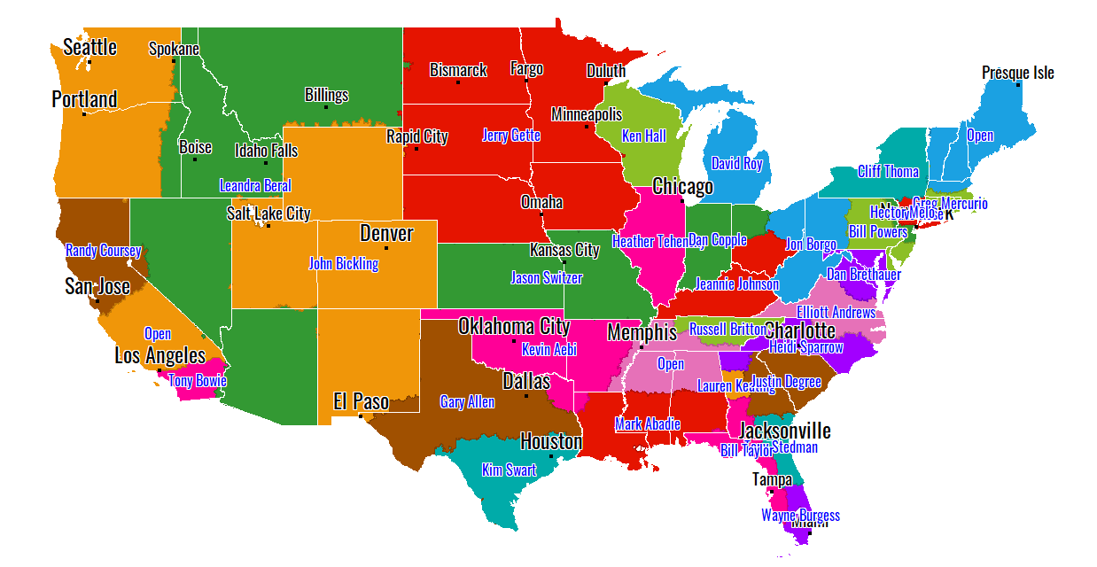
Territories

Slide 2
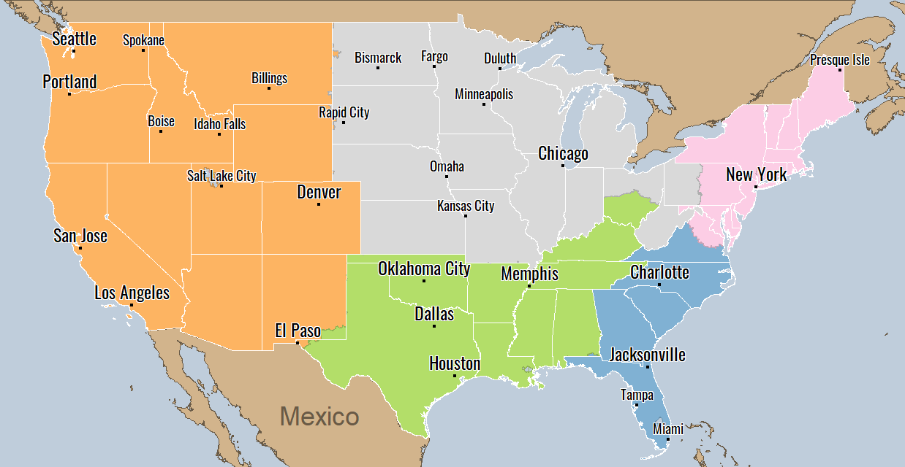
Districts

Slide 3
Mid-South

Slide 4
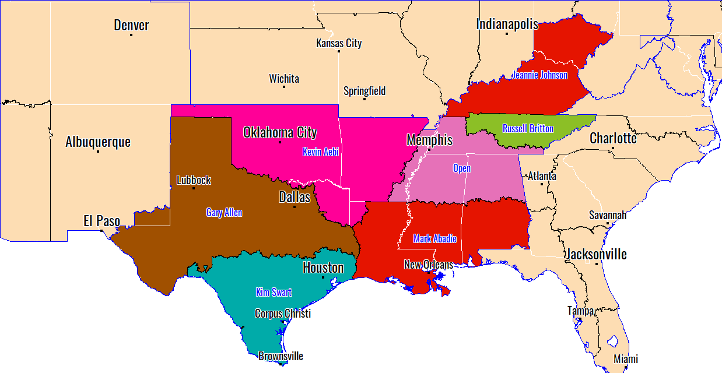
Mid-South

Slide 5
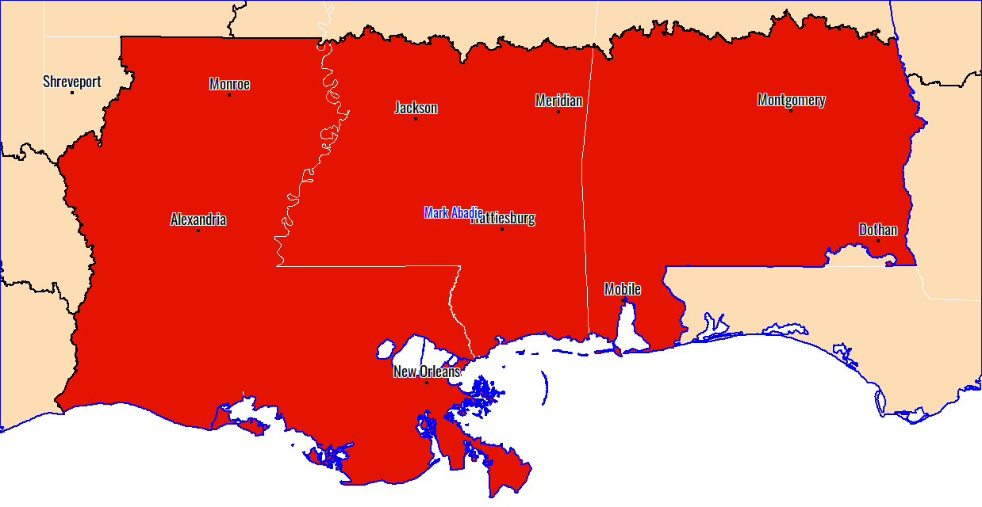
Louisiana and Mississippi

Slide 6
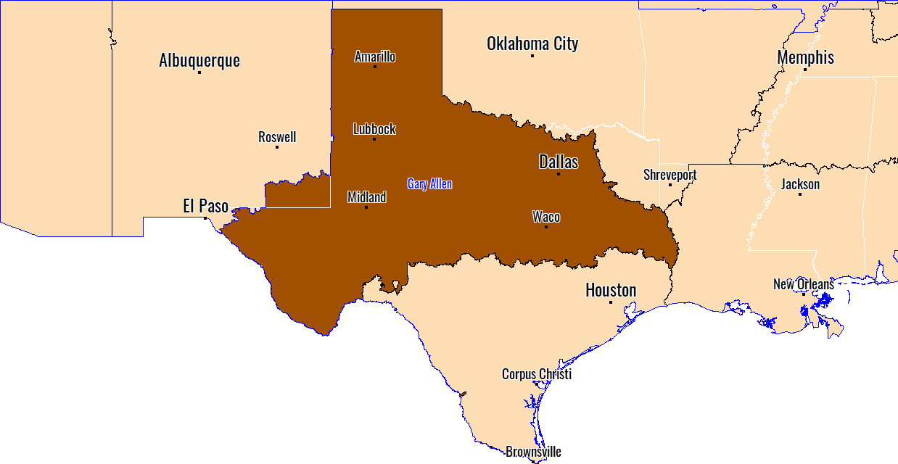
North Texas

Slide 7
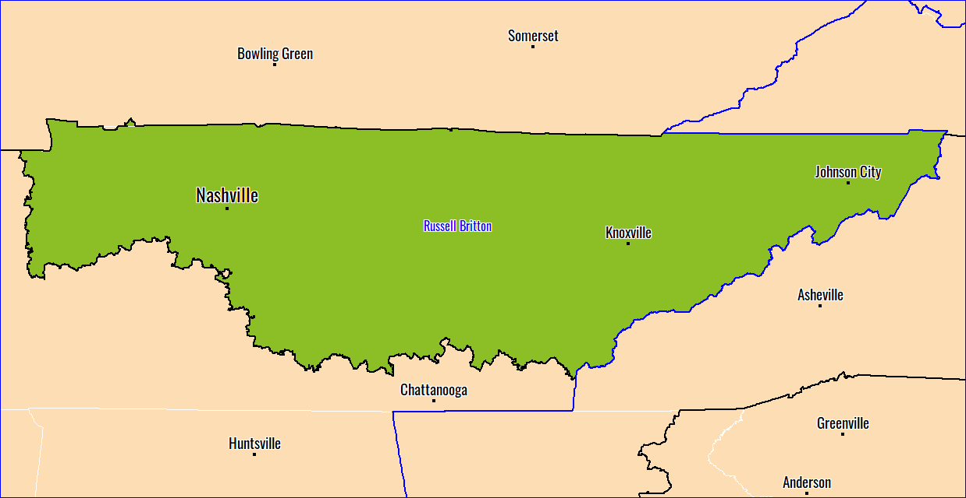
Northern TN

Slide 8
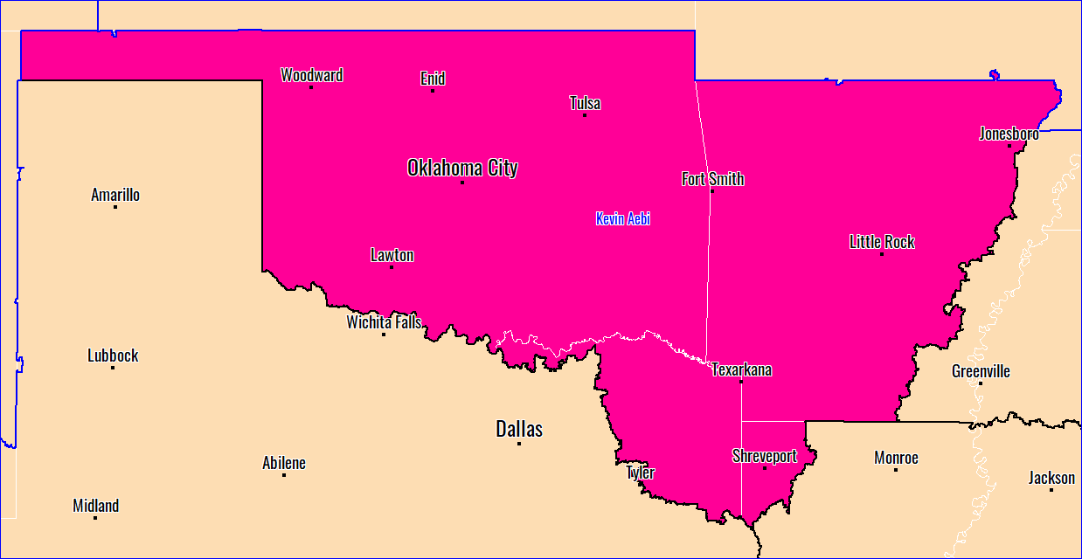
Oklahoma and Arkansas

Slide 9
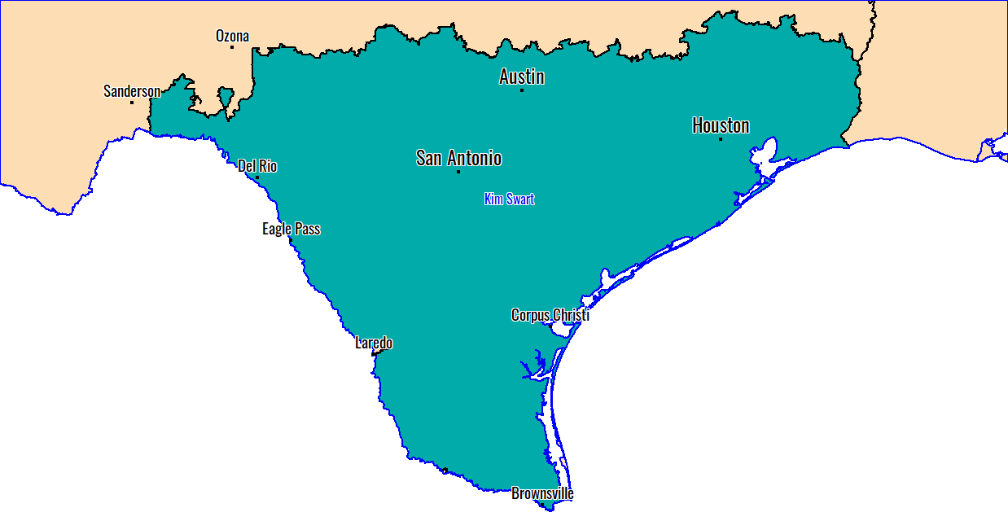
South Texas

Slide 10
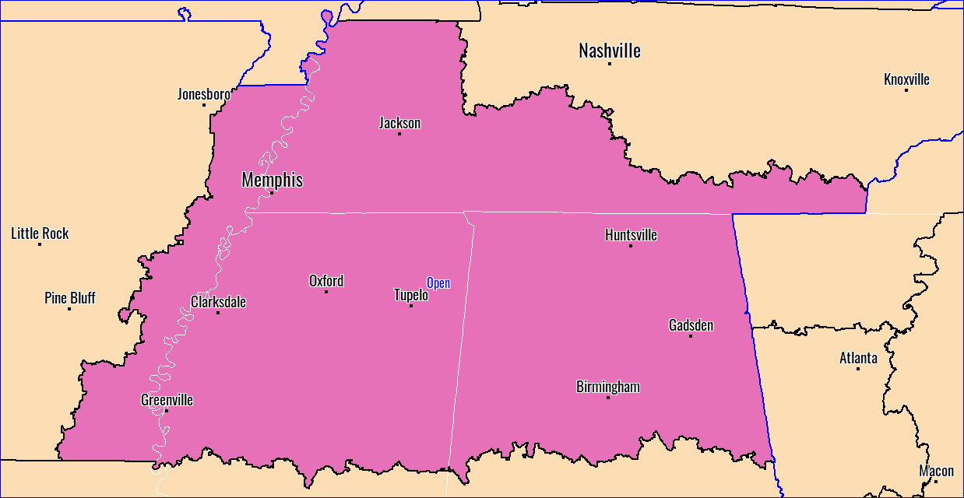
Tennessee

Slide 11
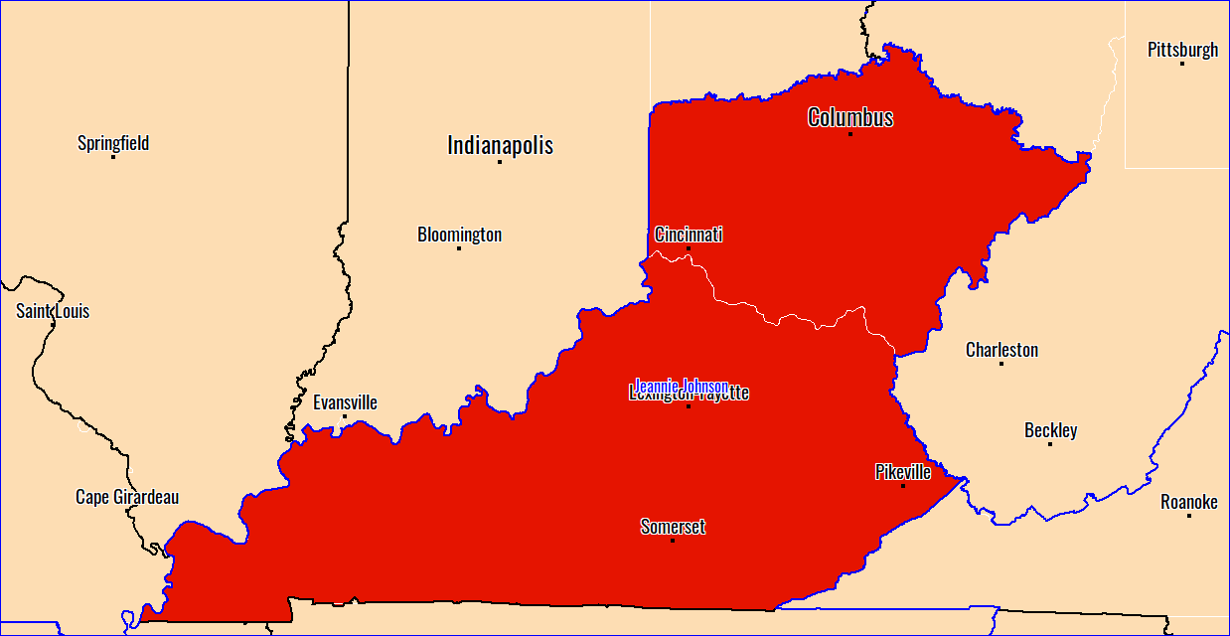
Western Ohio and Kentucky

Slide 12
Midwest

Slide 13
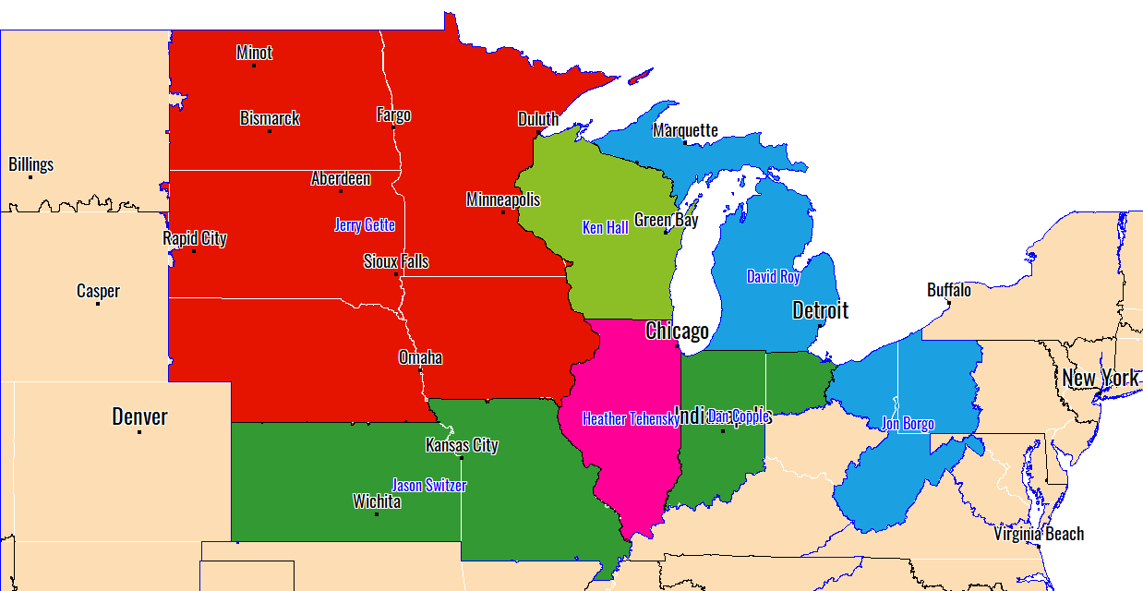
Midwest

Slide 14
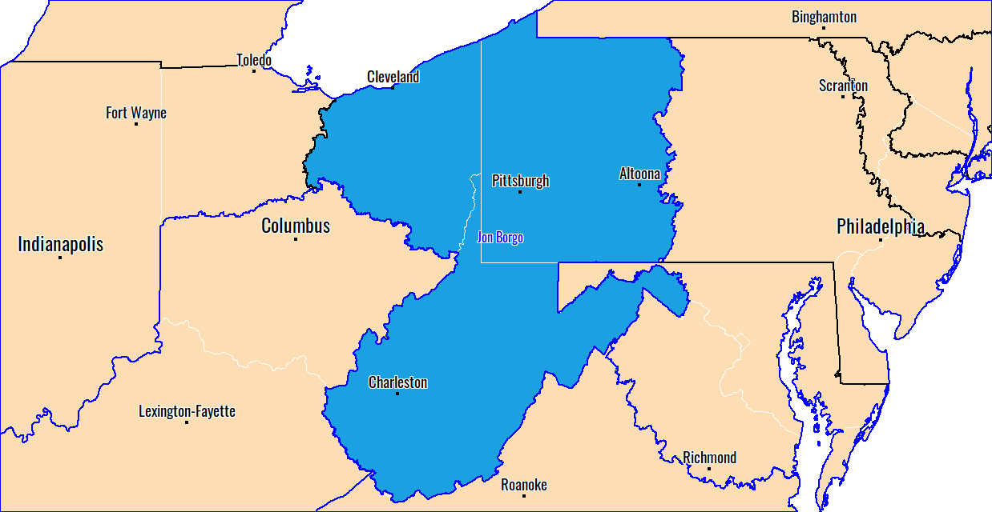
Eastern Ohio, Western PA, West Virginia

Slide 15
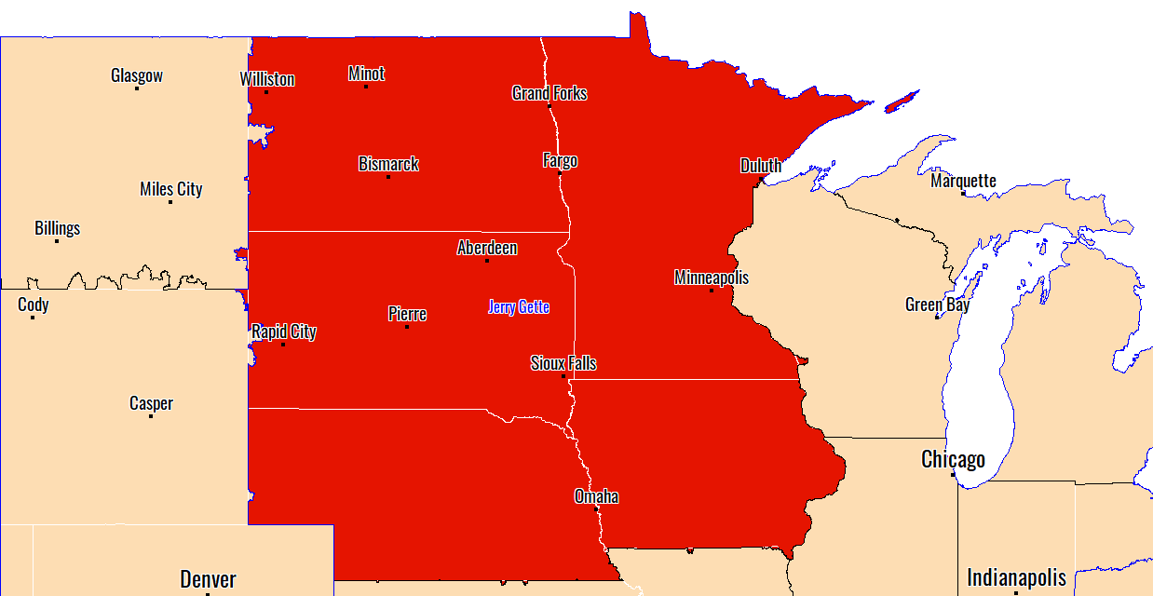
IA, NE, ND, SD, MN

Slide 16
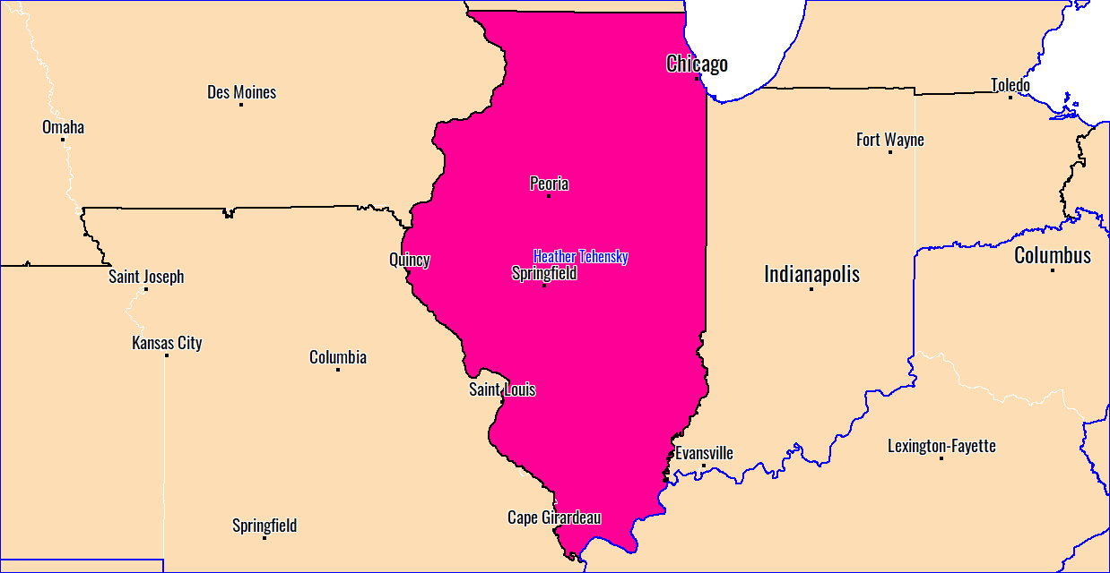
Illinois

Slide 17
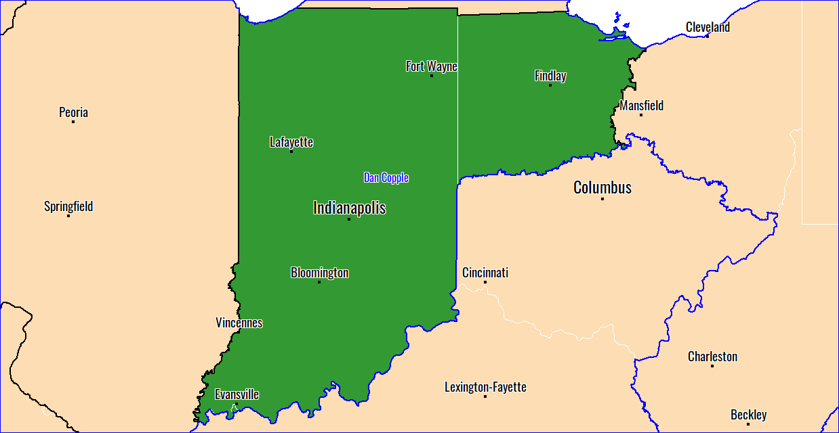
Indiana

Slide 18
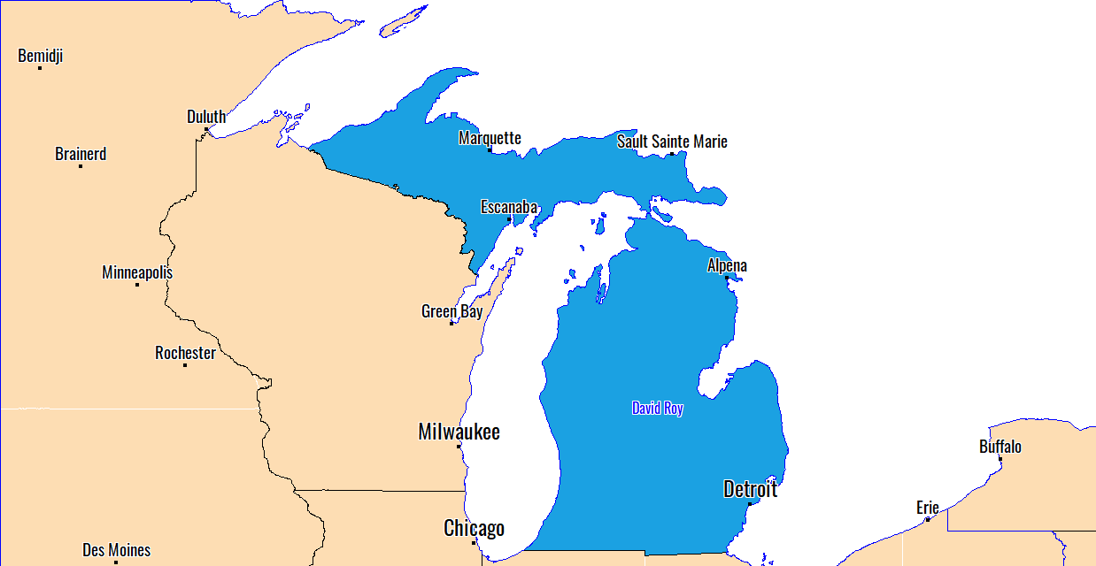
Michigan

Slide 19
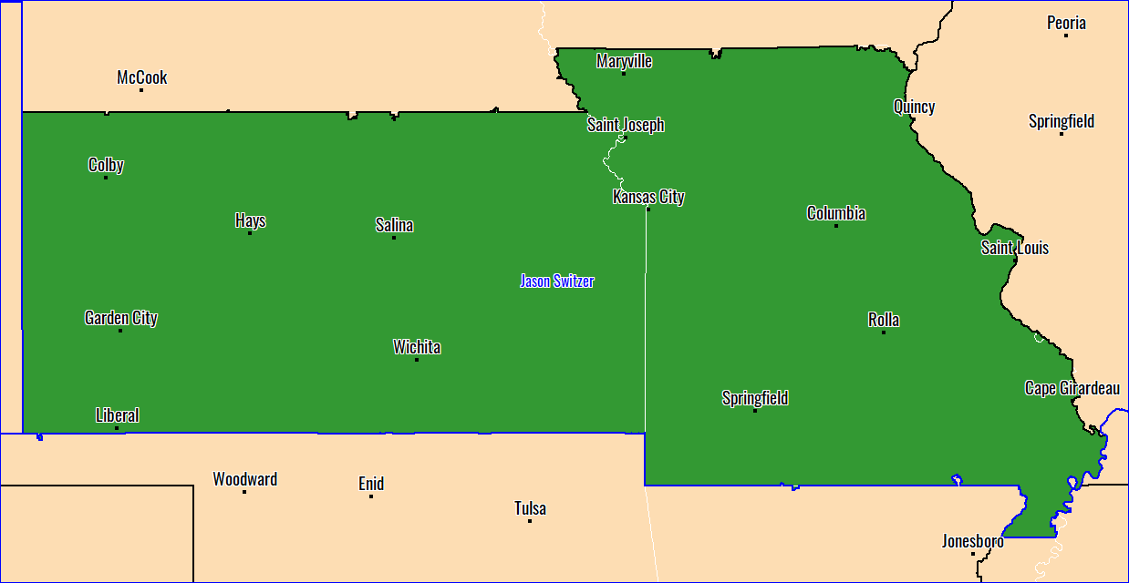
Missouri and Kansas

Slide 20
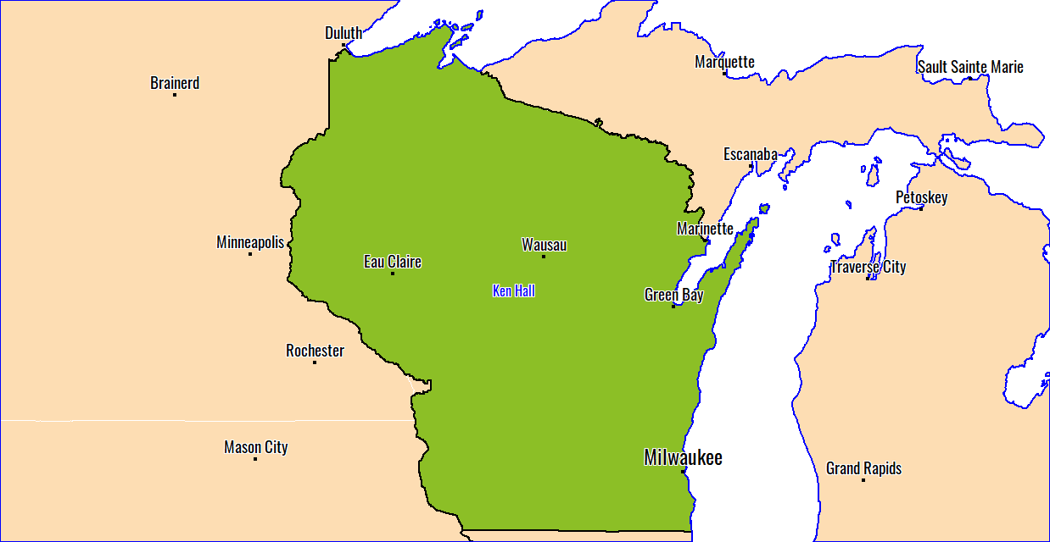
Wisconsin

Slide 21
Northeast

Slide 22
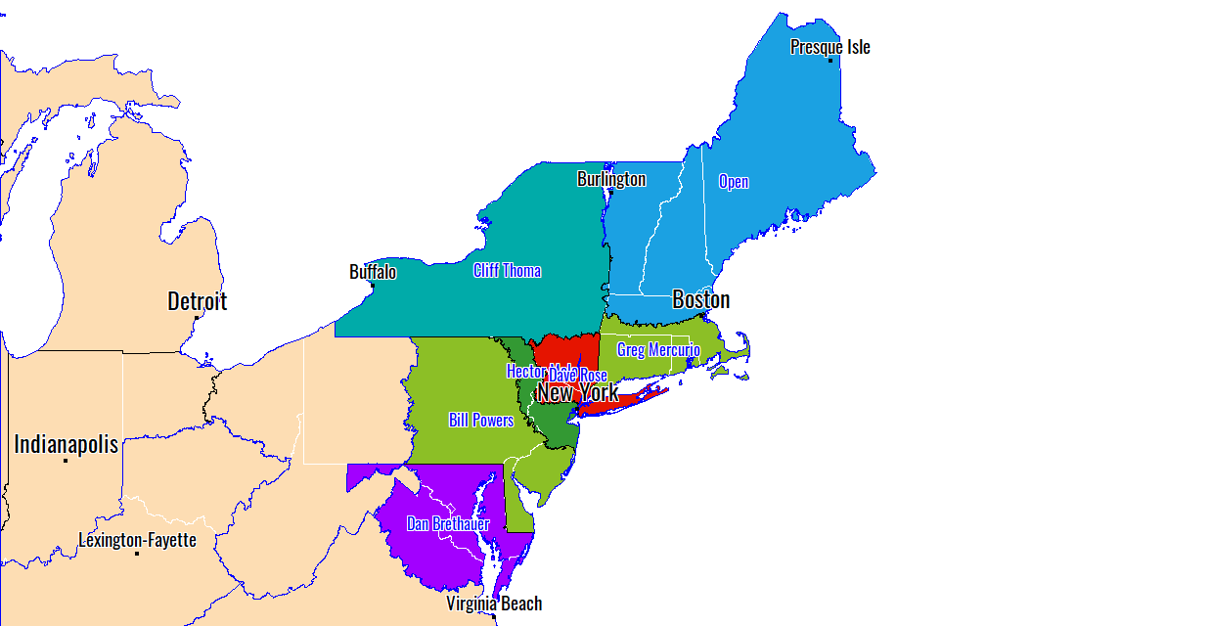
Northeast

Slide 23
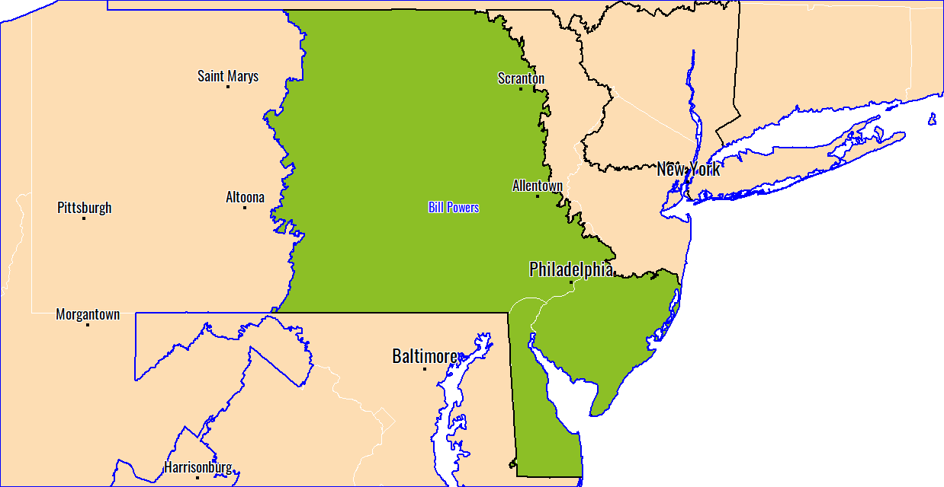
Eastern PA, Delaware, Southern NJ

Slide 24
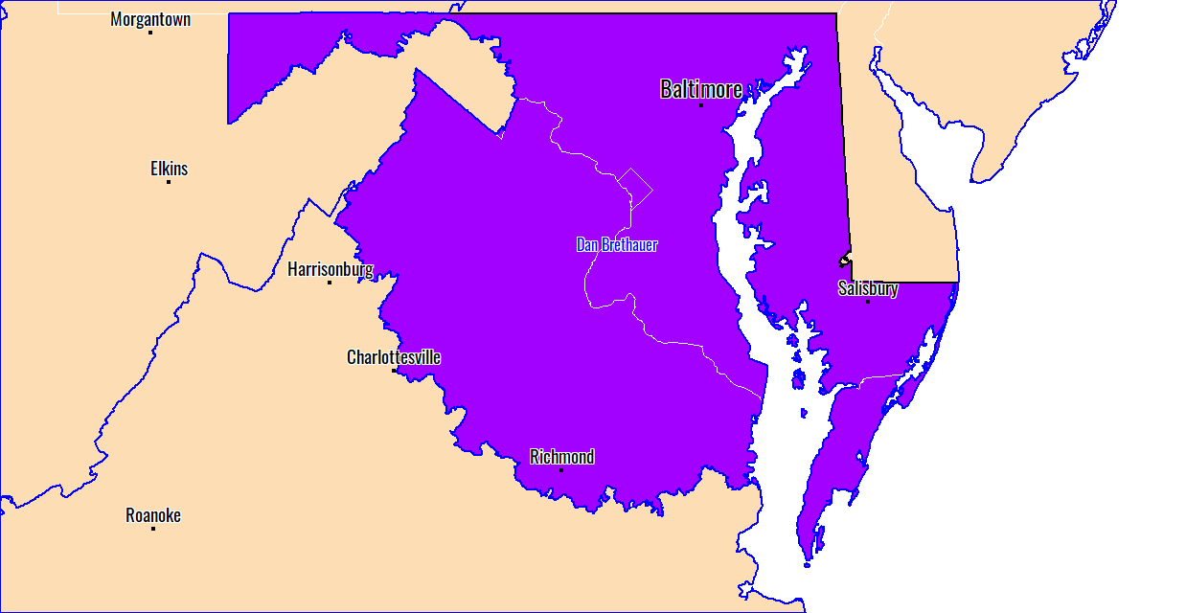
Maryland and Virginia

Slide 25
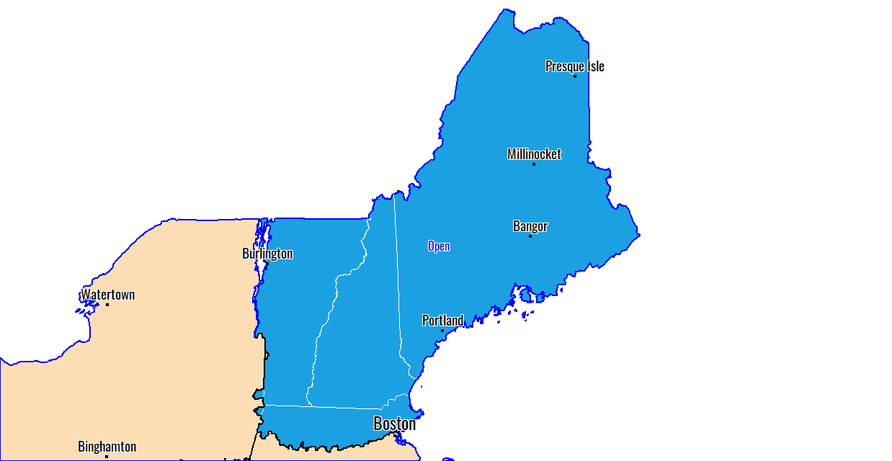
New England

Slide 26
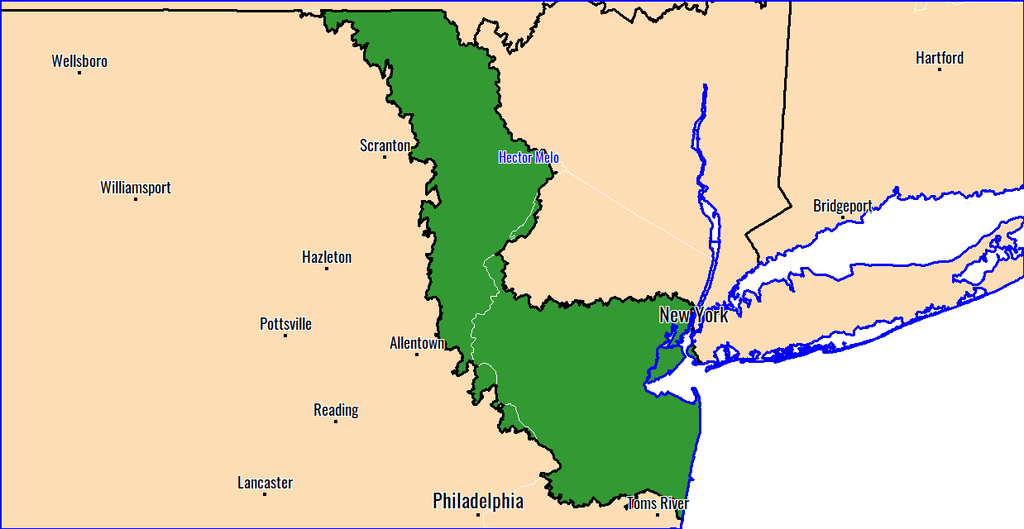
NorthEast PA - Northern NJ

Slide 27
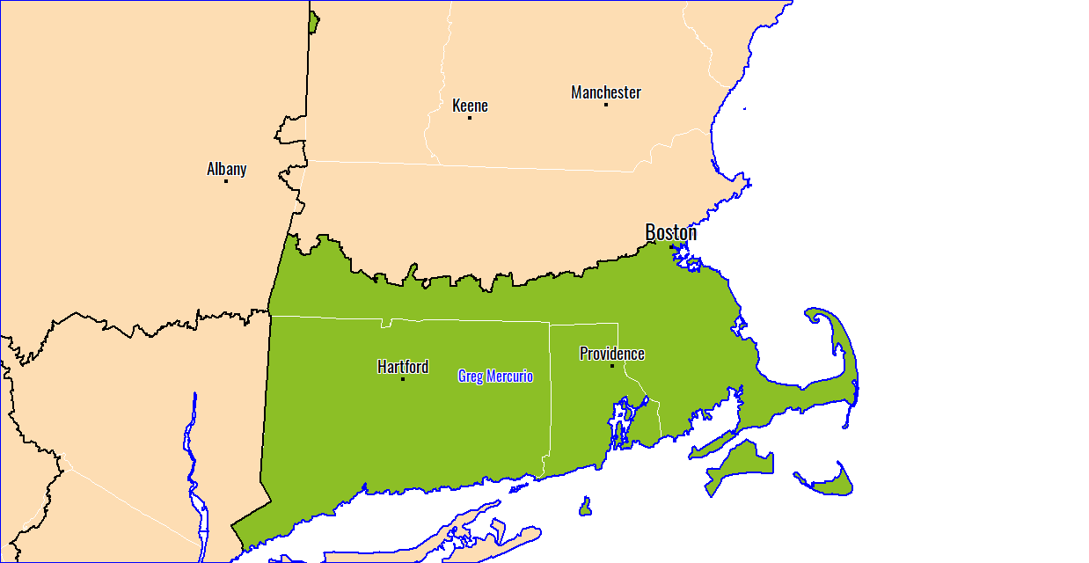
Northeastern States

Slide 28
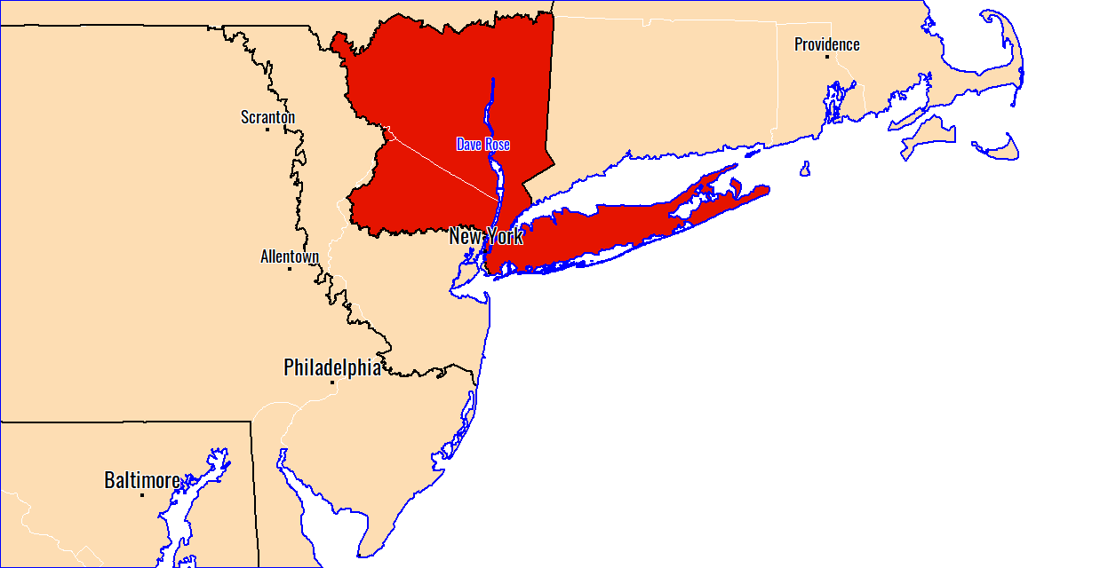
Southern NY, NYC, Northern NJ

Slide 29
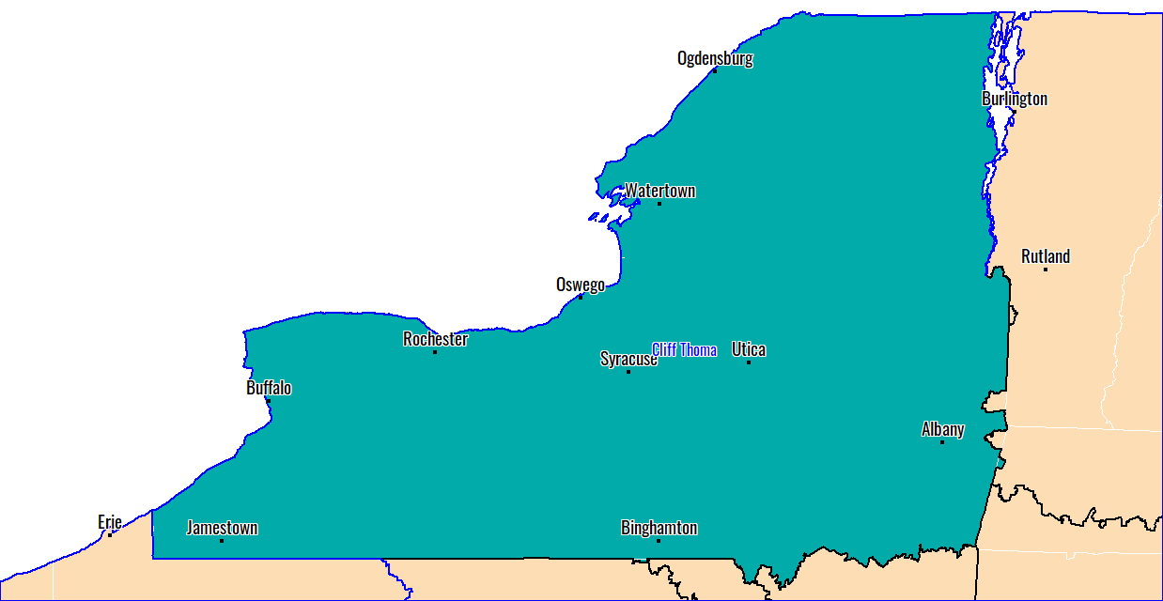
Upstate NY

Slide 30
Southeast

Slide 31
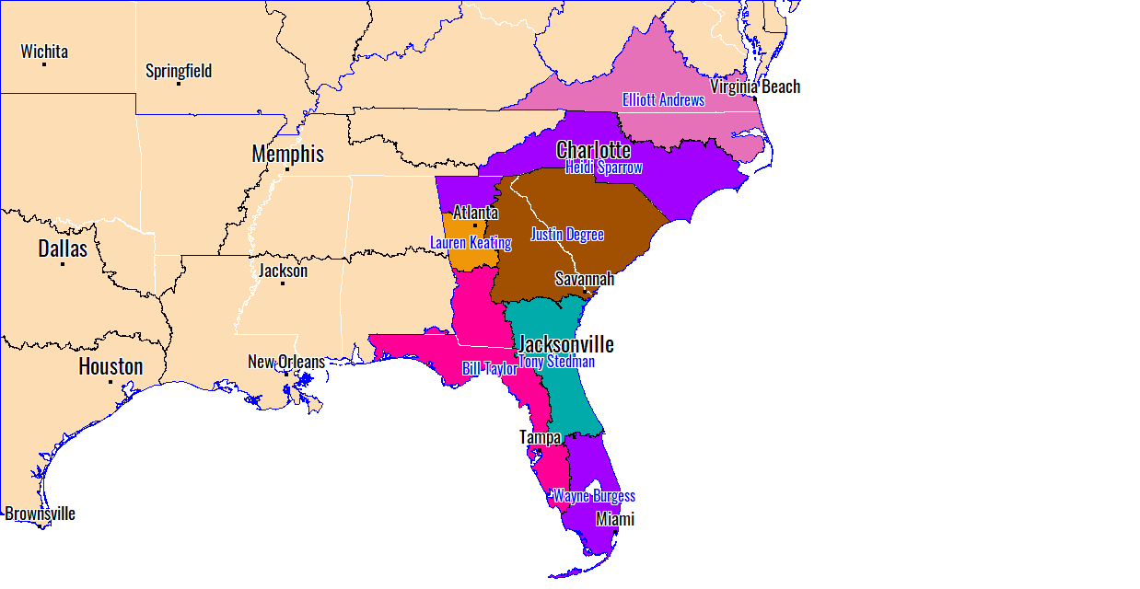
Southeast

Slide 32
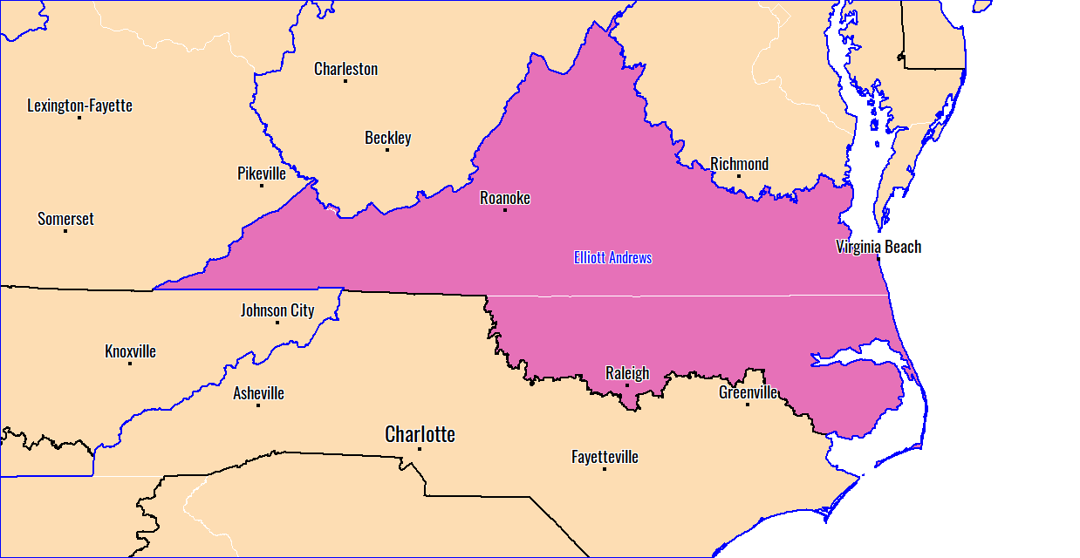
Eastern NC - VA

Slide 33
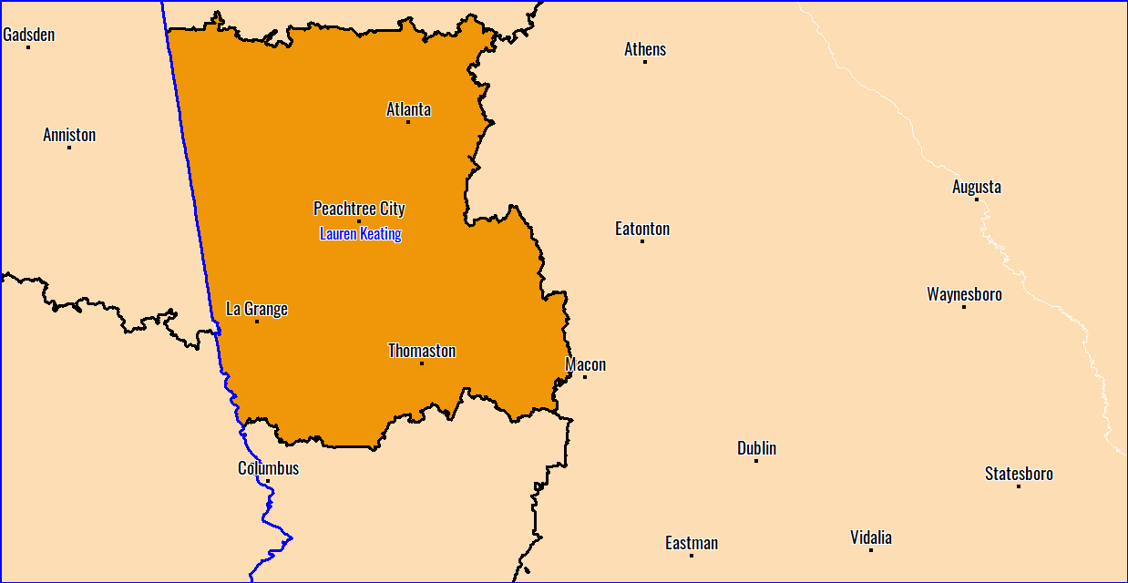
Georgia and Alabama

Slide 34
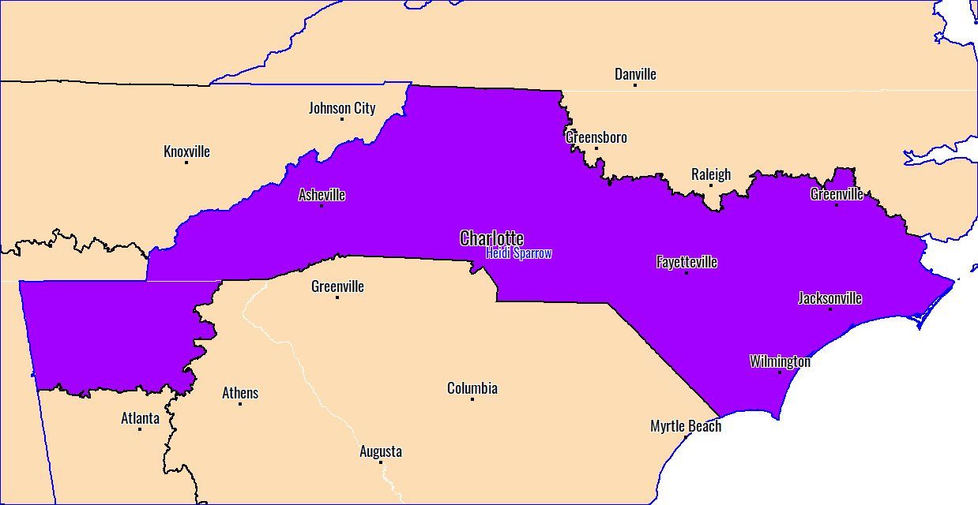
North Carolina

Slide 35
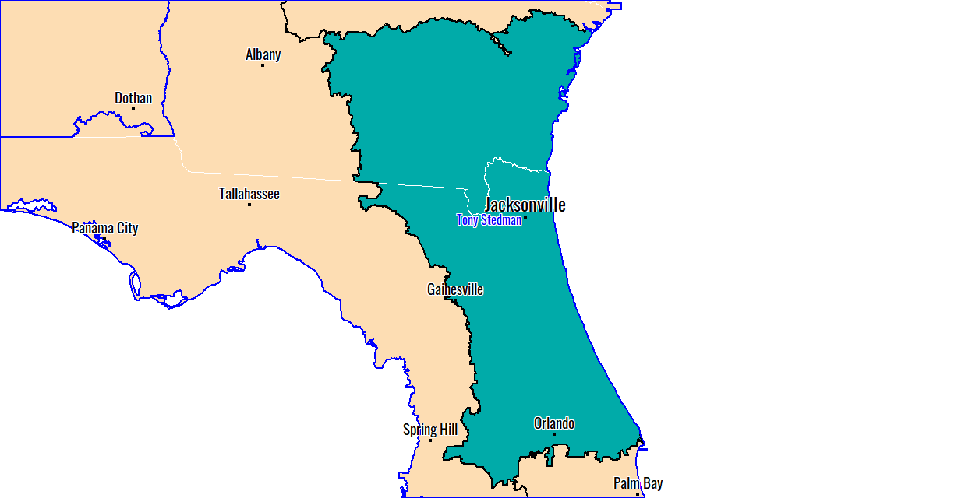
Northern Florida

Slide 36
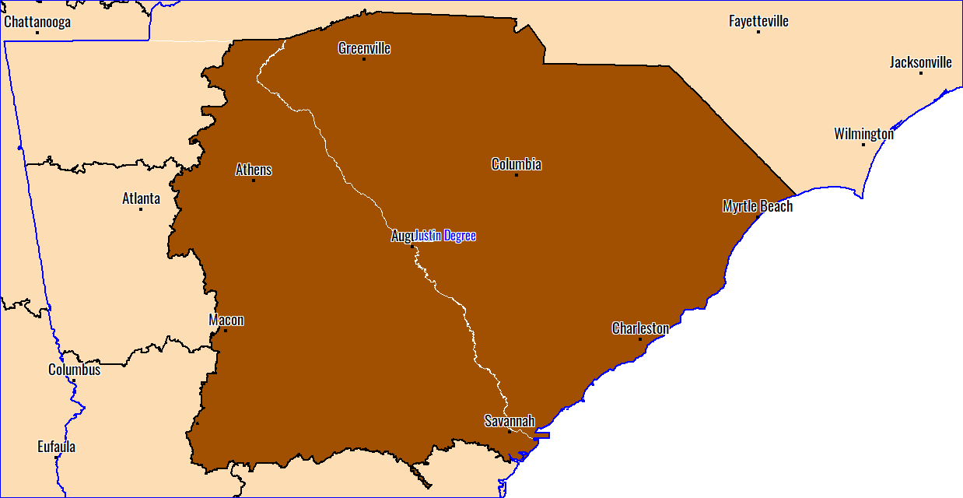
South Carolina

Slide 37
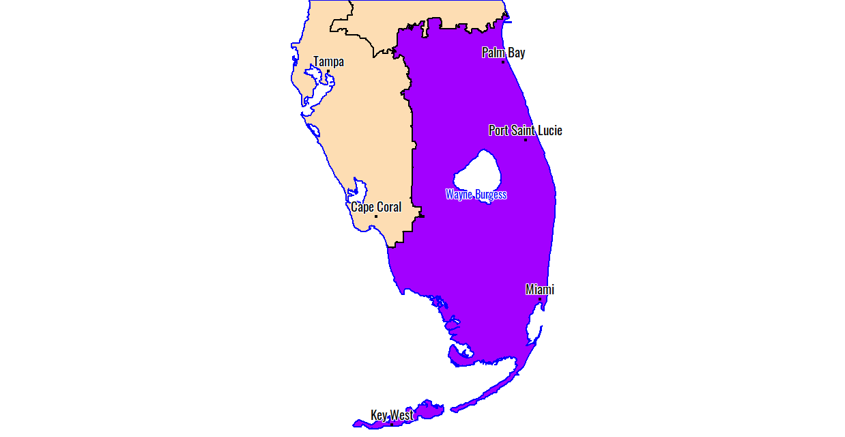
Southern Florida

Slide 38
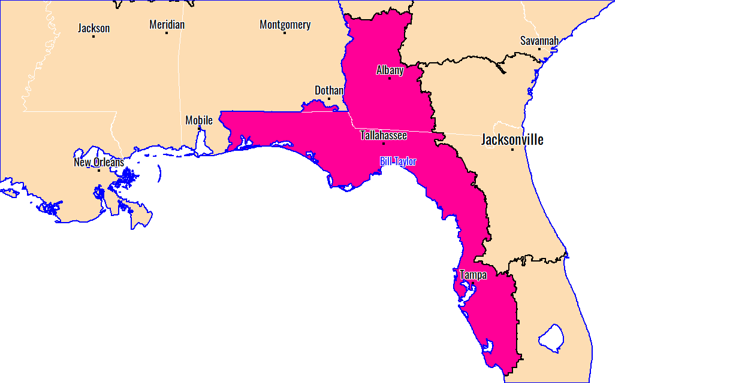
West Florida - Gulf Coast

Slide 39
West

Slide 40
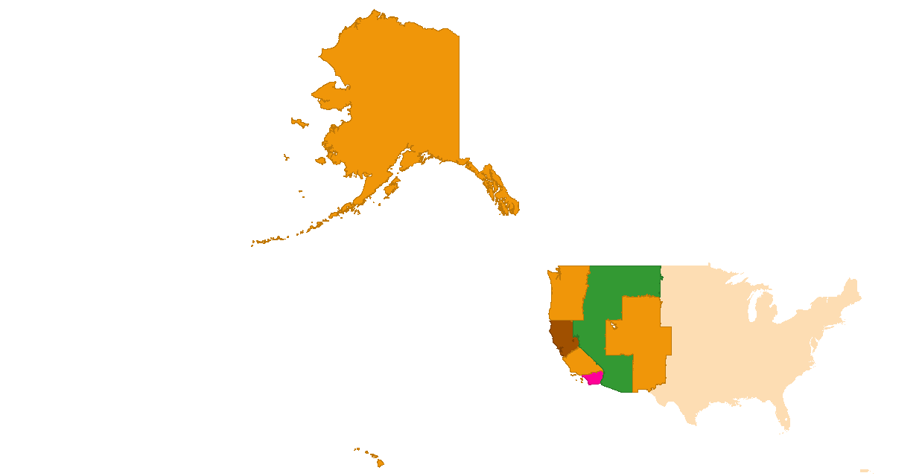
West

Slide 41
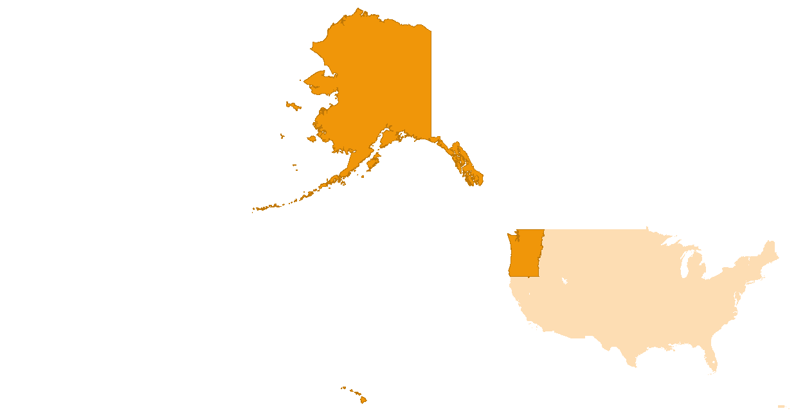
AK, HI, OR, SoCal, WA, N.ID

Slide 42
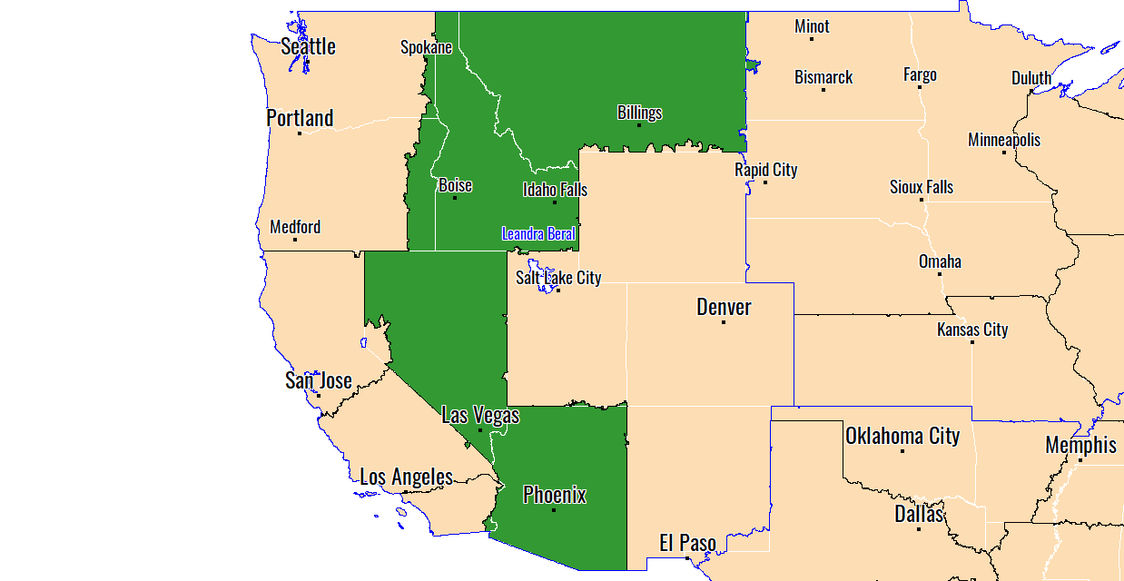
Boise, ID - Phoenix, AZ

Slide 43
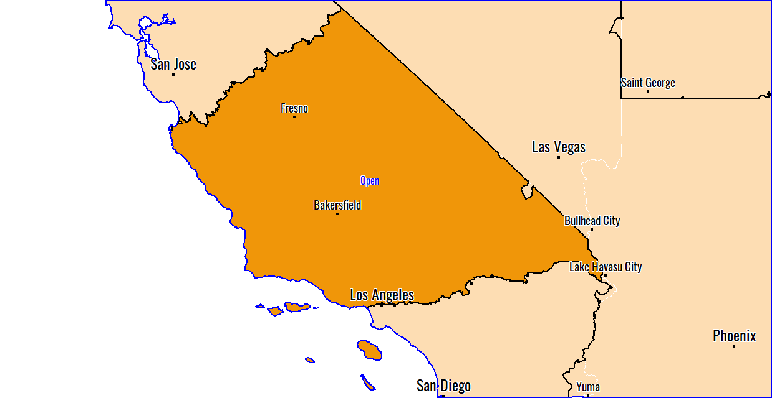
Central California

Slide 44
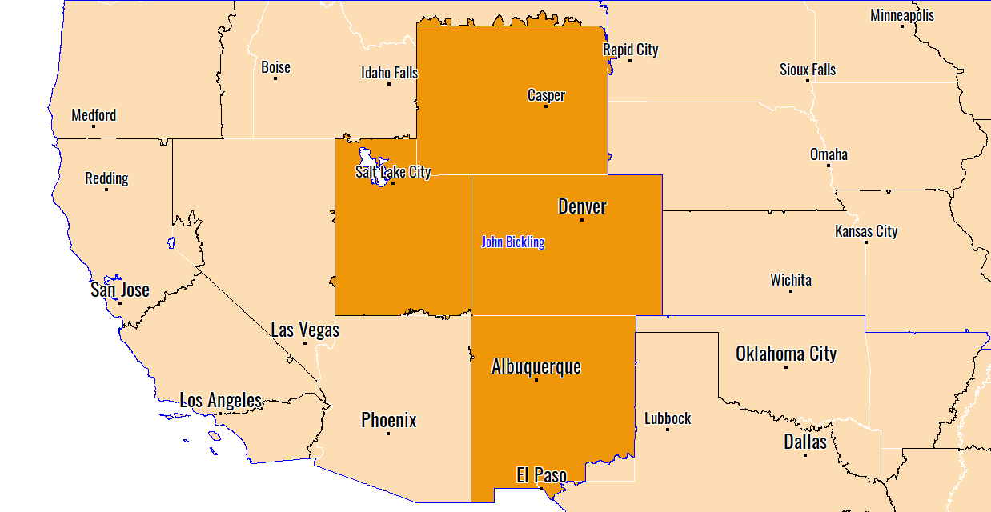
Idaho, Utah, Colorado, Wyoming & Montana

Slide 45
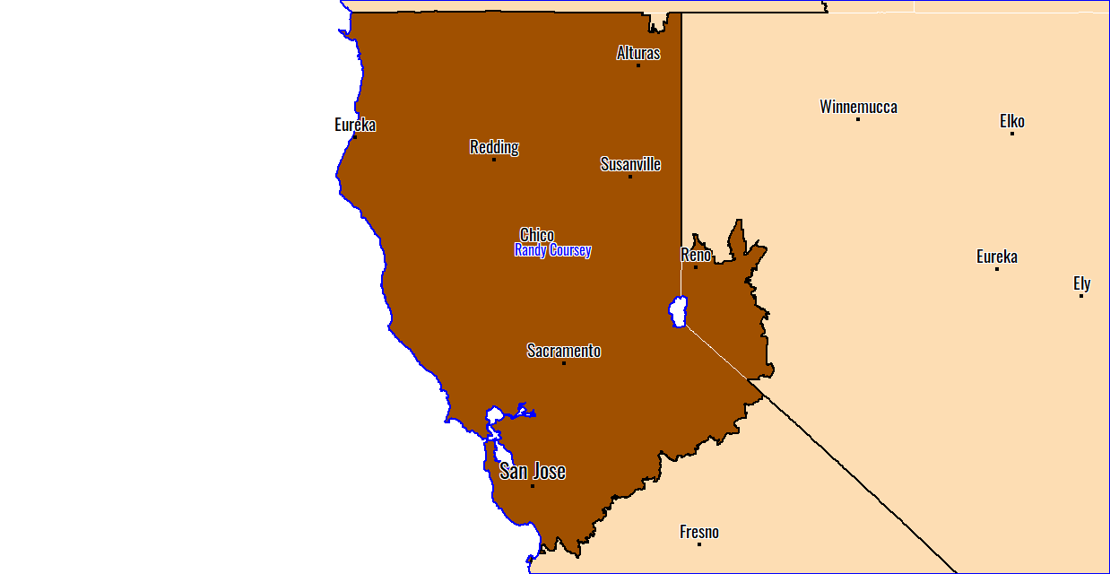
Northern California, Northern Nevada

Slide 46
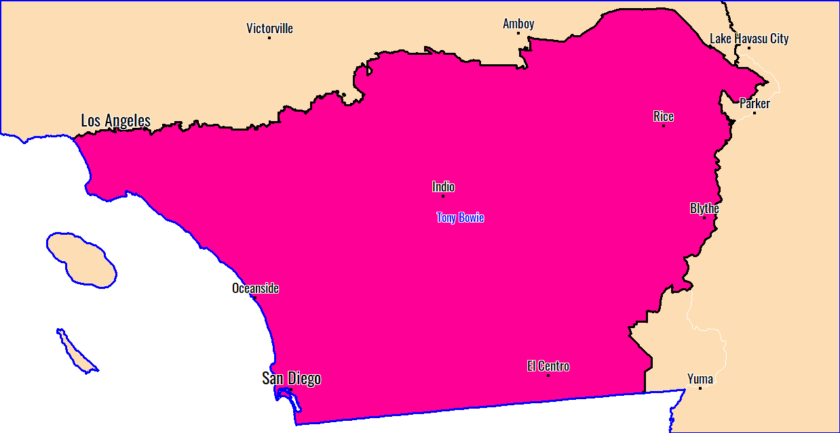
Southern California

