Slide 1


PREFERED VENDOR
4.25.2024
Karen Decker – Sales Operations Manager

Slide 2

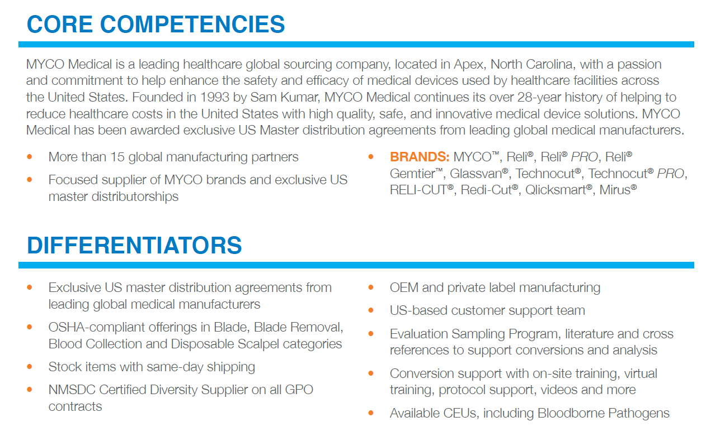

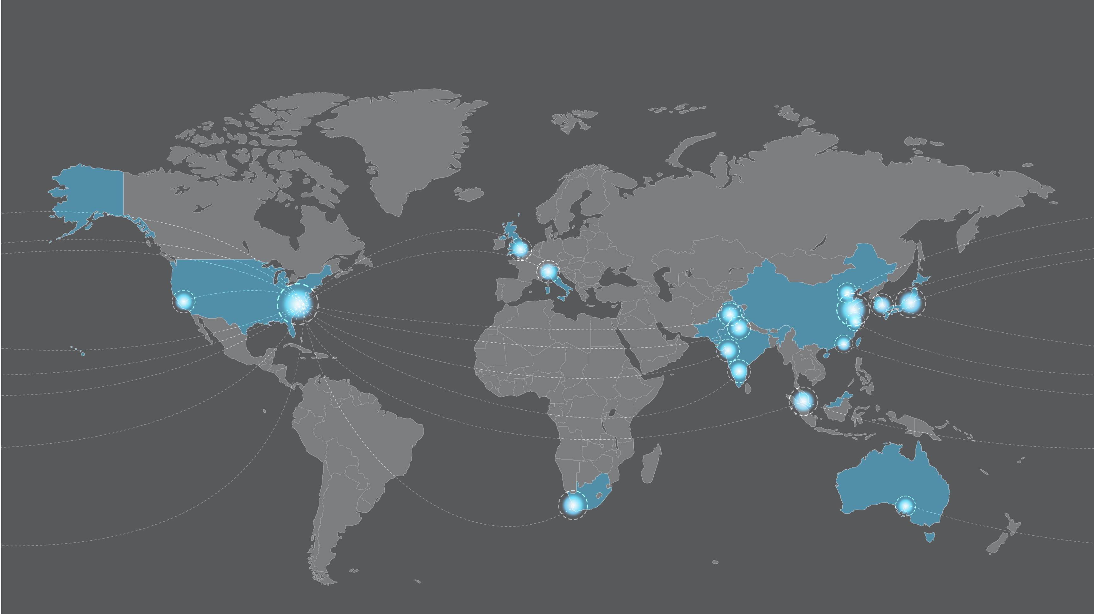
Company Overview
Sam Kumar
Founder & CEO
Founded in 1993
15 global manufacturing partners in nine countries

Slide 3


Reducing our nation’s healthcare costs with high quality, safe and innovative solutions…
MYCO plays a vital role in reducing our nation’s healthcare costs while ensuring that our families, friends, co-workers, and communities have access to high-quality affordable healthcare both now and in the future. When there is a crisis in healthcare every member of the MYCO team finds a way to help pull our customers and communities through difficult times.
MYCO’s team of professionals always provides exceptional customer experiences by responding with compassion, trust, and reliability in every transaction. The entire MYCO team values clinical feedback from our customers and clinicians to ensure that we bring high quality, safe and innovative solutions to all patients regardless of their care setting.
We recognize and affirm that all employees add value and a unique perspective that shape our organizational successes. We are excellent at what we do and proud of our positive impact to healthcare.

Slide 4
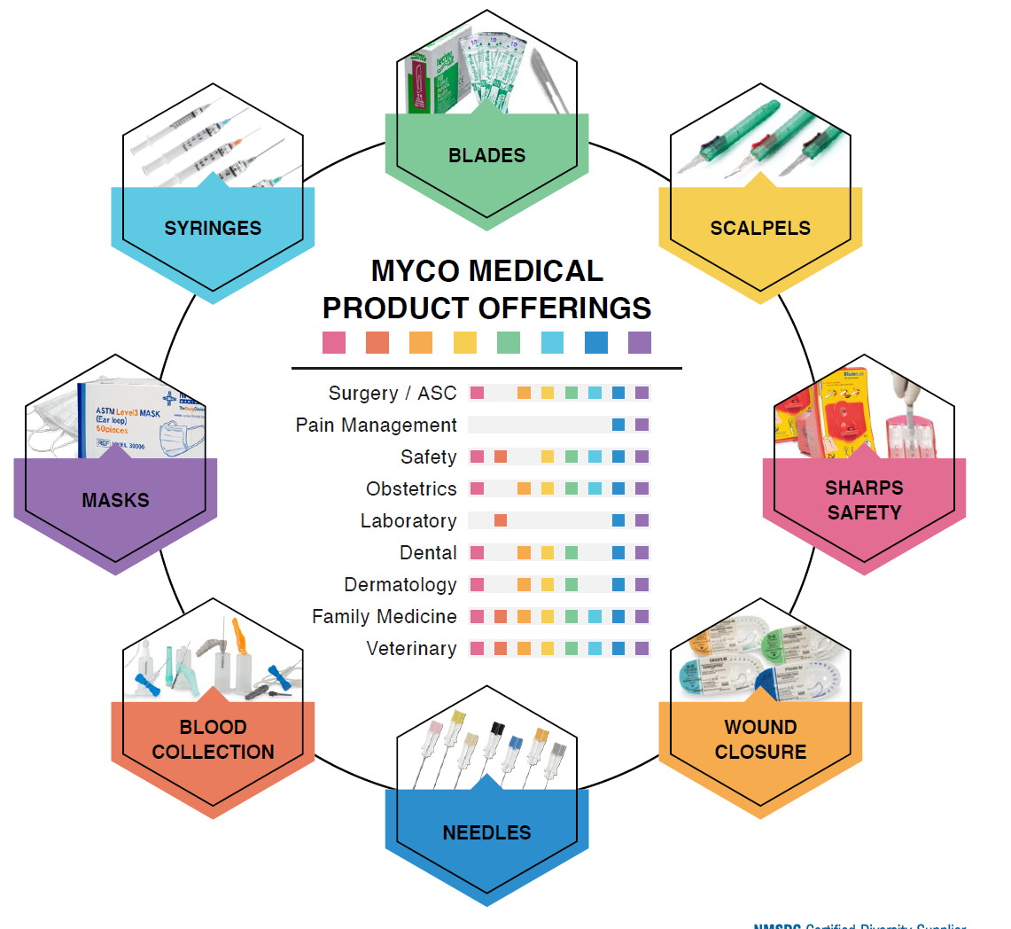
MYCO Product Offering
Competing in markets where products are:
Overpriced
Underserved – lack of choice
Voice of Customer drives our product development
Notes:
IFU Videos and posters
Dedicated studio for live or recorded training sessions
Onsite training support available
Creating Manufacturing dashboard to show current production and maximum production of products. Scalability and timeframe to expand when needed

Slide 5
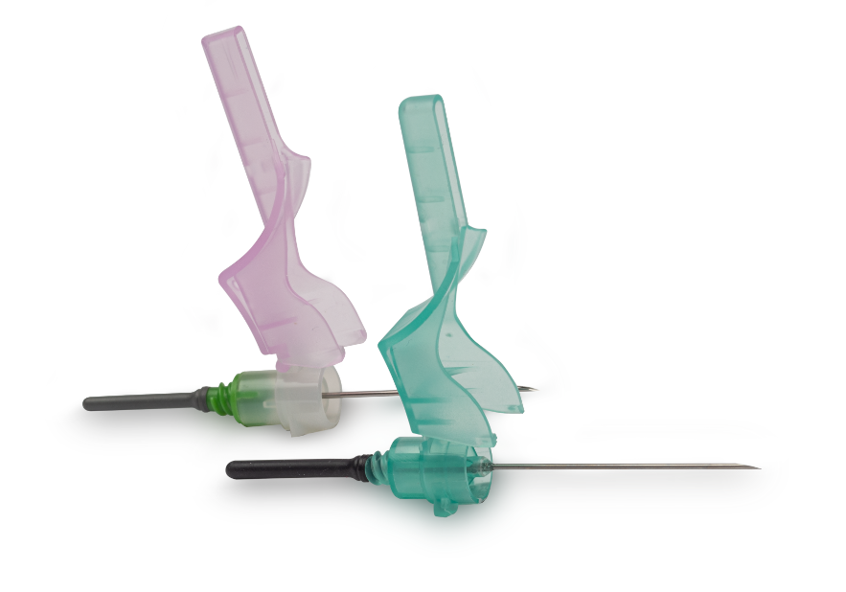
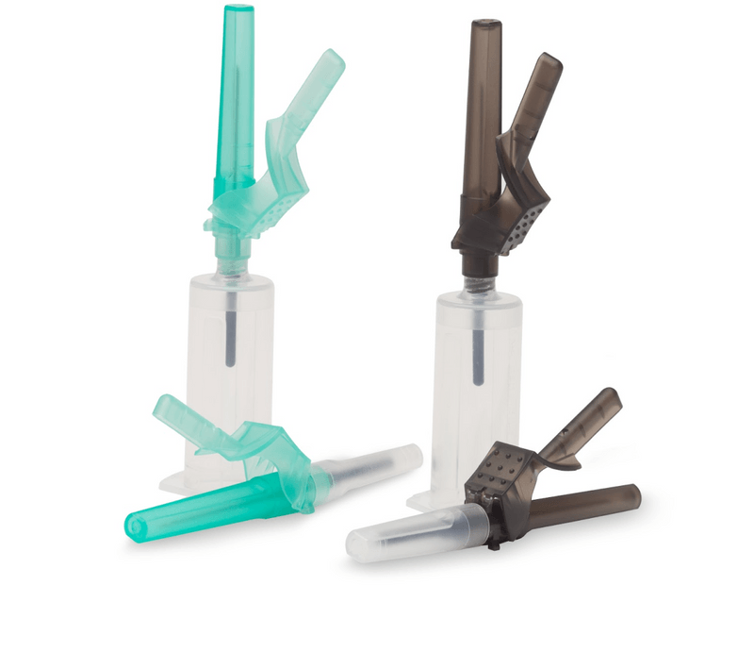
Product Offering: Safety B/C Needles
Easy conversion!
Competitor
MYCO Reli®
21G and 22G 1.25” options
With or without tube holders preattached
Large landing pad with easy and secure locking
“Living Hinge” design to keep safety shield from disconnecting from needle hub
Clinically preferred by large lab organization over market leader
Easy Savings!
Contracts
HealthTrust 6021
Vizient LB0937

Slide 6
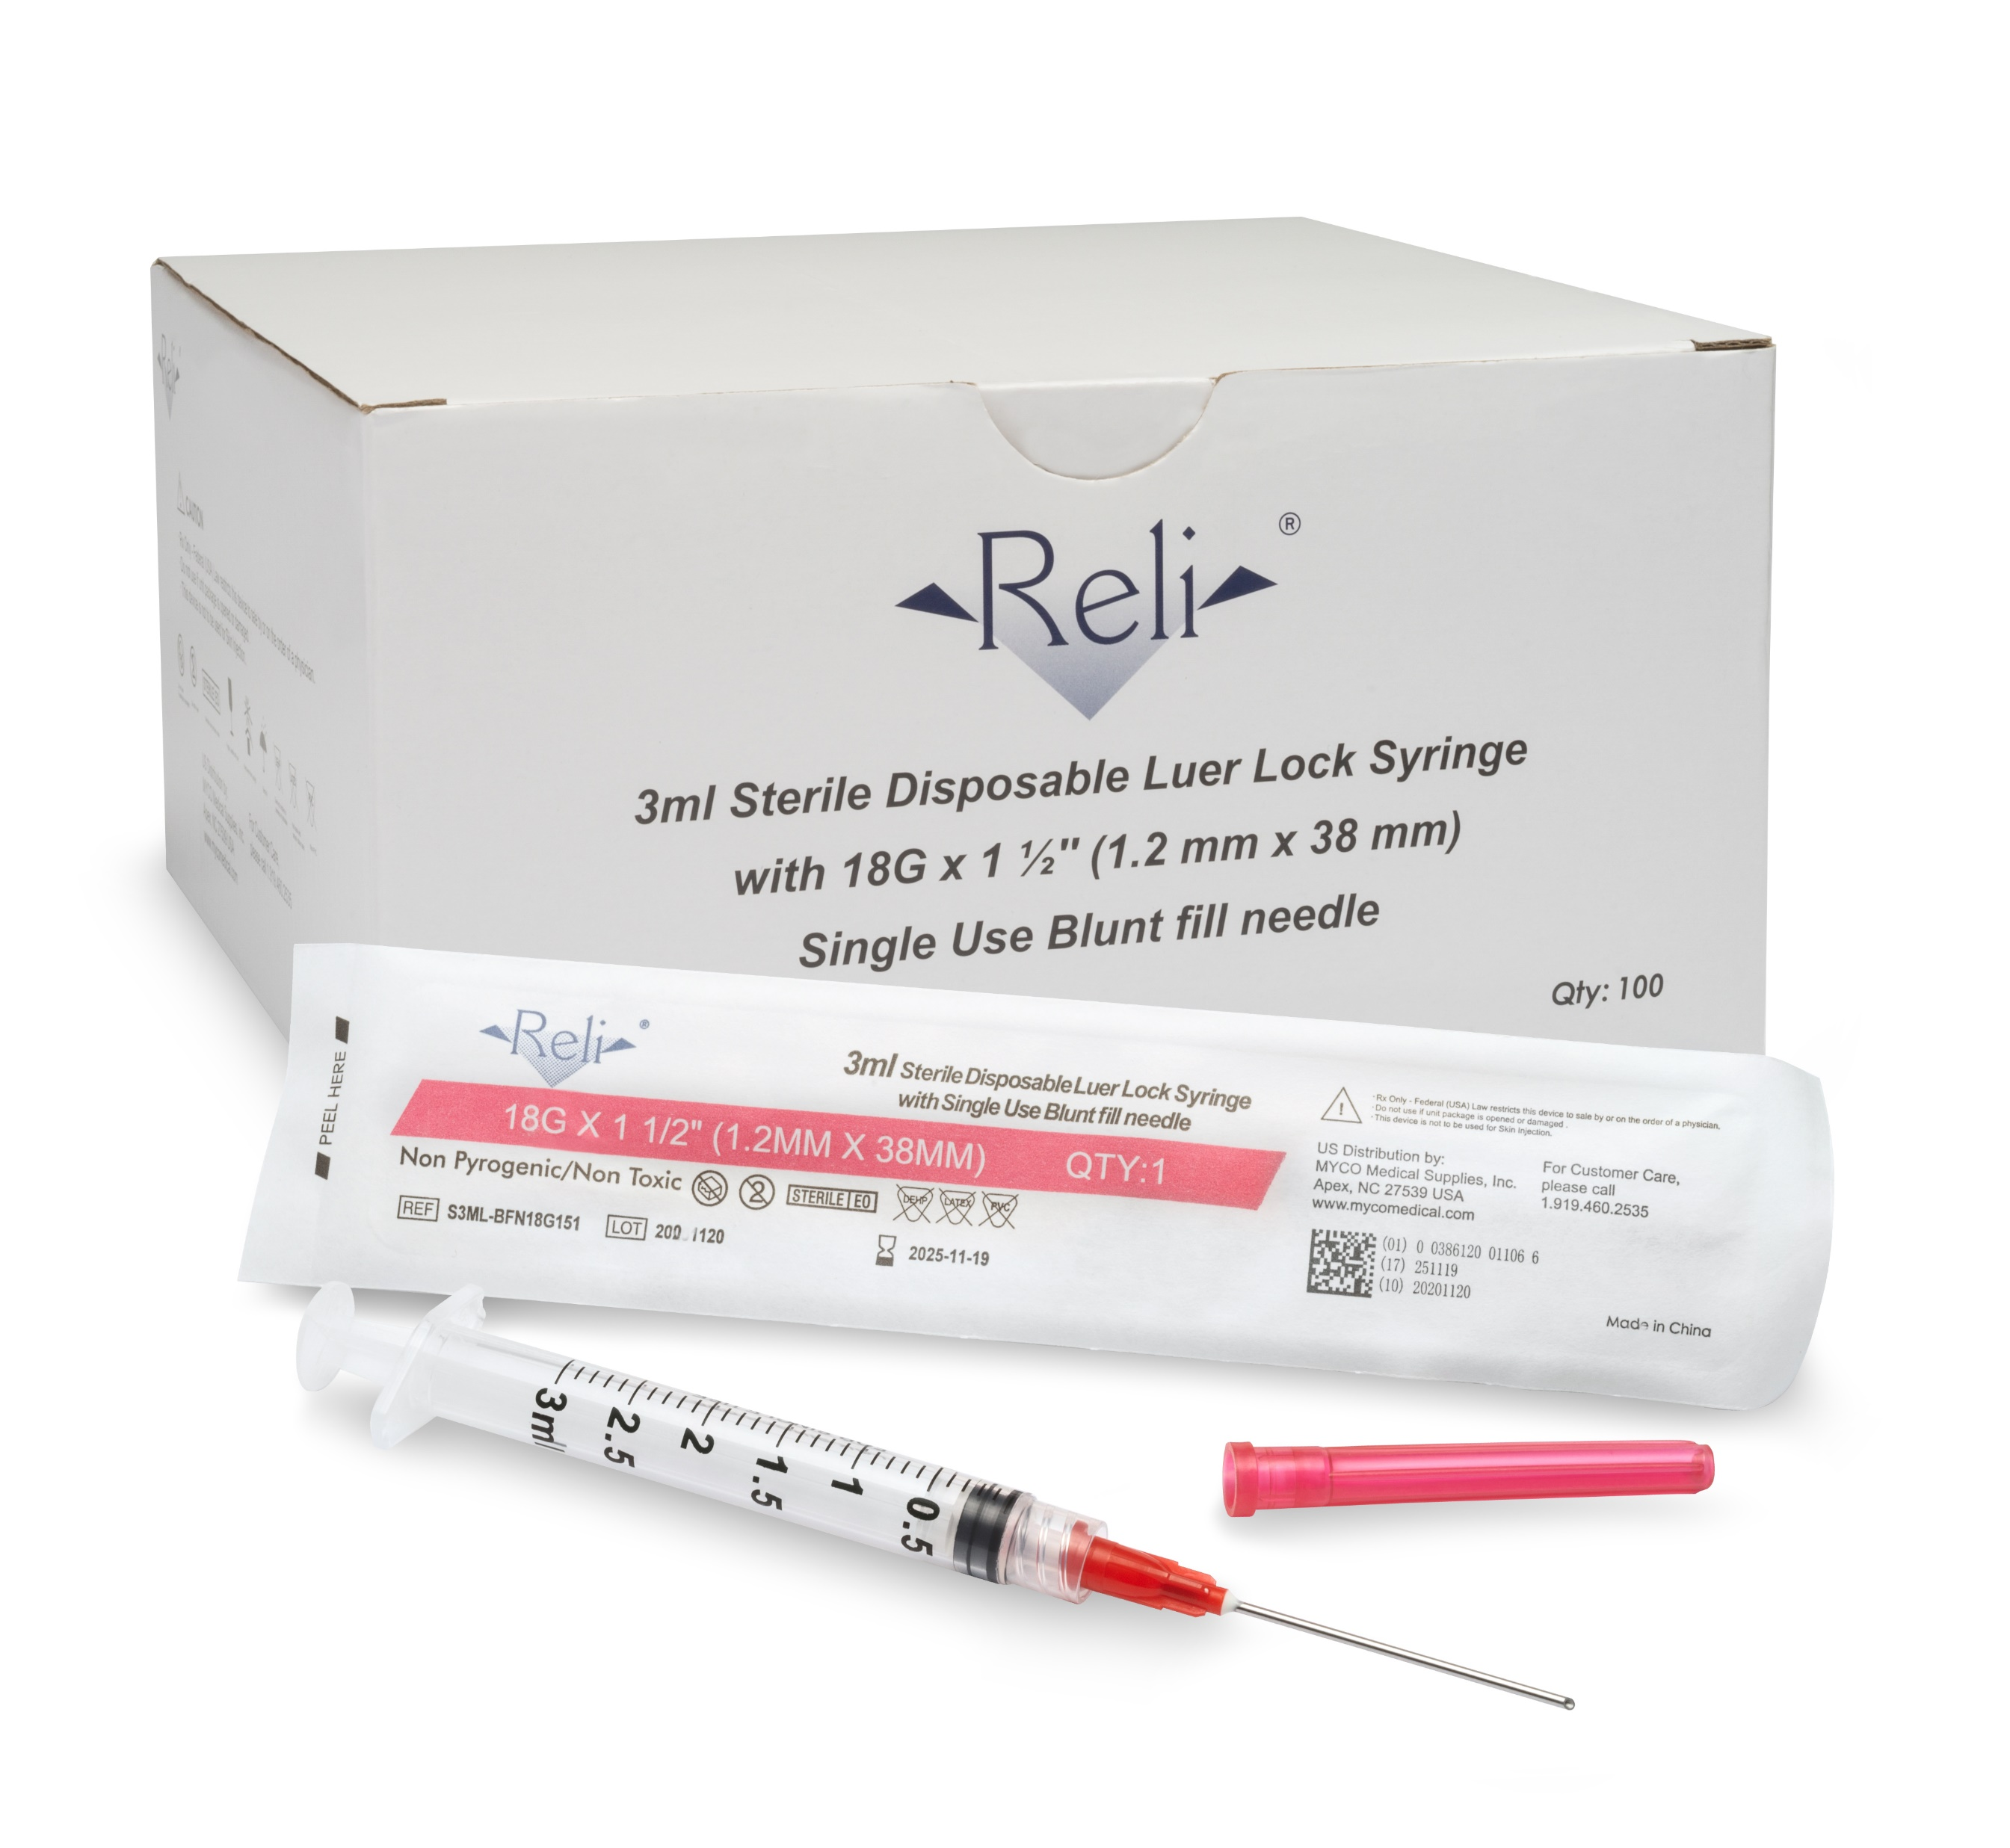
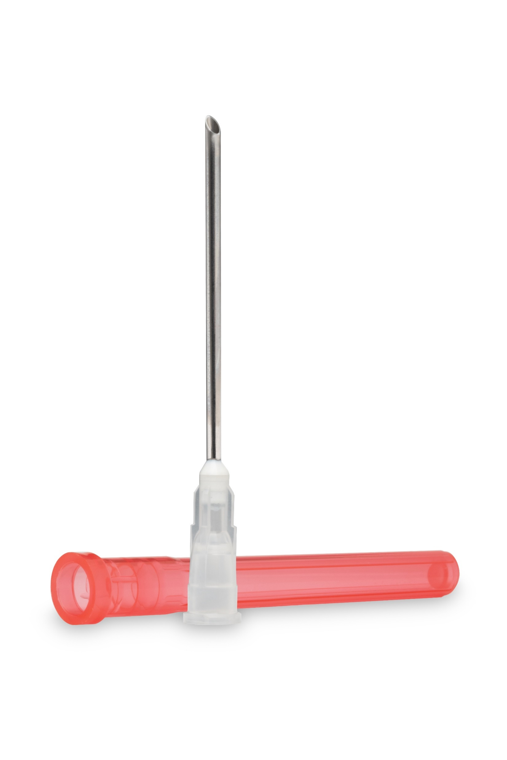
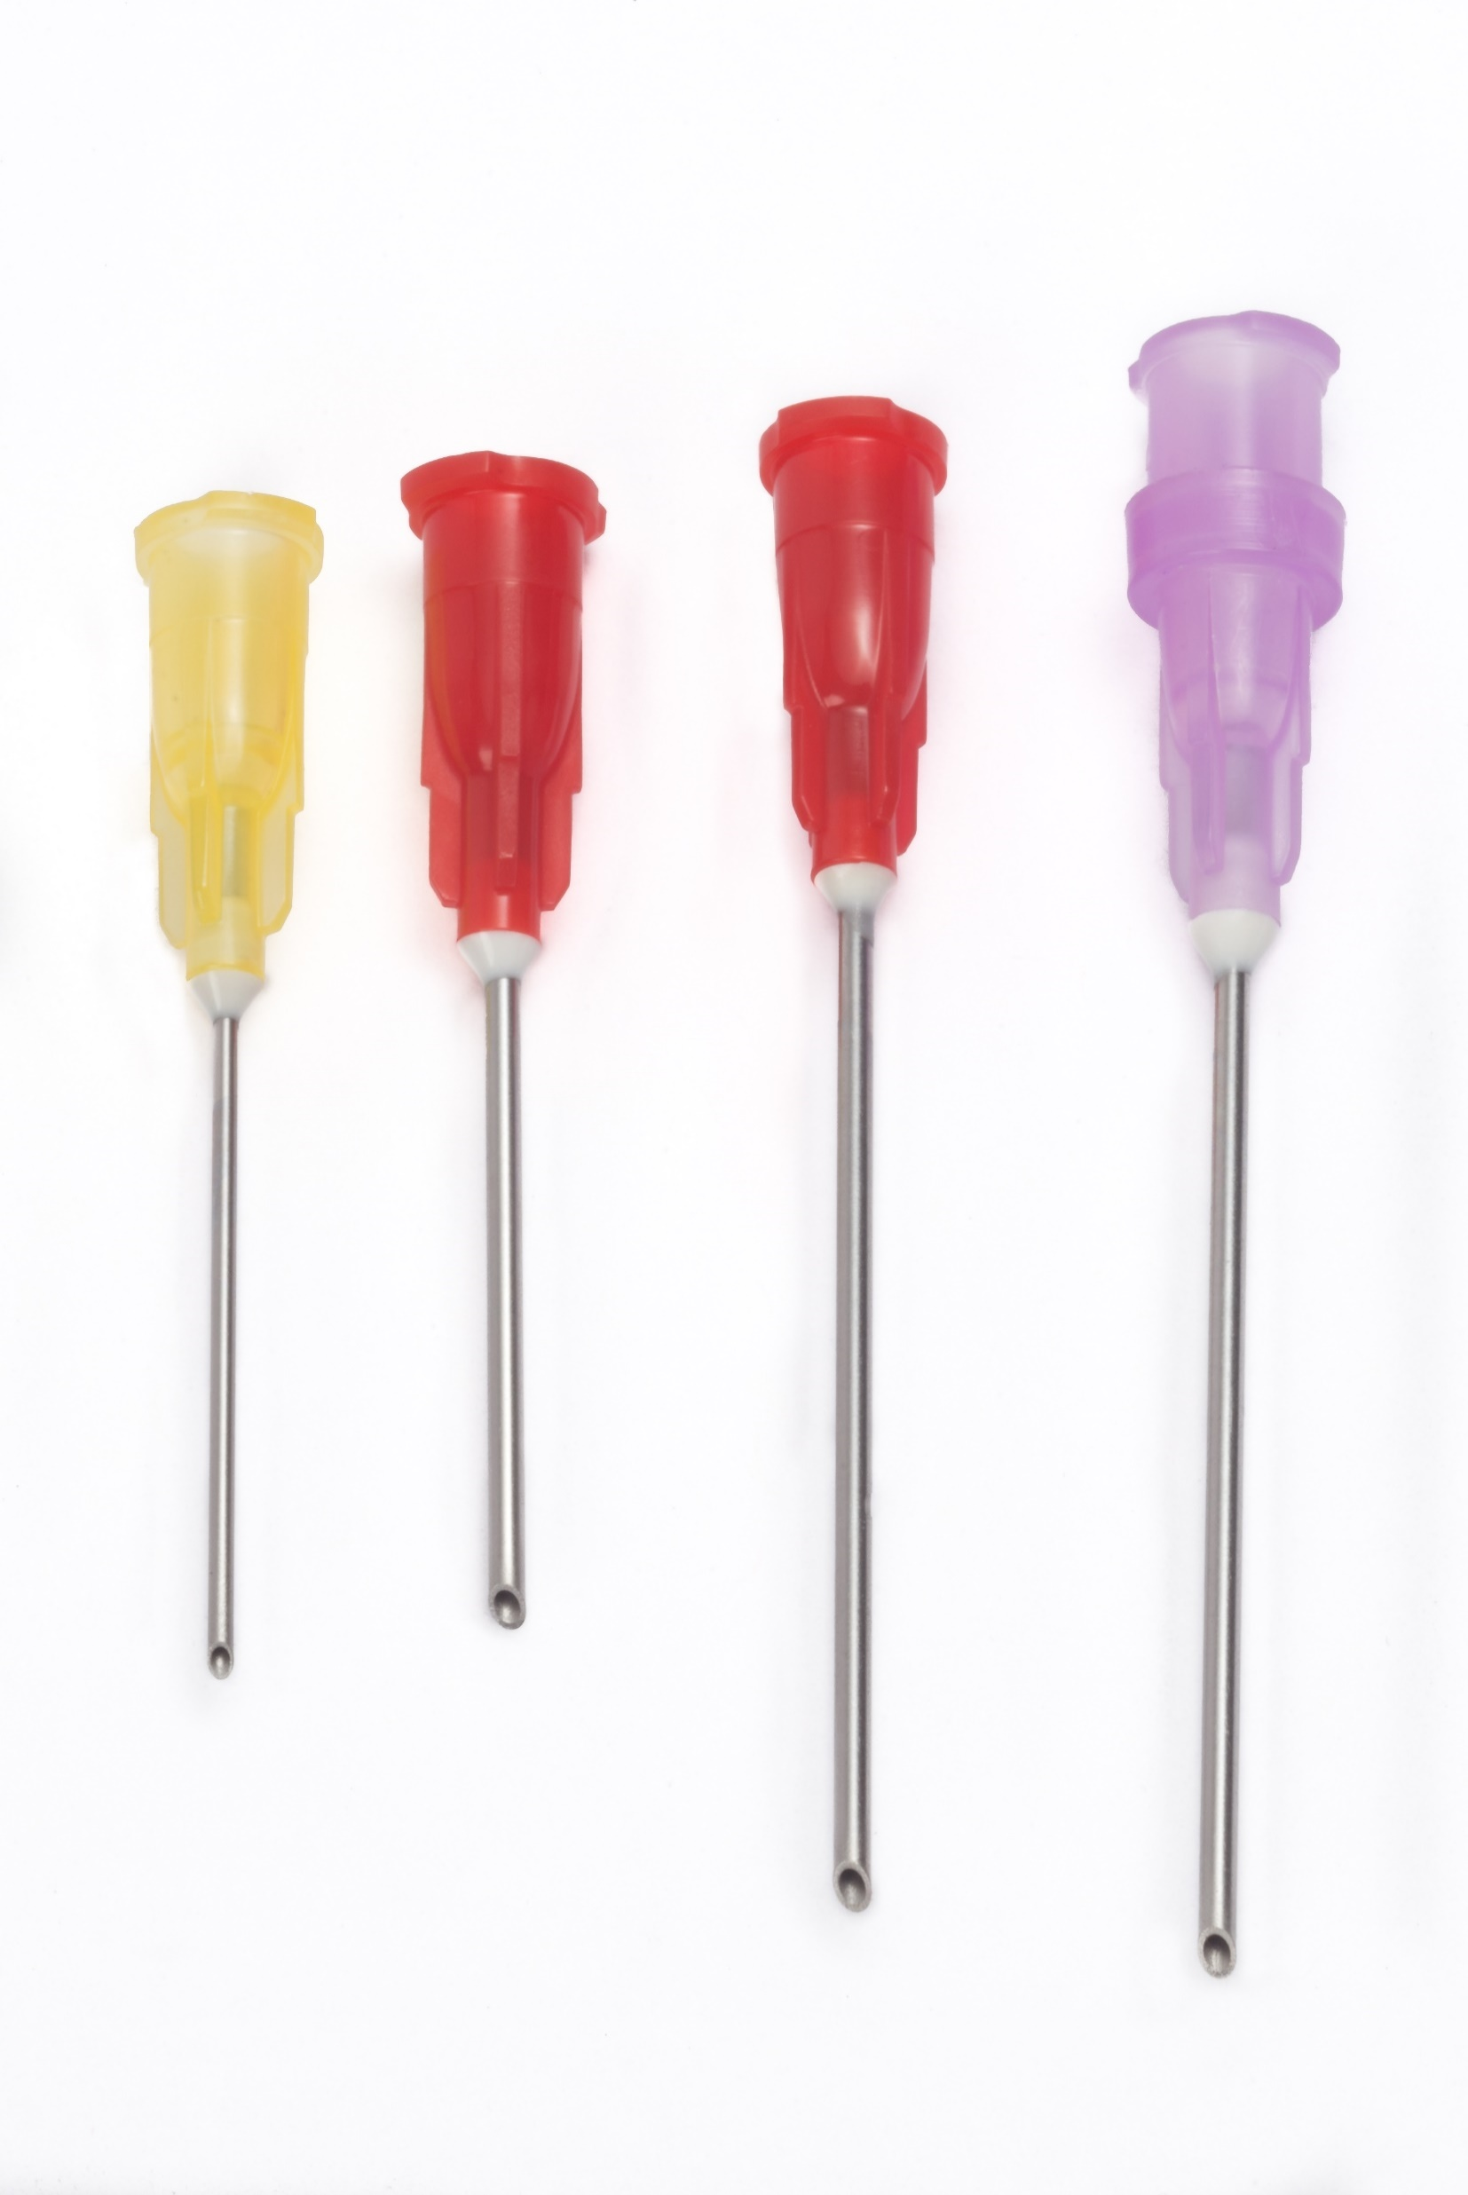
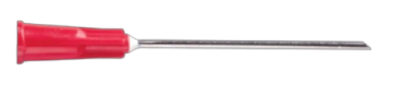
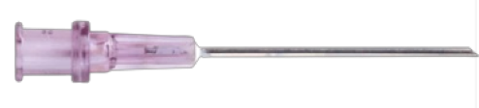
Product Offering: Blunt Fill Needles
Easy conversion!
16G x 1.5”
20g 18Gx1” 18Gx1.5” Filtered 18Gx1.5”
Full range from 16G -20G
Filtered 18G x 1.5”
3 options for pre-attached syringes.
3 ML, 5ML,10ML
Like for like with the market leader
MYCO sold 80 million units in 2023
Easy Savings!
Contracts
HealthTrust 6905
Premier PP-NS-1632
Local VZ07012020
Competitor product

Slide 7
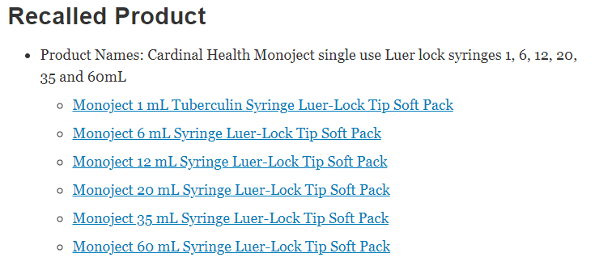
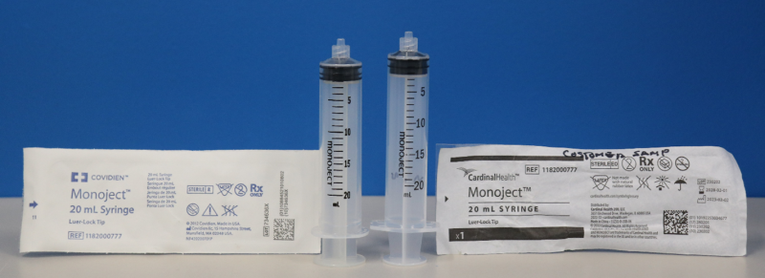
Syringe Disruption
MYCO has not commissioned any syringe design changes since launch
MYCO has 3rd party U.S. testing performed in January 2023
https://www.fda.gov/medical-devices/medical-device-recalls/cardinal-health-recalls-monoject-disposable-syringes-incompatibilities-syringe-pumps
Notes:
IFU Videos and posters
Dedicated studio for live or recorded training sessions
Onsite training support available
Creating Manufacturing dashboard to show current production and maximum production of products. Scalability and timeframe to expand when needed

Slide 8
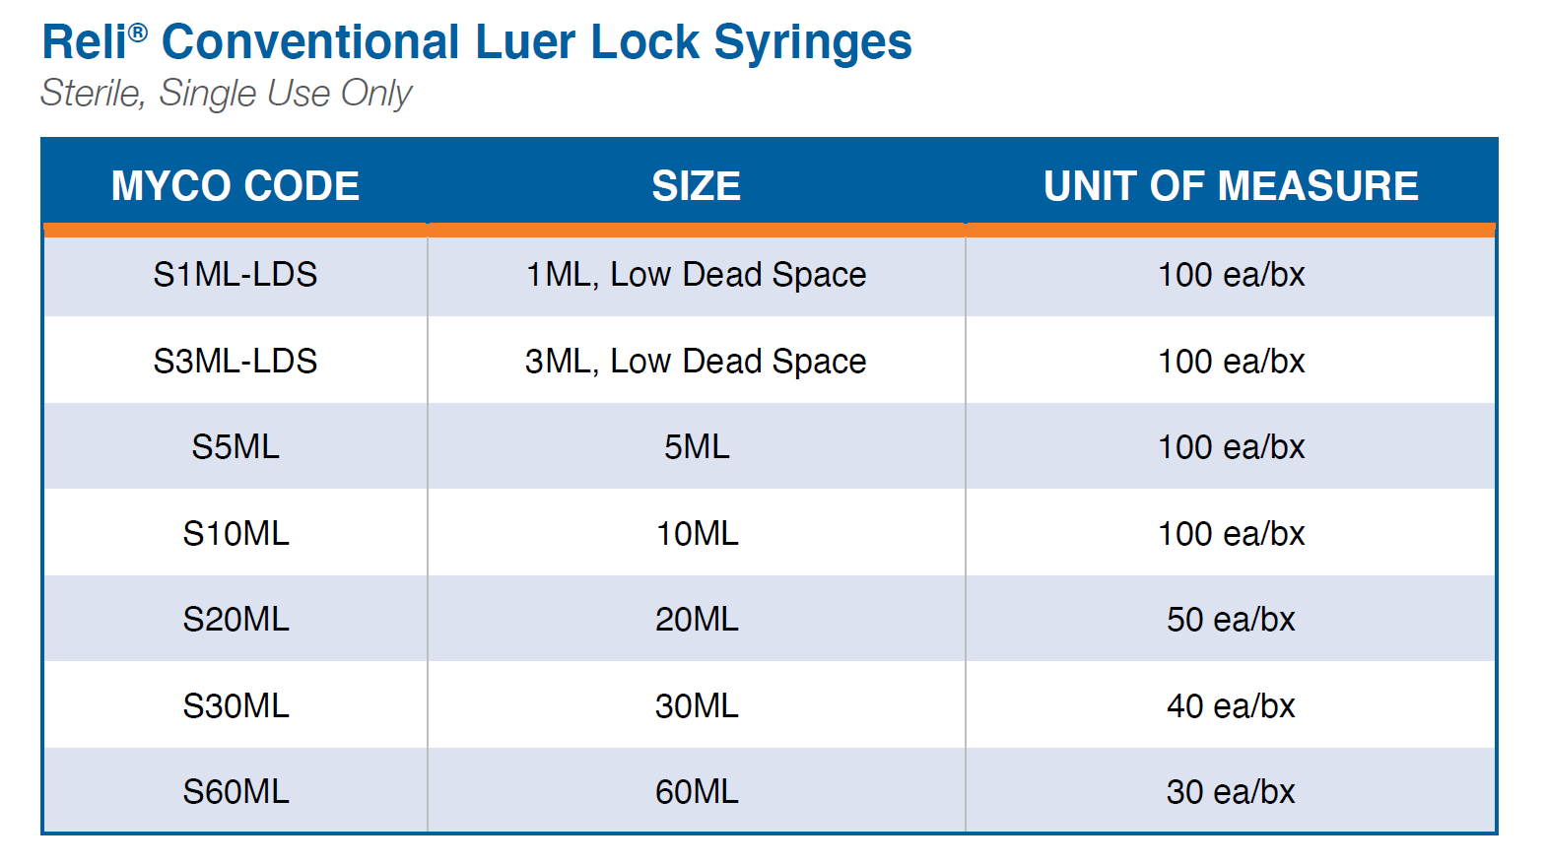
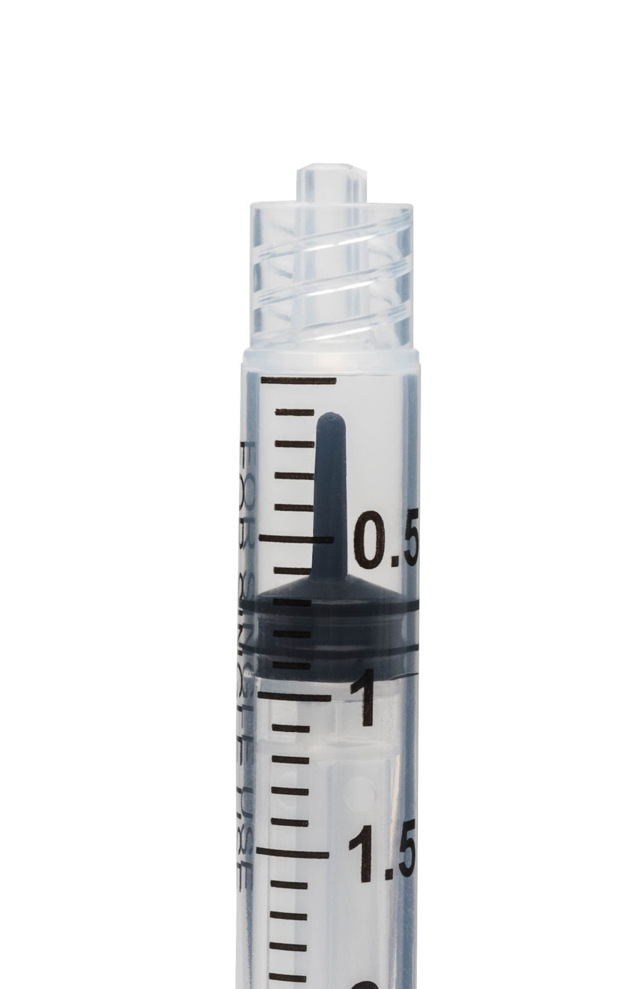
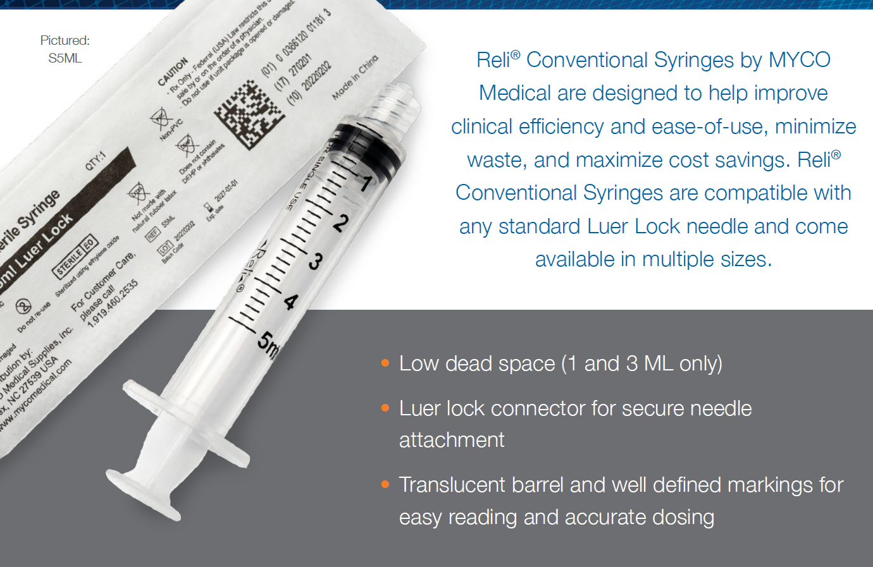
Product Offering – LL Syringes
MYCO has not commissioned any syringe design changes since launch
Low dead space design
Contracts
HealthTrust 18866
Premier PP-NS-1632
MYCO has 3rd party U.S. testing performed in January 2023
Notes:
IFU Videos and posters
Dedicated studio for live or recorded training sessions
Onsite training support available
Creating Manufacturing dashboard to show current production and maximum production of products. Scalability and timeframe to expand when needed

Slide 9
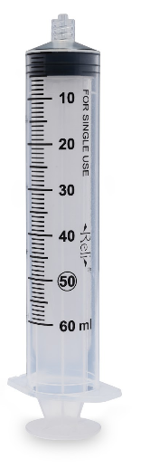
Conventional LL Syringe Promo
MYCO has not commissioned any syringe design changes since launch
WHEN YOU BUY THIS:
1ML Syringe – 3 Boxes
3ML Syringe – 3 Boxes
5ML Syringe – 3 Boxes
10ML Syringe – 3 Boxes
20ML Syringe – 3 Boxes
30ML Syringes – 3 Boxes
60ML Syringes – 3 Boxes
YOU GET THIS FREE:
1ML Syringe – 1 Box
3ML Syringe – 2 Boxes
5ML Syringe – 2 Boxes
10ML Syringe – 2 Boxes
20ML Syringe – 1 Box
30ML Syringes – 1 Box
60ML Syringes – 1 Box
TERMS
FREE product shipped directly to the end user.
Promotion runs through December 31, 2024.
FREE samples upon request. Email: SampleRequests@MYCOMedical.com
MYCO has 3rd party U.S. testing performed in January 2023
Contracts
HealthTrust 18866
Premier PP-NS-1632
Notes:
IFU Videos and posters
Dedicated studio for live or recorded training sessions
Onsite training support available
Creating Manufacturing dashboard to show current production and maximum production of products. Scalability and timeframe to expand when needed

Slide 10
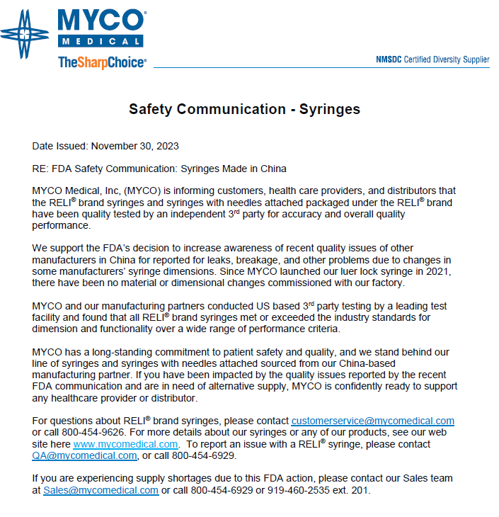
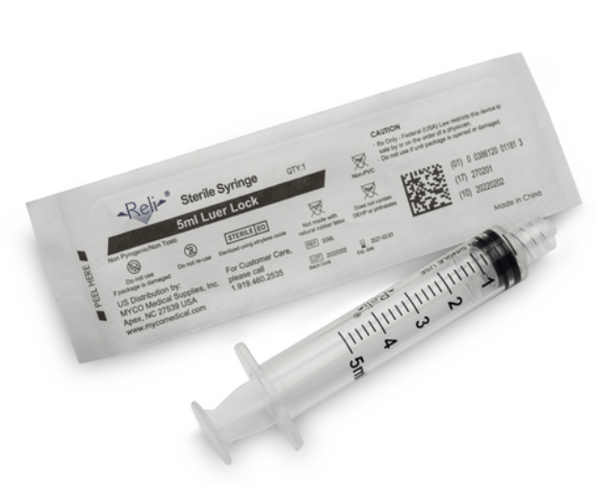
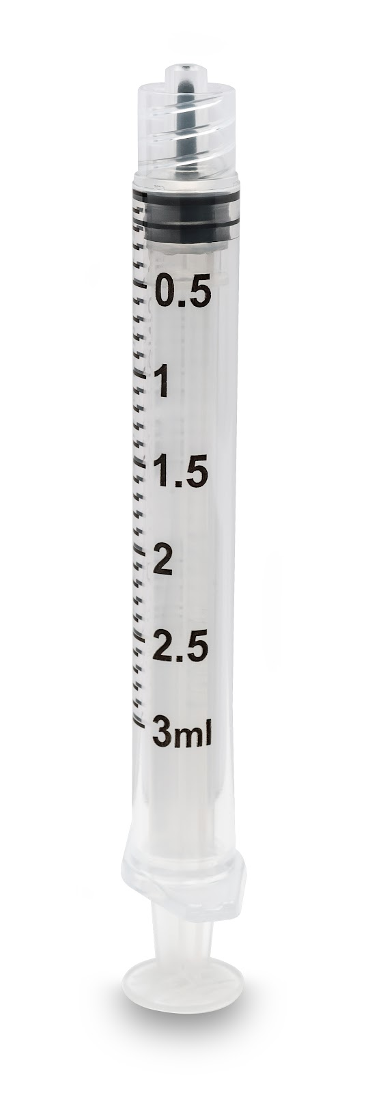
MYCO Syringes & FDA Communication
MYCO has not commissioned any syringe design changes since launch
MYCO has 3rd party U.S. testing performed in January 2023
Notes:
IFU Videos and posters
Dedicated studio for live or recorded training sessions
Onsite training support available
Creating Manufacturing dashboard to show current production and maximum production of products. Scalability and timeframe to expand when needed

Slide 11
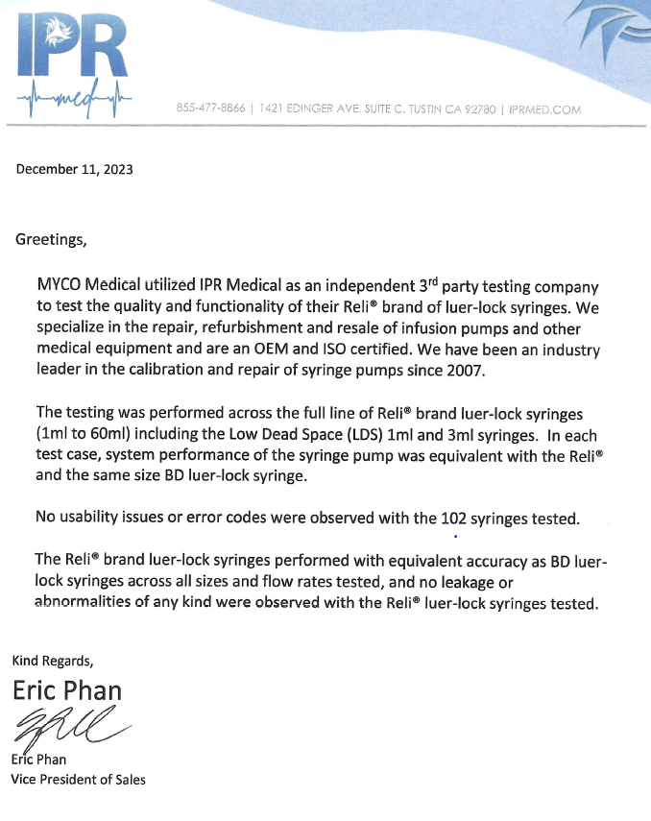
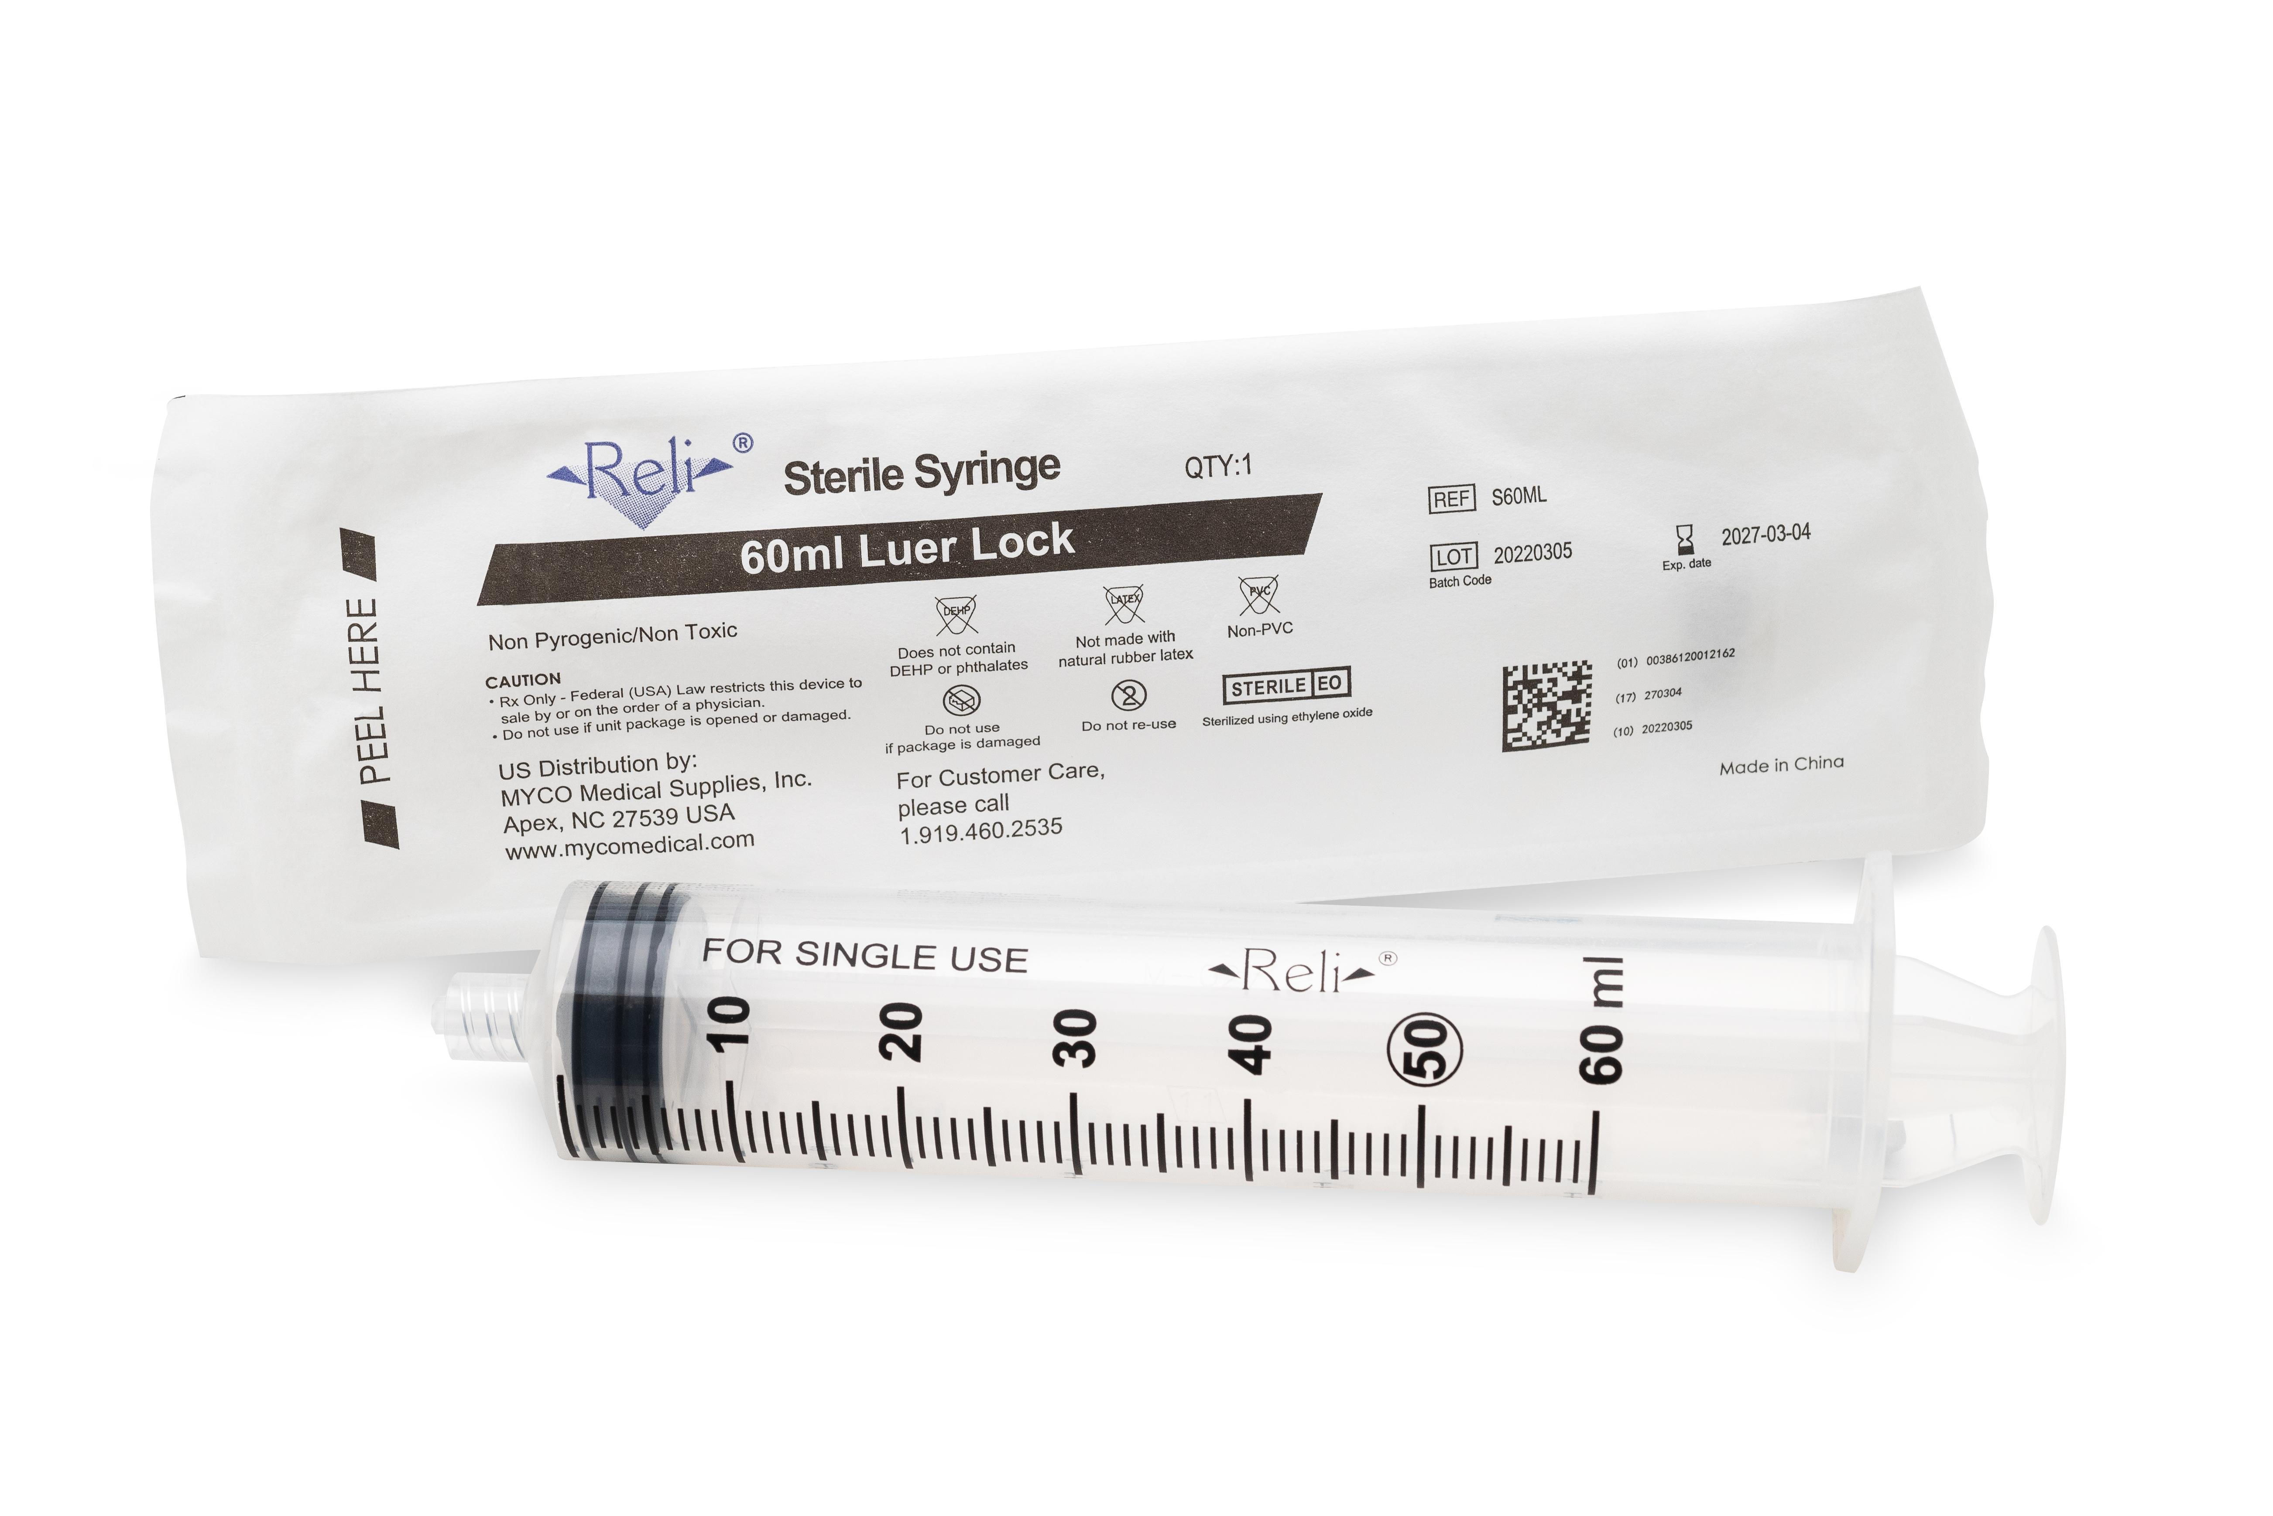
MYCO Syringe Pump Testing
MYCO has not commissioned any syringe design changes since launch
MYCO has 3rd party U.S. testing performed in January 2023
Notes:
IFU Videos and posters
Dedicated studio for live or recorded training sessions
Onsite training support available
Creating Manufacturing dashboard to show current production and maximum production of products. Scalability and timeframe to expand when needed

Slide 12

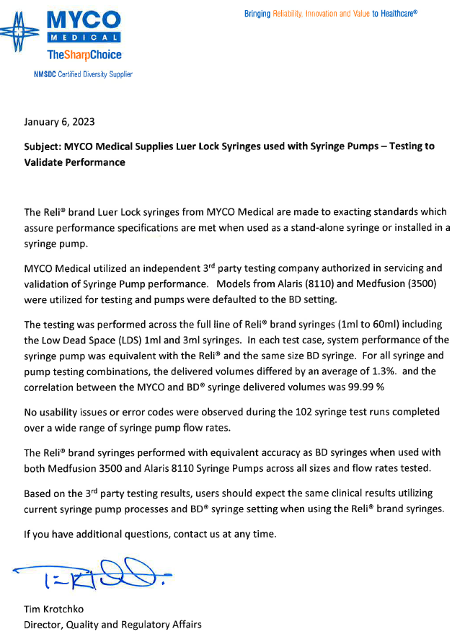
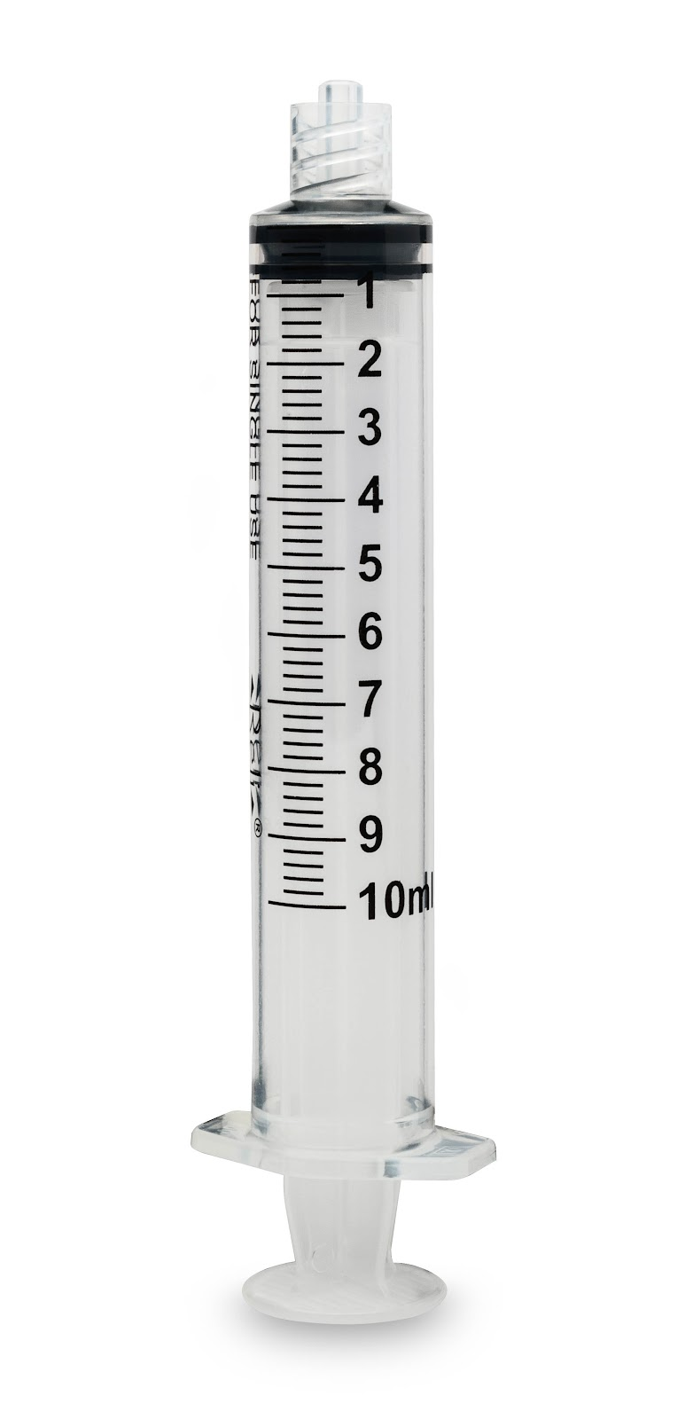
MYCO Syringe Pump Testing
MYCO syringe pump testing and results
Full line of luer lock syringes up to 60ml
Notes:
IFU Videos and posters
Dedicated studio for live or recorded training sessions
Onsite training support available
Creating Manufacturing dashboard to show current production and maximum production of products. Scalability and timeframe to expand when needed

Slide 13
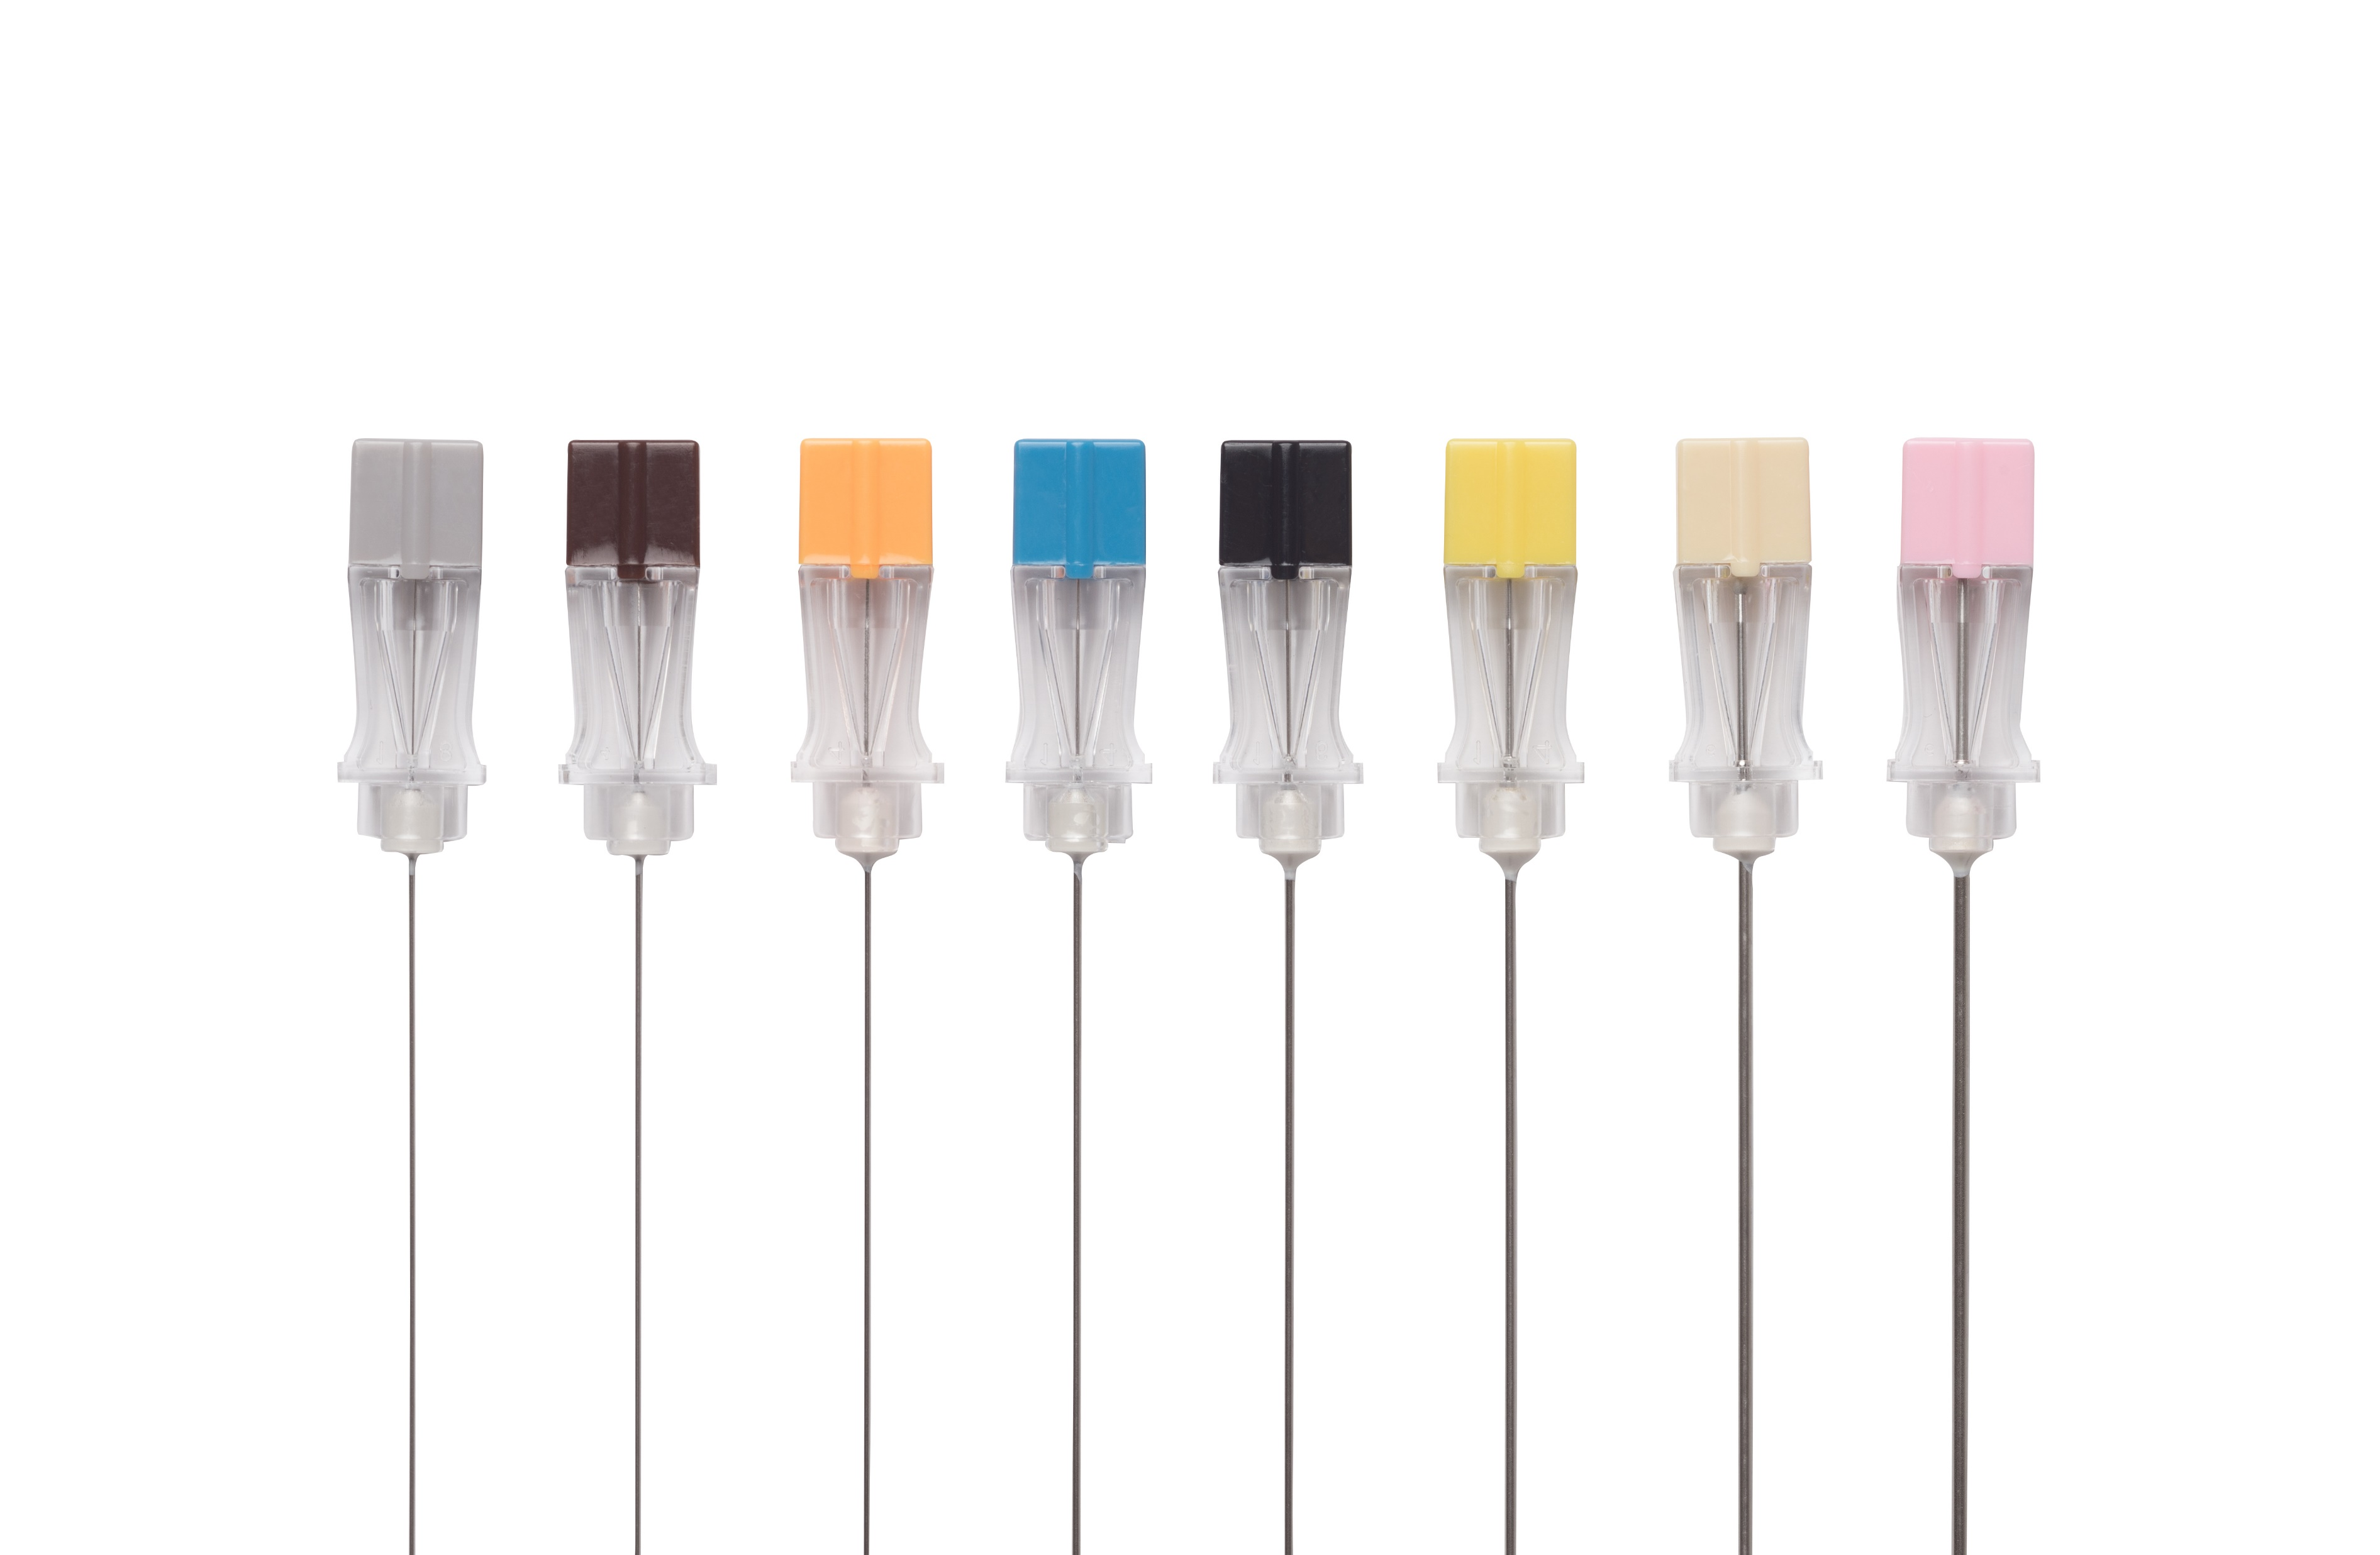

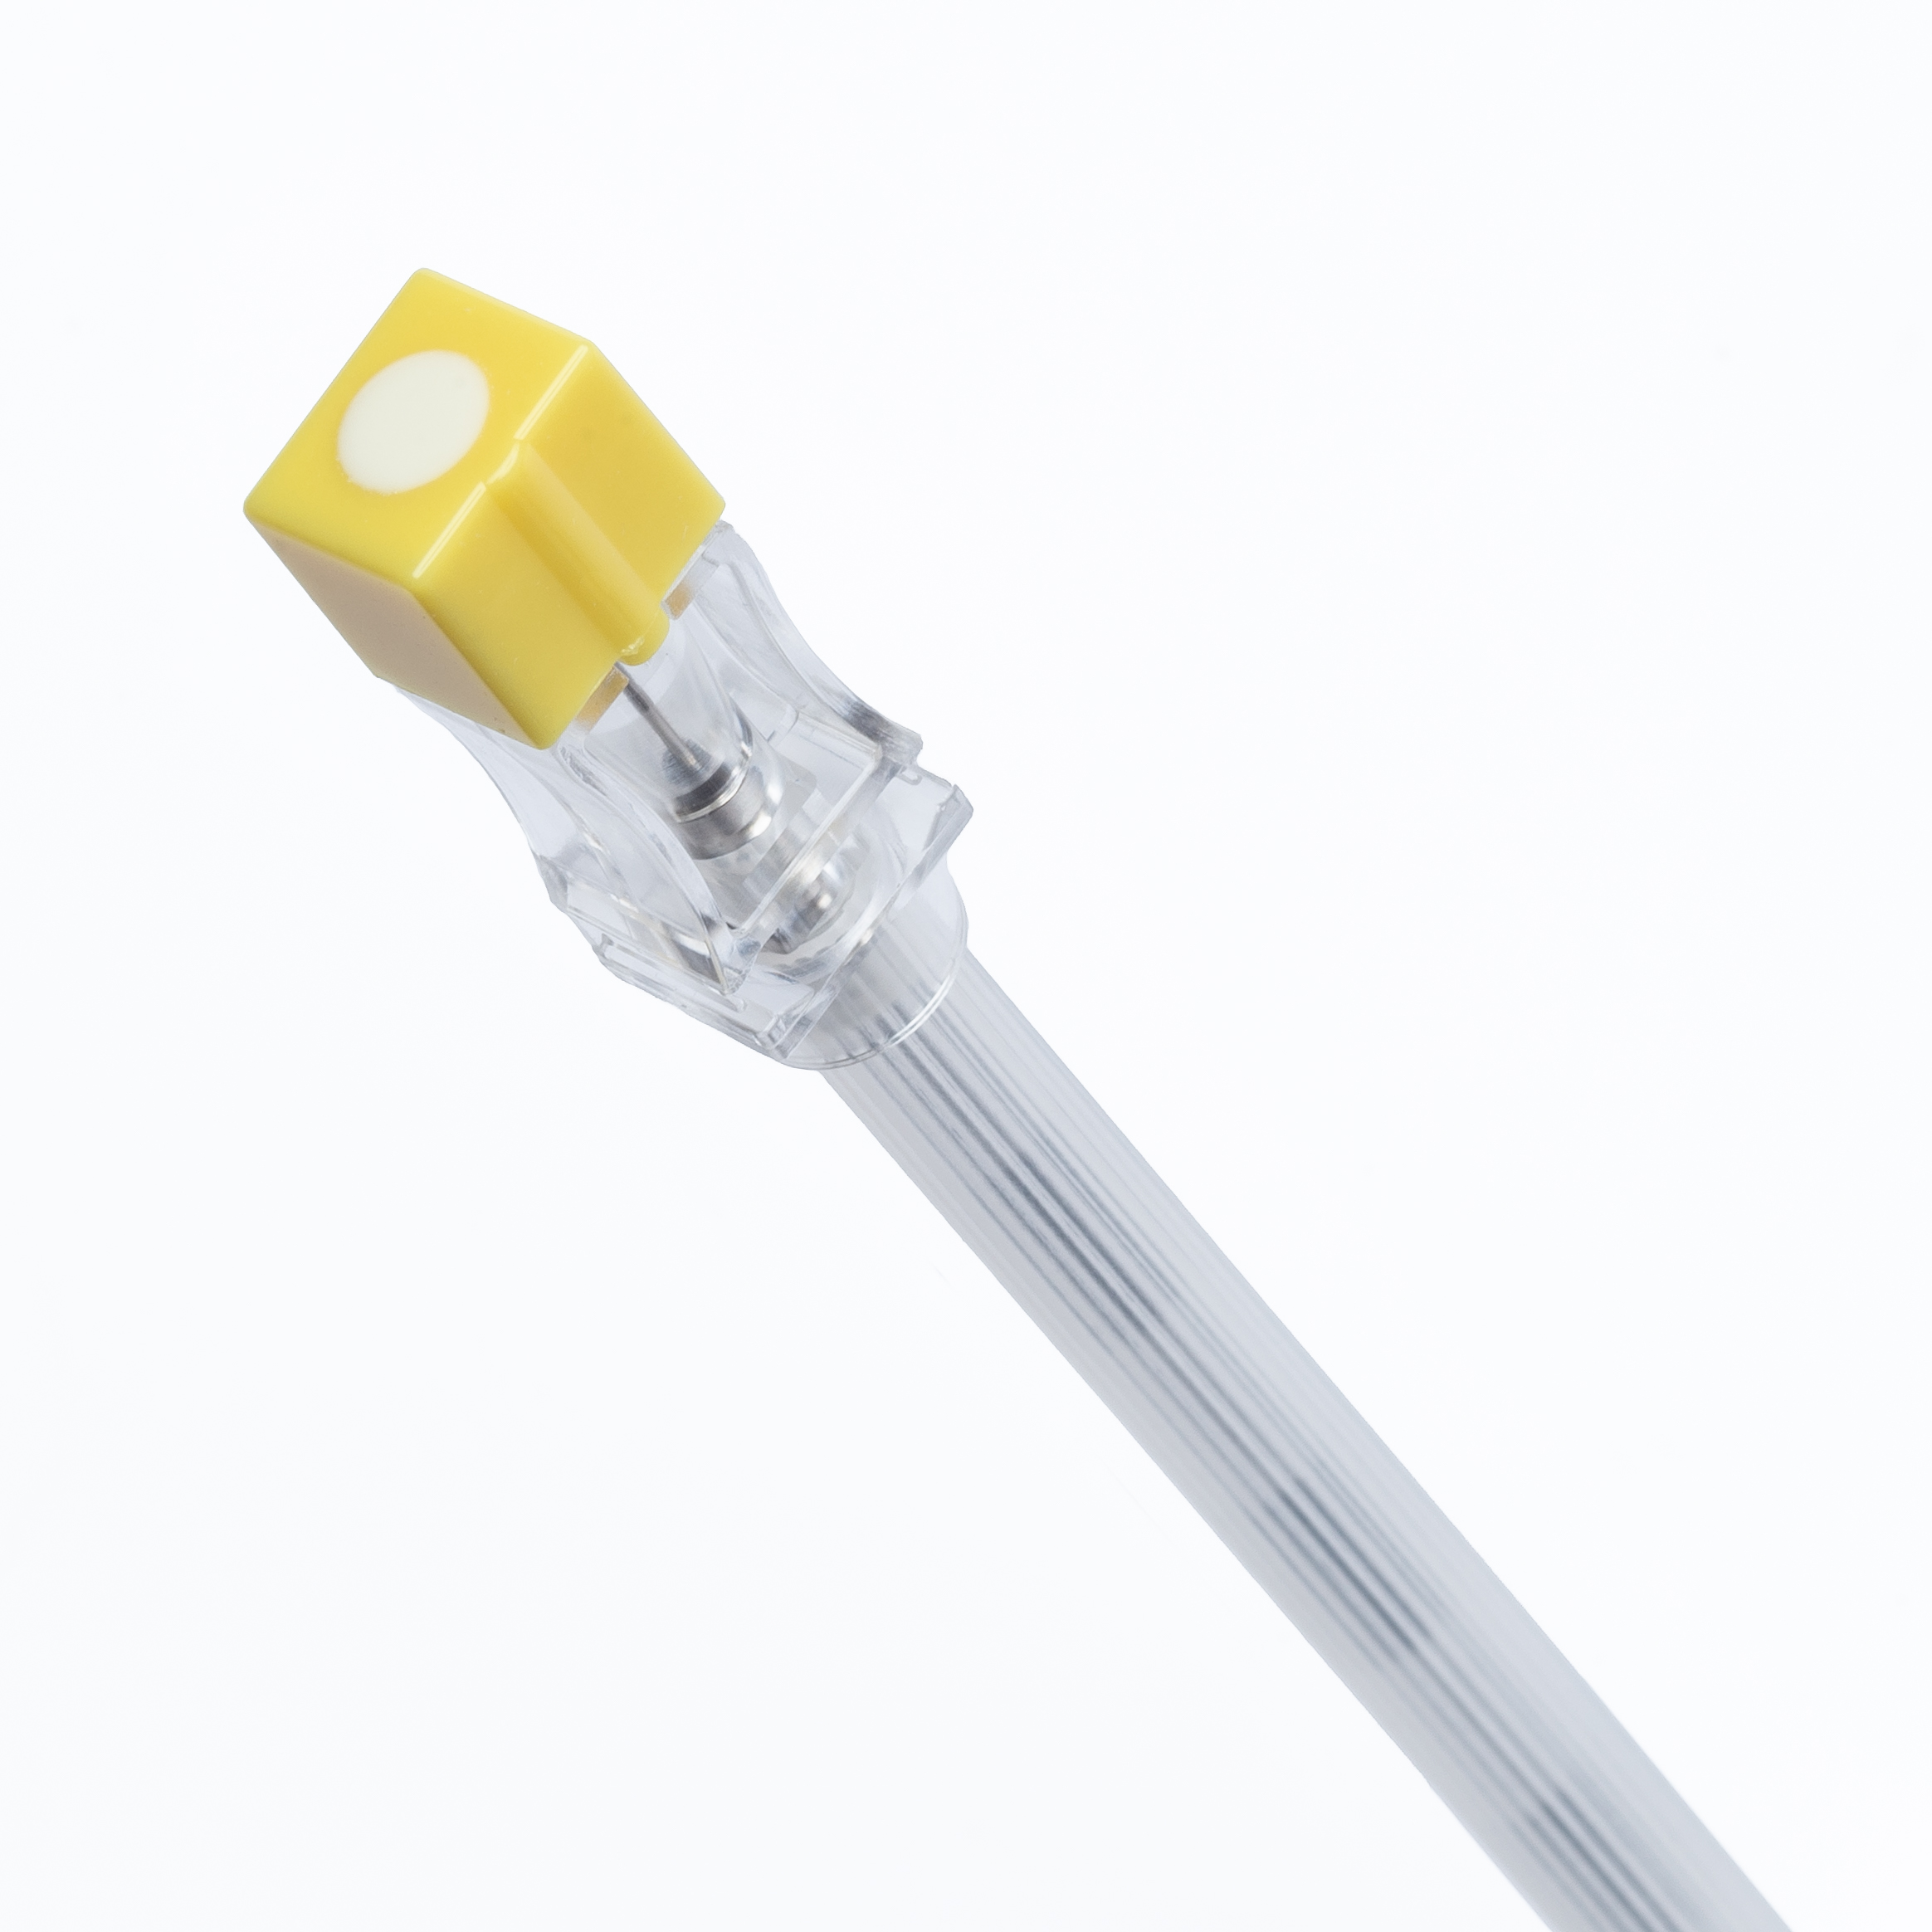
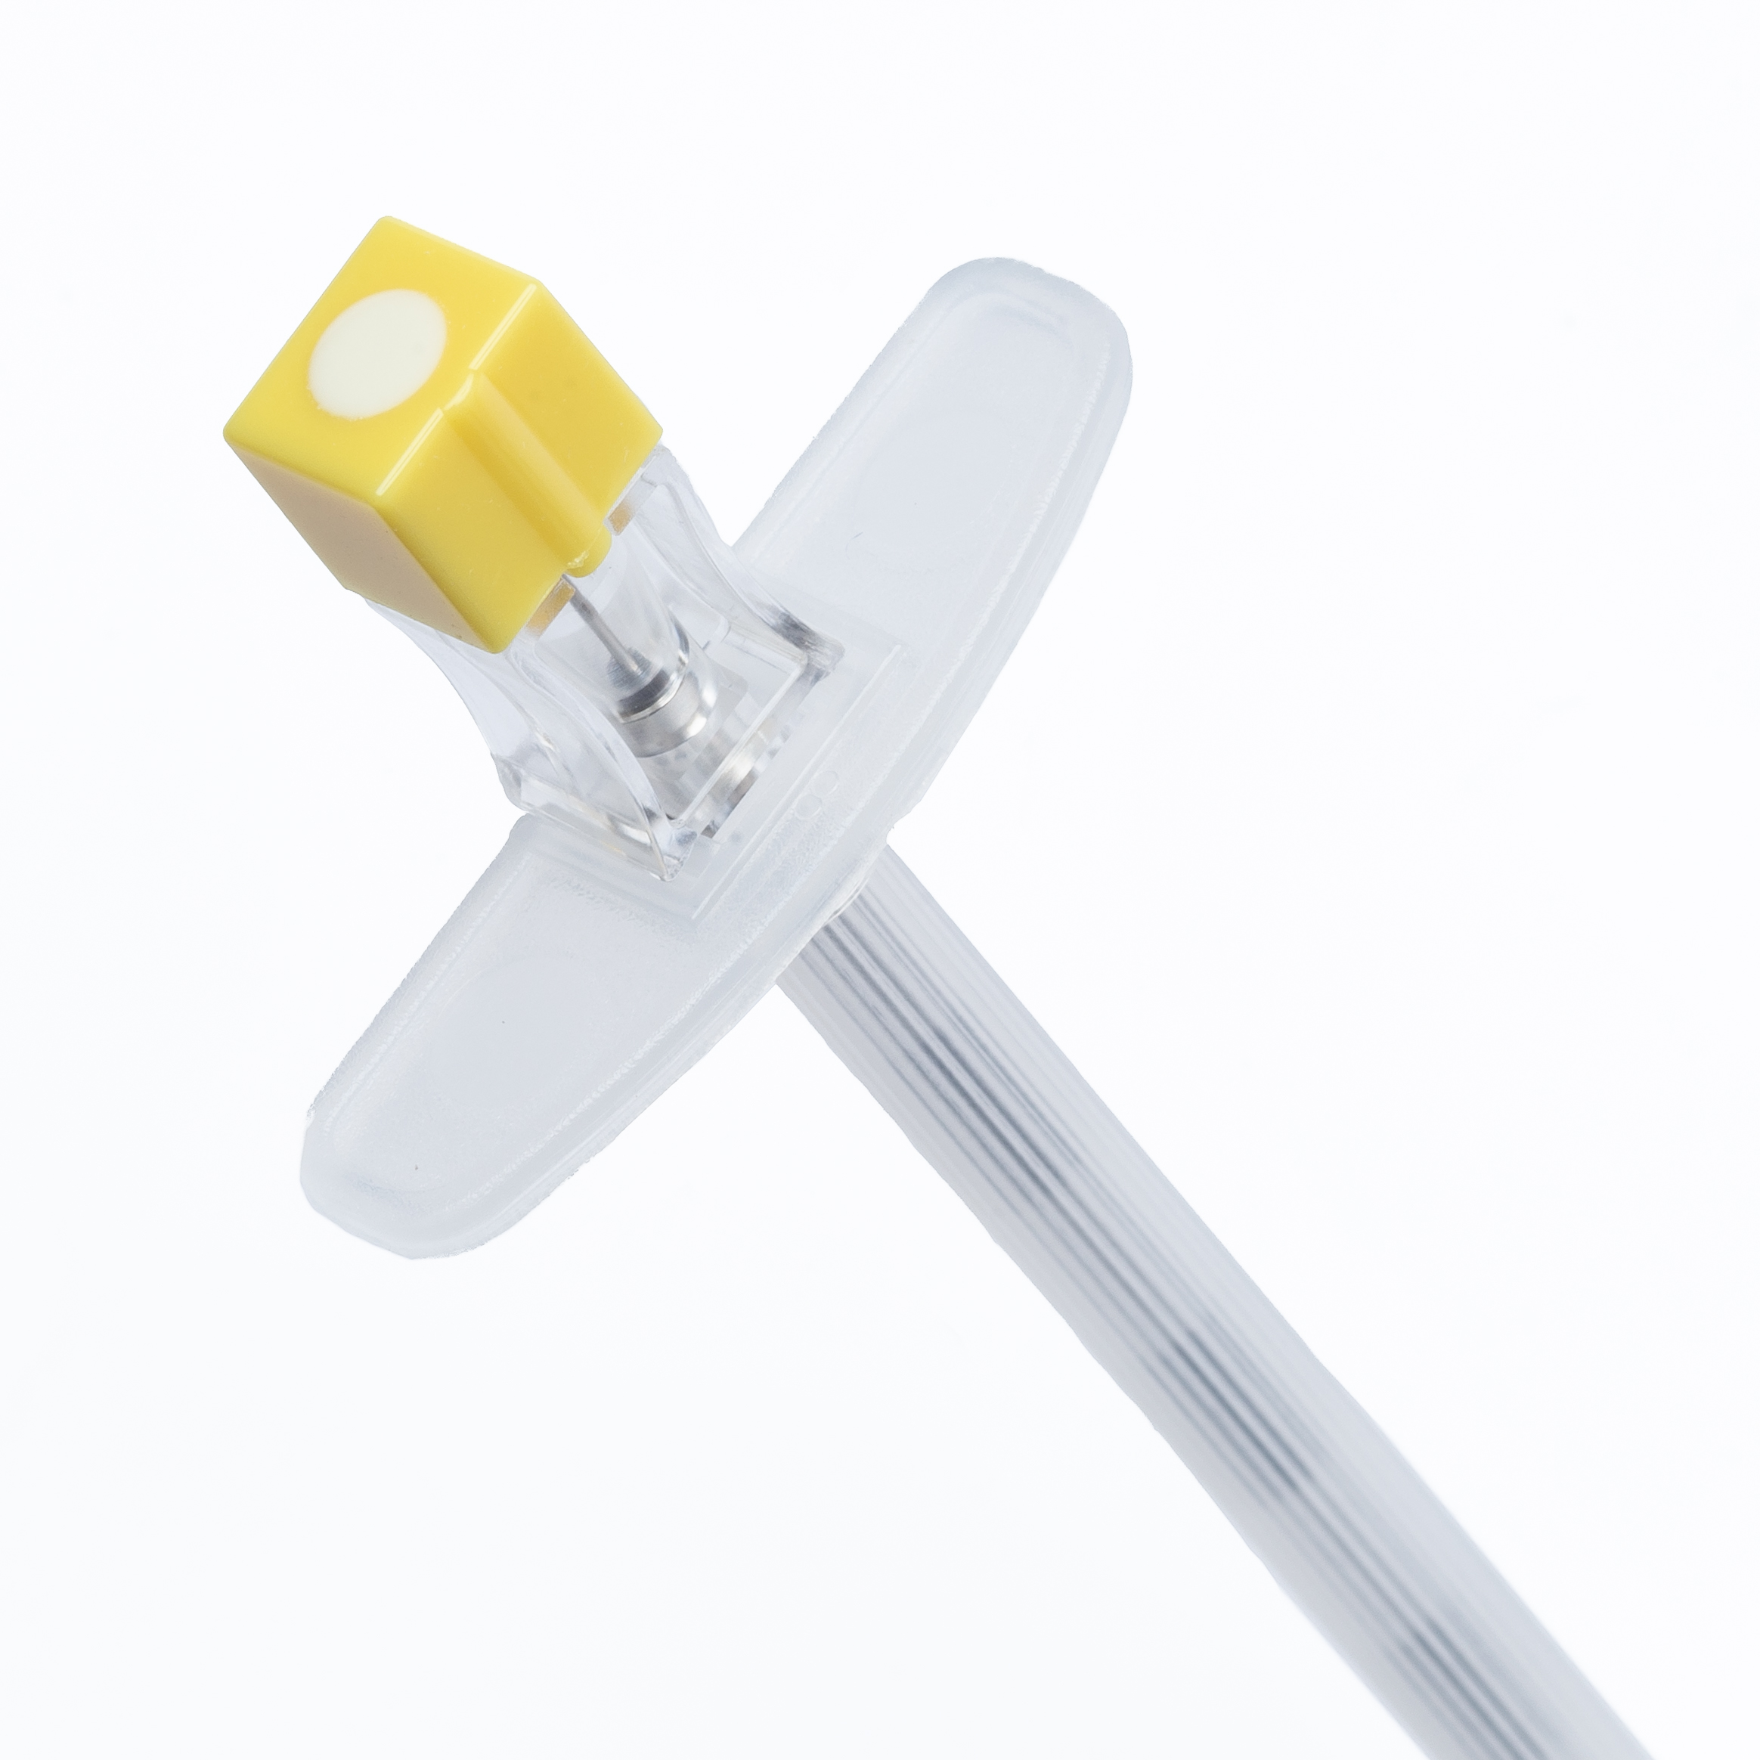
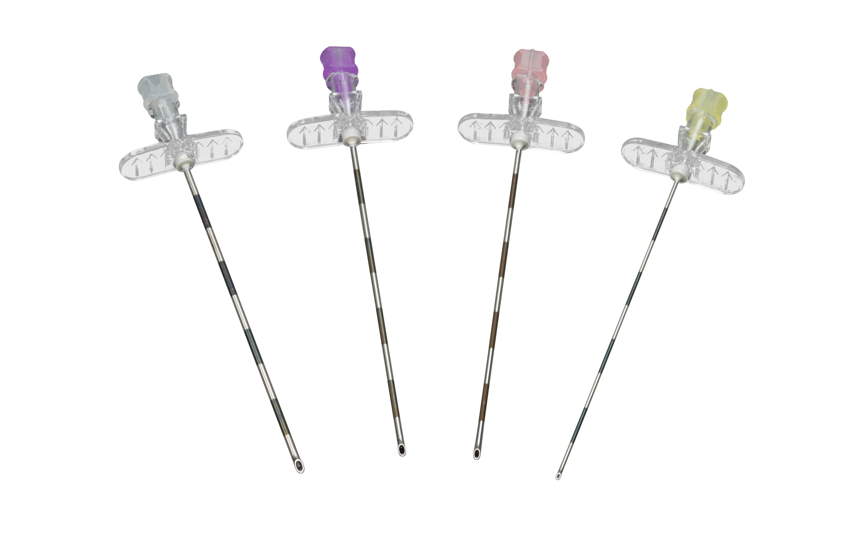
SPIF: Spinal & Epidural Needles
Length: 7 months, January – July
Retroactive for January
$1.50 per box based on tracings
Evaluated quarterly
With success – extension is optional
Competitor
Contracts
HealthTrust 18866
Premier PP-OR-2044
Local VZ07012020
Large clear hubs
better visualization of CSF (Cerebrospinal fluid)
Aides in control due to the tactile feel
ISO standard for gauge colors
Offerings with echogenic stylets & metric markings
Fixed wing and detachable wing epidural needles
Sterile and non-sterile options
Styles: Quincke, Pencil Point, Chiba, Epidural
Target Markets:
Pain Clinics
Urology
Fertility Clinics
OB
Anesthesiology
Radiology

Slide 14
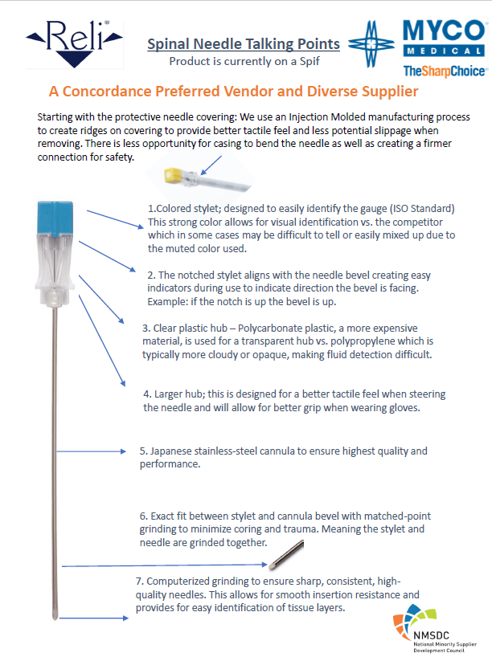
SPIF: Spinal & Epidural Needles
Length: 7 months, January – July
Retroactive for January
$1.50 per box based on tracings
Evaluated quarterly
With success – extension is optional
Target Markets:
Pain Clinics
Urology
Fertility Clinics
OB
Anesthesiology
Radiology

Slide 15
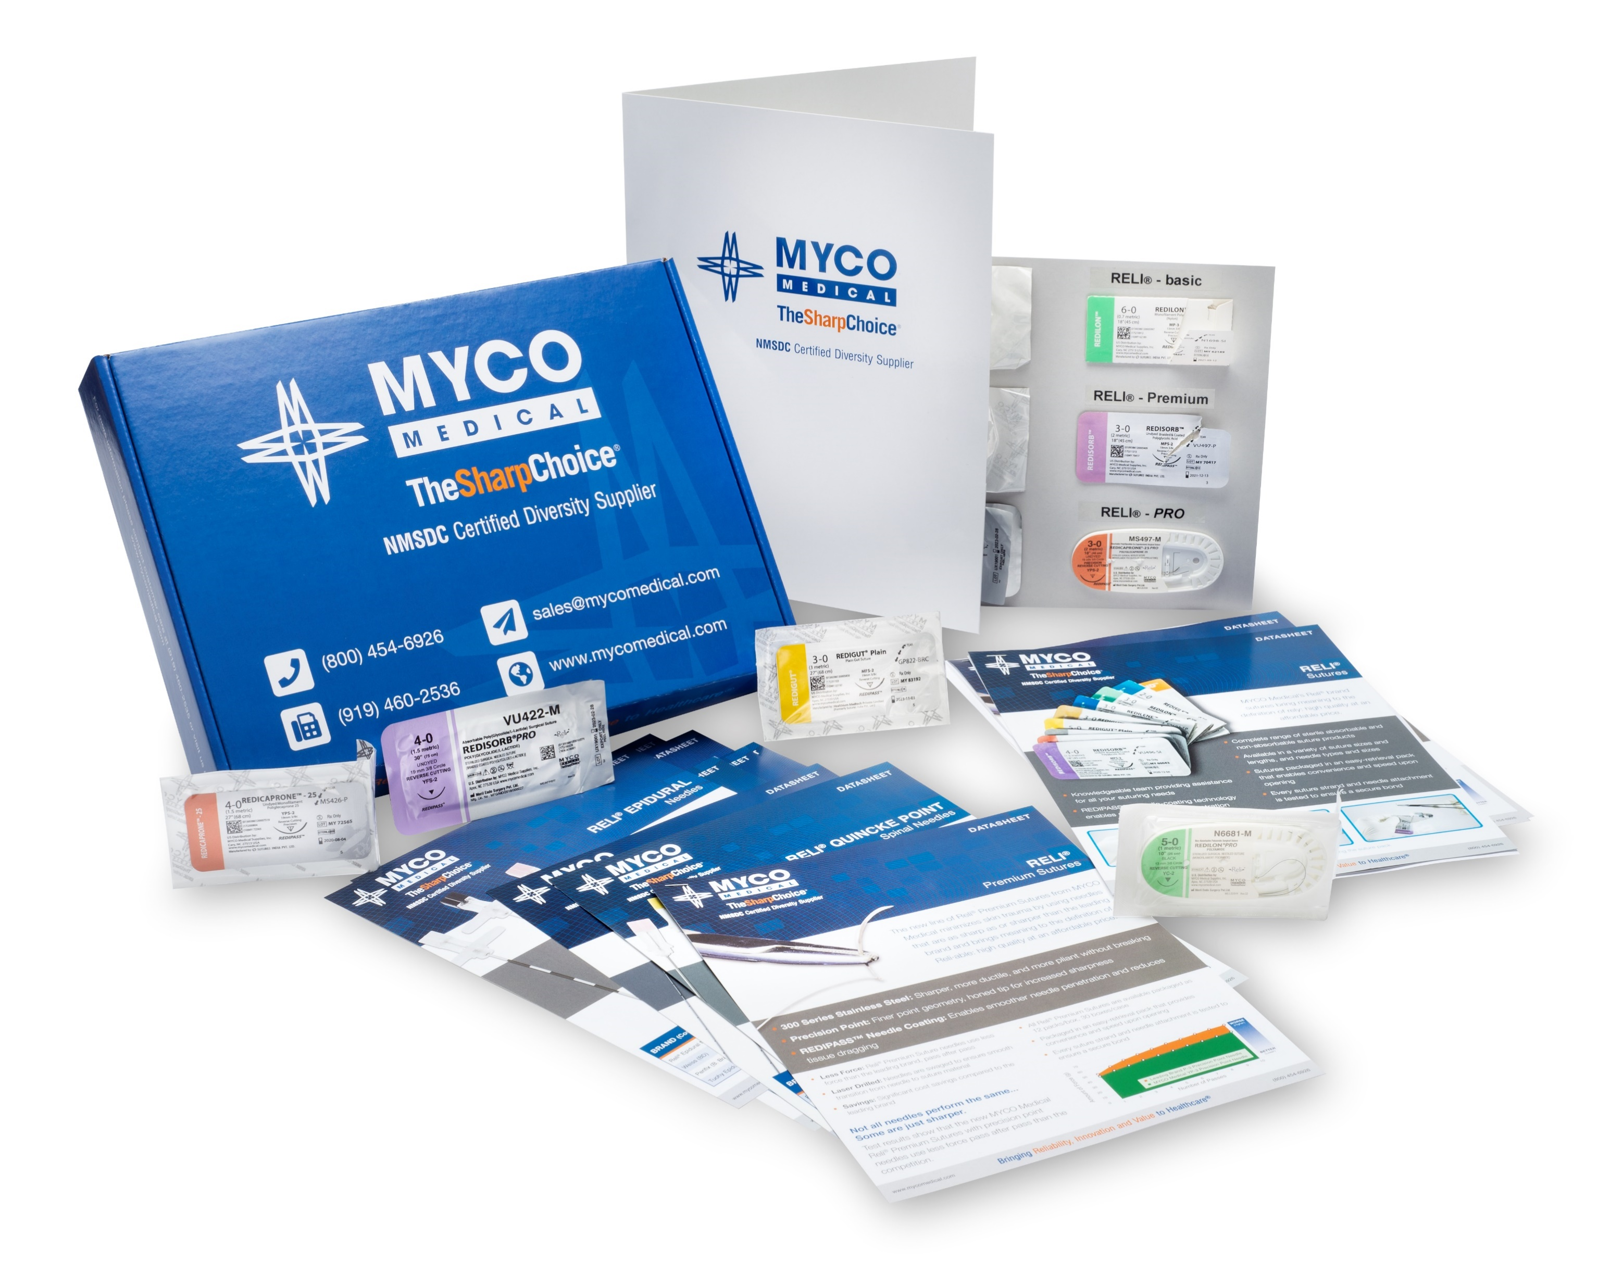
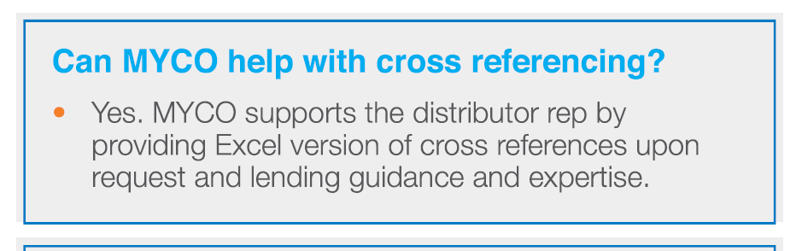
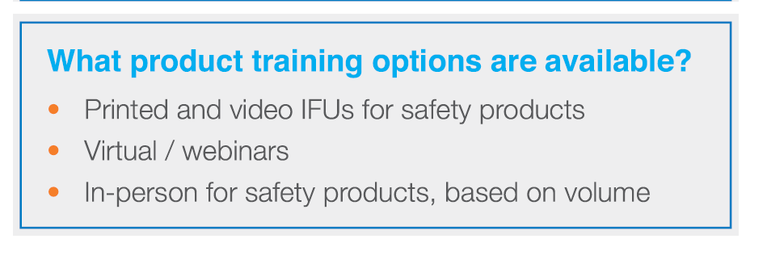
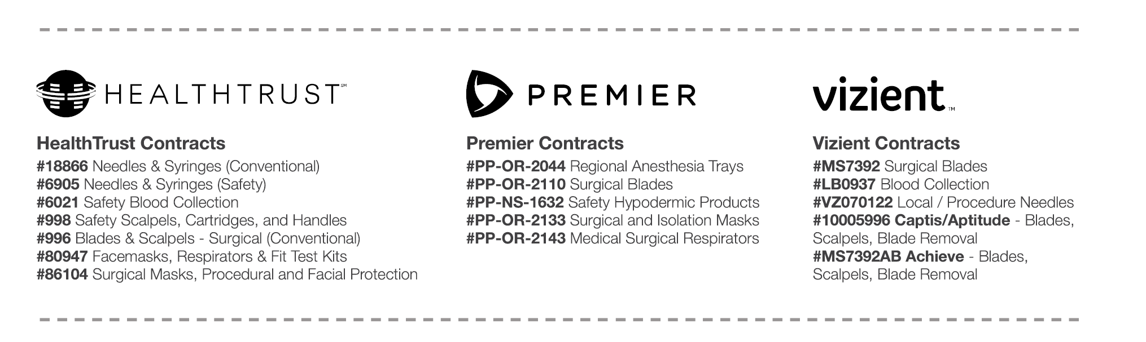
Questions?
Complimentary Samples
Karen Decker, Sales Ops
kdecker@mycomedical.com
c: 919.356.8054 o: 919.460.2535 x123
Cameron Brannon, Sales Support
cbrannon@mycomedical.com
o: 918.460.2535 x115

Slide 17
Conventional Luer Lock Syringe Promo
FREE Product shipped directly to the end user.
Promotion runs through December 31, 2024.
WHEN YOU BUY THIS:
1ML Syringe – 3 Boxes
3ML Syringe – 3 Boxes
5ML Syringe – 3 Boxes
10ML Syringe – 3 Boxes
20ML Syringe – 3 Boxes
30ML Syringes – 3 Boxes
60ML Syringes – 3 Boxes
YOU GET THIS FREE:
1ML Syringe – 1 Box
3ML Syringe – 2 Boxes
5ML Syringe – 2 Boxes
10ML Syringe – 2 Boxes
20ML Syringe – 1 Box
30ML Syringes – 1 Box
60ML Syringes – 1 Box
FREE samples available upon request. Email: SampleRequests@MYCOmedical.com
Notes:
IFU Videos and posters
Dedicated studio for live or recorded training sessions
Onsite training support available
Creating Manufacturing dashboard to show current production and maximum production of products. Scalability and timeframe to expand when needed

