Slide 1
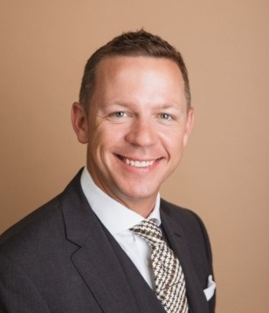
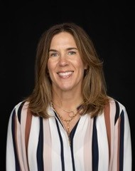
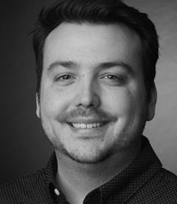
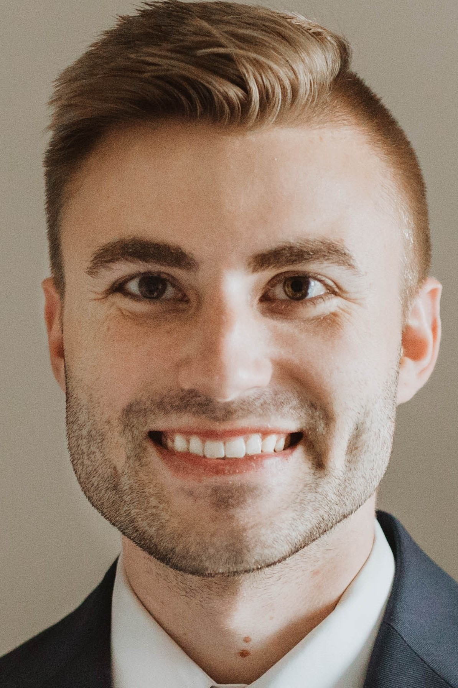
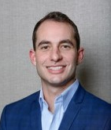
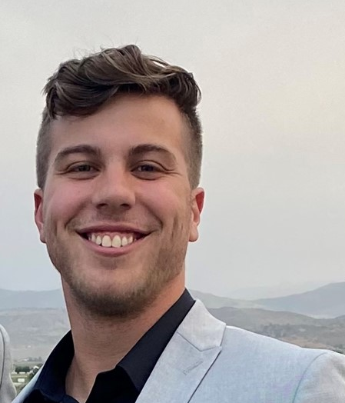
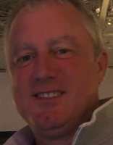

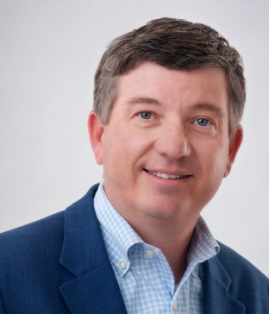
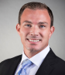
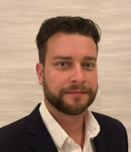
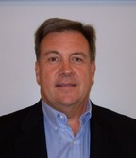
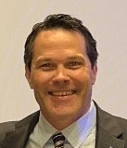
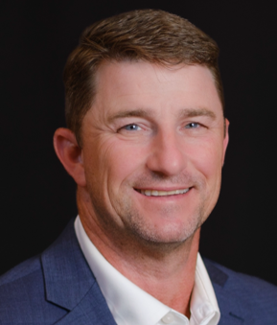
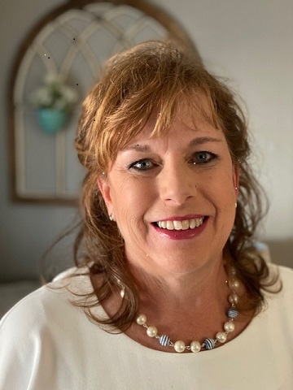
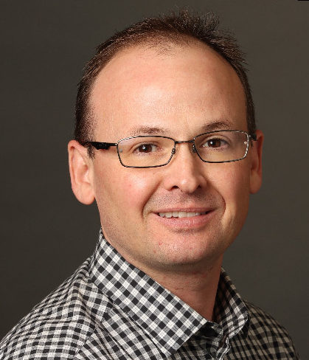
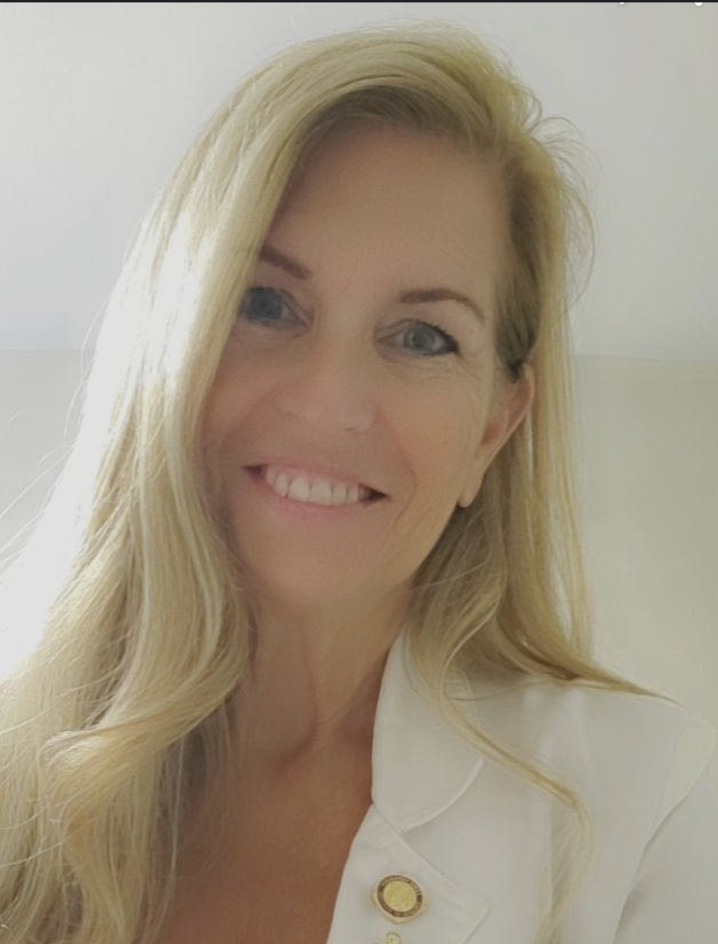
Vygon Sales
2025
Delaine Renko
Sr. Territory Manager
Thomas Love
Sr. Territory Manager
Matt Lustig
Sr. Territory Manager
Jeremy Wilmington
VP, Sales (22/7 yrs.)
Greg Palma
Territory Manager
Jesse Paolella
Territory Manager
ME
WA
VT
MT
ND
NH
MA
OR
MN
NY
CT
Tyler Fischer
Territory Manager
ID
SD
WI
MI
RI
WY
PA
NJ
NE
IA
OH
DE
Joe Mellett
Sr. Territory Manager
IL
IN
WV
MD
Mitchell Miller
Director of Sales, West
(20 yrs.)
Bill Millar
Director of Sales, East
(22/ 15 yrs.)
NV
VA
DC
CA
UT
CO
MO
KY
KS
NC
Brett Hayden
Territory Manager
OPEN
Clinical Educator - West
TN
SC
AZ
OK
AR
NM
AL
GA
MS
AK
TX
LA
Jason Dicpinigaitis
Territory Manager
FL
Steve Goodson
Executive Territory Manager
Kirk Bowman
Sr. Director Corporate Accounts – West
(35 yrs.)
Jeff Thompson
Director Corporate Accounts – East
(20/ 8 yrs.)
Catrina Starner
Executive Territory Manager
*120 years of Medical Device*
HI
Jeremy Talmadge
Executive Territory Manager
OPEN
Territory Manager
Connie Girgenti
National Clinical Educator

